Slide 1
Carbohydrates
Centres of chirality
Asymmetric carbons
Stereoisomers
R,S nomenclature
Racemic mixtures

Slide 2
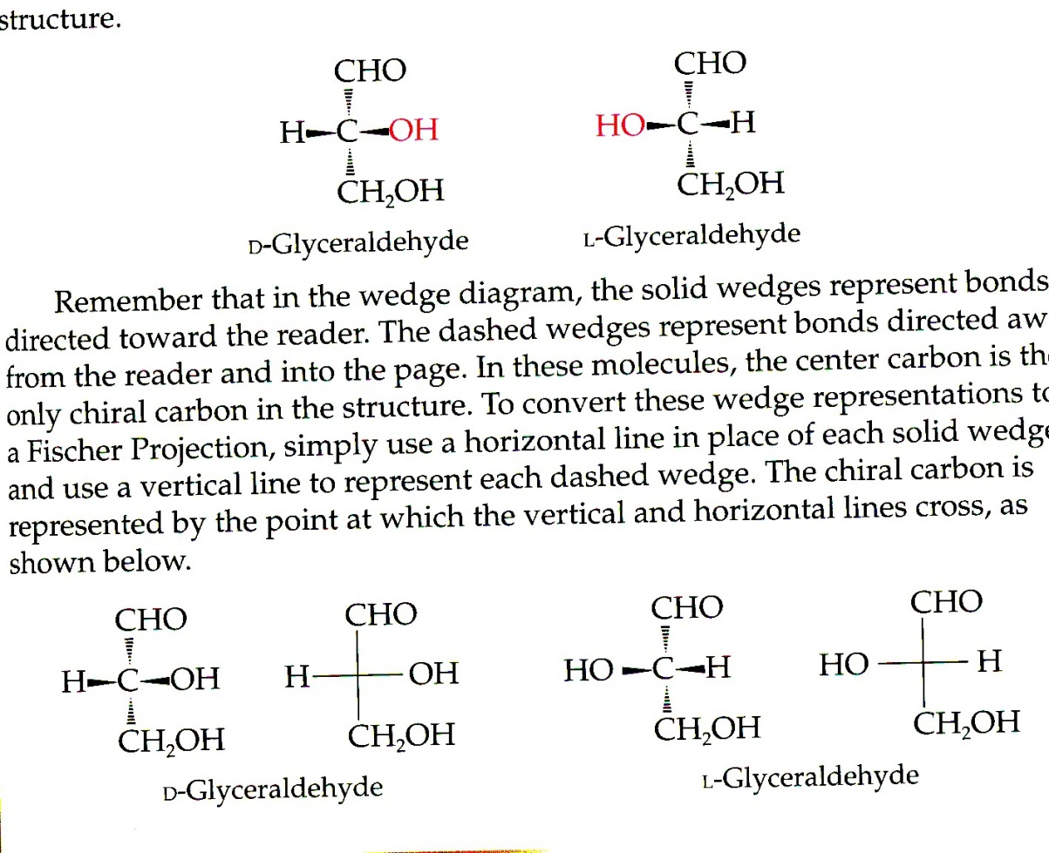
Fischer projection

Slide 3
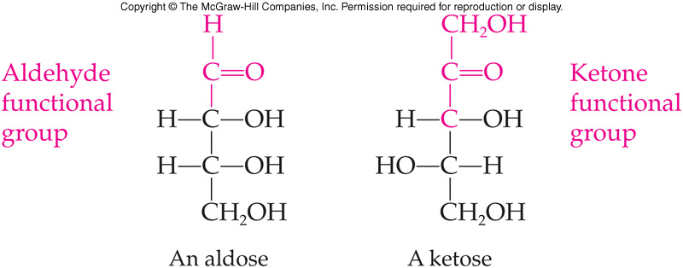
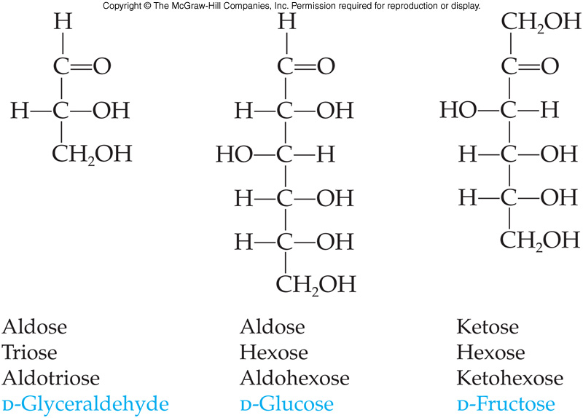
Naming Monosaccharides
Named on the basis of
Functional groups
  Ketone carbonyl = ketose
  Aldehyde carbonyl = aldose
Number of carbon atoms in the main skeleton
  3 carbons = triose
  4 carbons = tetrose
  5 carbons = pentose
  6 carbons = hexose
Combining both systems gives even more information
16.2 Monosaccharides

Slide 4
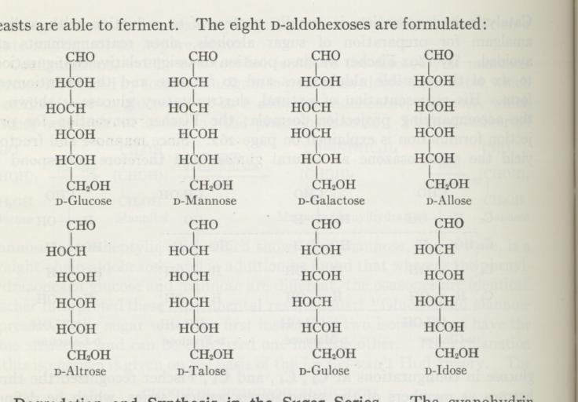
Hexoses

Slide 5
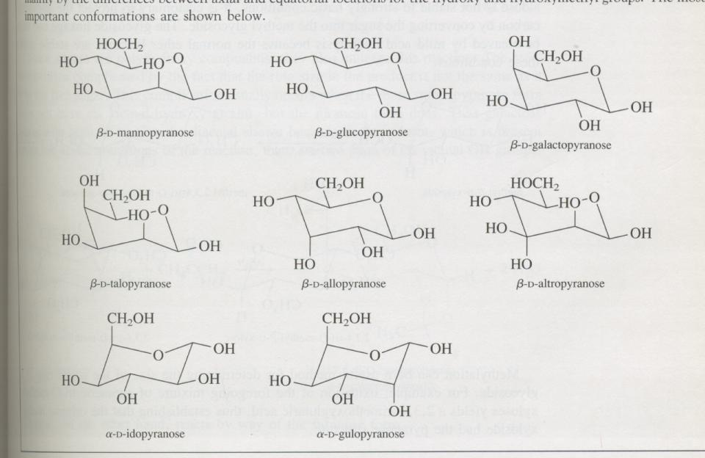
Hexoser

Slide 6
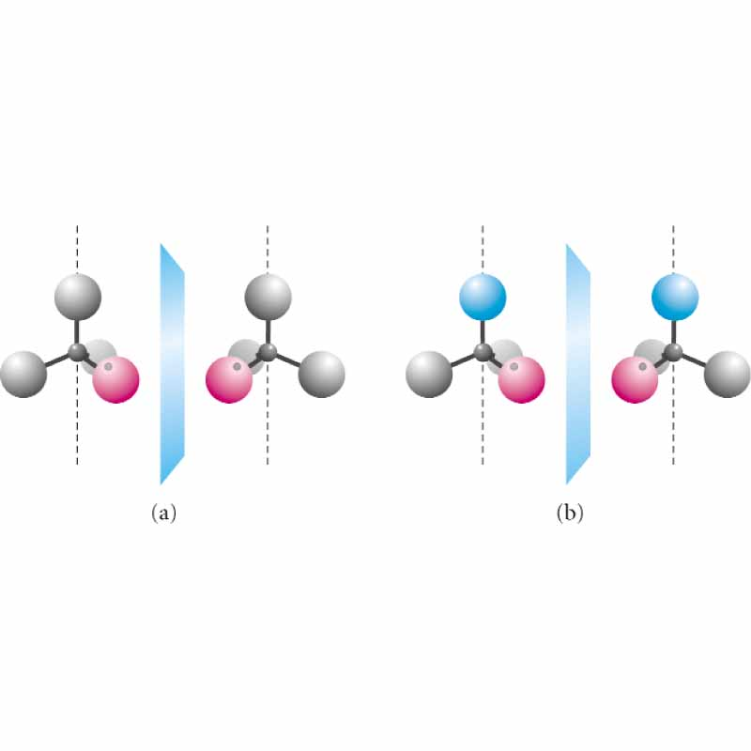
One and two substituents

Slide 7
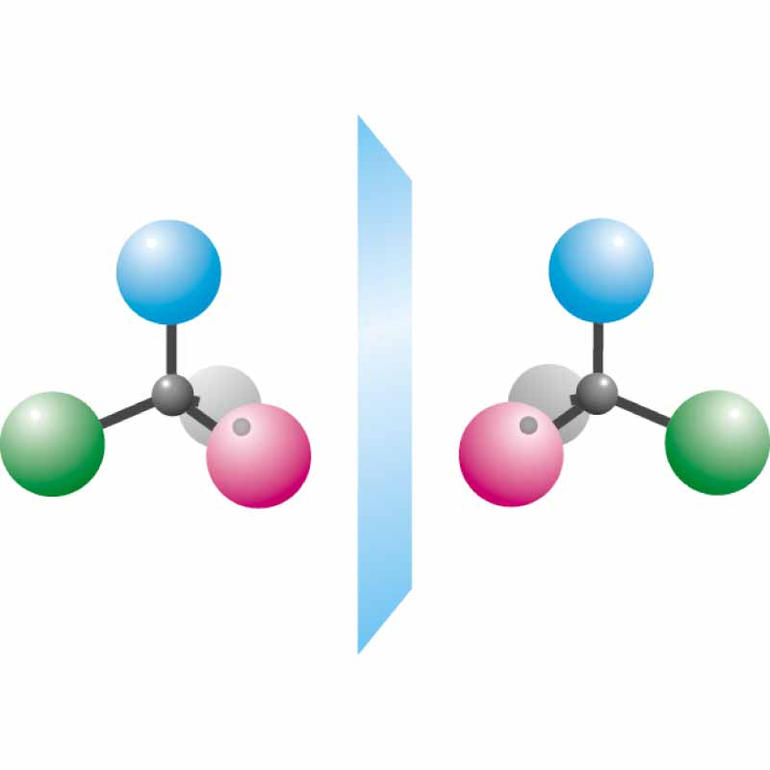
Asymmetric carbon

Slide 8
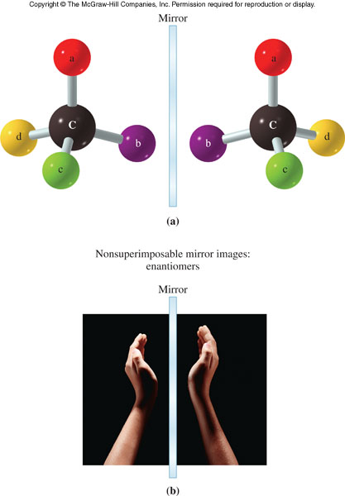
Enantiomers
16.3 Stereoisomers and Stereochemistry

Slide 9
Chirality
A carbon atom that has four different groups bonded to it is called a chiral carbon atom
Any molecule containing a chiral carbon can exist as a pair of enantiomers
Chirality in glyceraldehyde (the simplest carbohydrate) is conveyed by a chiral carbon
Larger biological molecules often have more than one chiral carbon
16.3 Stereoisomers and Stereochemistry

Slide 10
Chirality of Glyceraldehyde
Glyceraldehyde has a chiral carbon and thus, has two enantiomers
  The D isomer has the -OH on the stereocenter to the right
  The L isomer has the -OH on the stereocenter to the left
16.3 Stereoisomers and Stereochemistry
Mirror
plane
Chiral Carbon:
connected to
four
different atoms
or groups

Slide 11
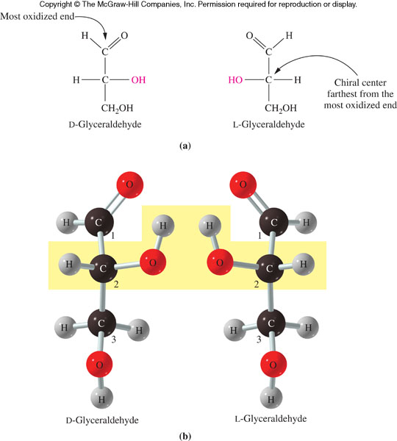
Structural Formulas of D- and L- Glyceraldehyde
16.3 Stereoisomers and Stereochemistry

Slide 12
Optical Activity
Enantiomers are also called optical isomers
Enantiomers interact with plain polarized light to rotate the plane of the light in opposite directions
  This interaction with polarized light is called optical activity
  Optical activity distinguishes the isomers
  It is measured in a device called a polarimeter
16.3 Stereoisomers and Stereochemistry

Slide 13
Polarized Light
Normal light vibrates in an infinite number of directions perpendicular to the direction of travel
  When the light passes through a polarizing filter (Polaroid sunglasses) only light vibrating in one plane reaches the other side of the filter
  A polarimeter allows the determination of the specific rotation of a compound
    Measures its ability to rotate plane-polarized light
16.3 Stereoisomers and Stereochemistry

Slide 14
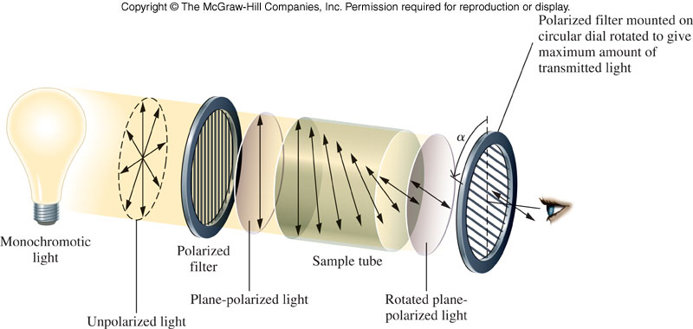
Schematic Drawing of a Polarimeter
16.3 Stereoisomers and Stereochemistry

Slide 15
The Relationship Between Molecular Structure and Optical Activity
When an enantiomer in a solution is placed in the polarimeter, the plane of rotation of the polarized light is rotated
  One enantiomer always rotates light in a clockwise (+) direction
    This is the dextrorotatory isomer
  The other isomer rotates the light in a counterclockwise (-) direction
    It is the levorotatory isomer
Under identical conditions, the enantiomers always rotate light to exactly the same degree, but in opposite directions
16.3 Stereoisomers and Stereochemistry

Slide 16
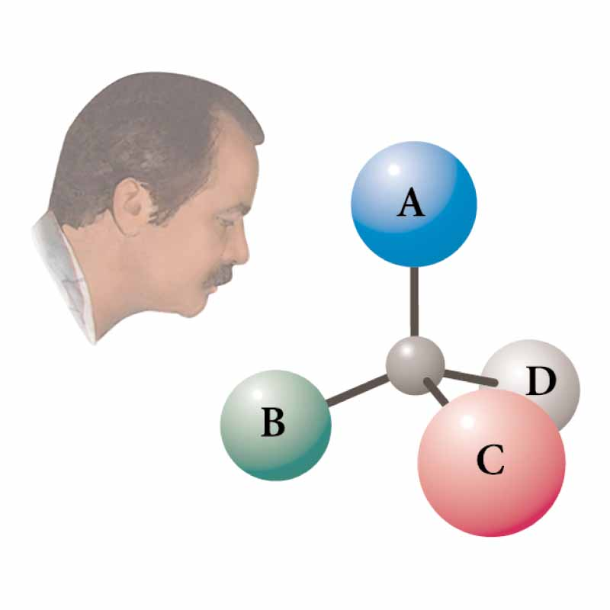
Absolute configuration S

Slide 17
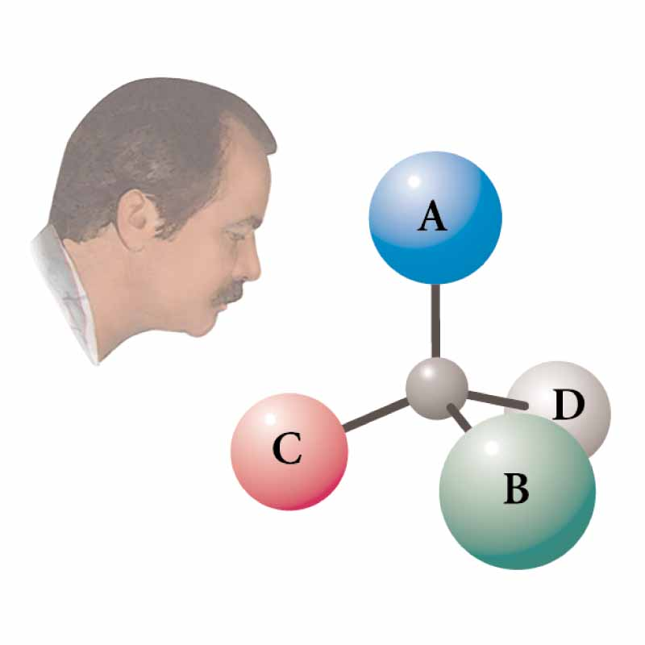
R

Slide 18
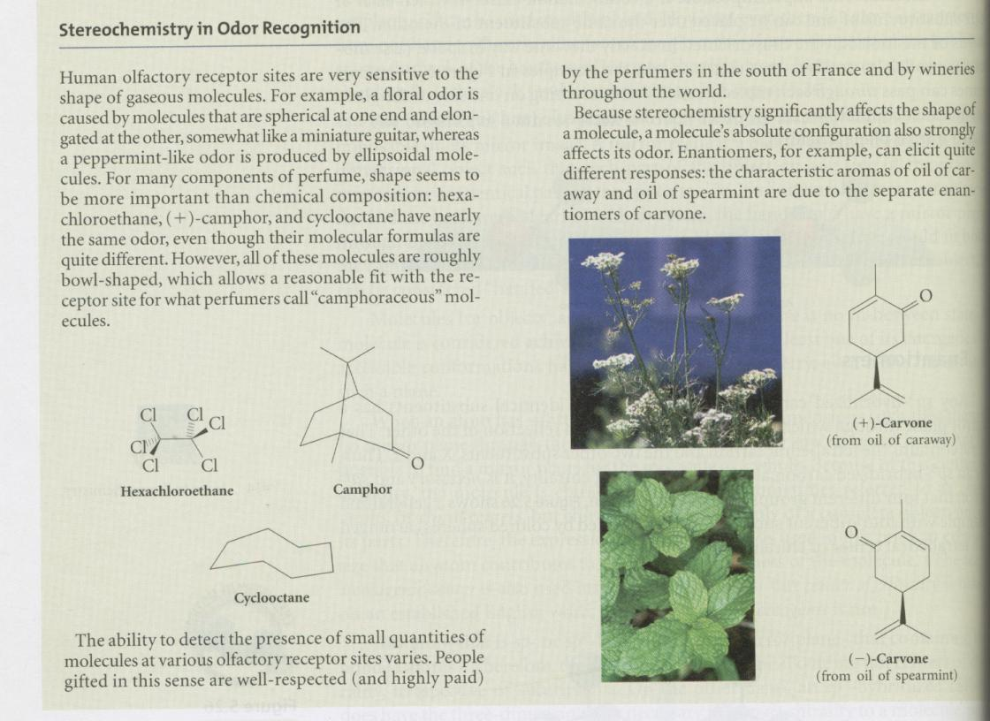
Carvone

Slide 19
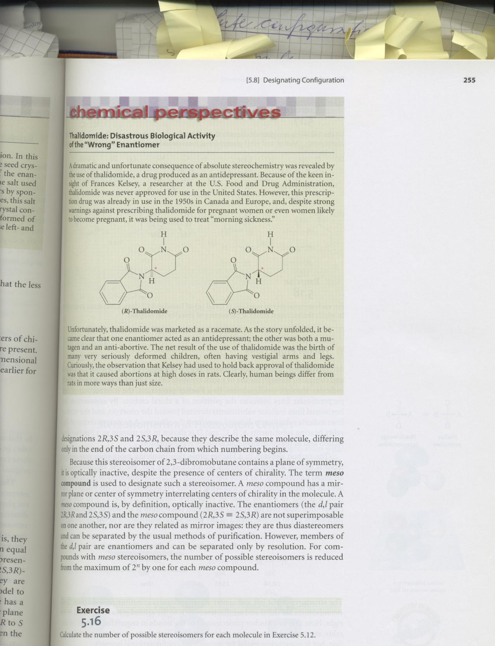

Slide 20
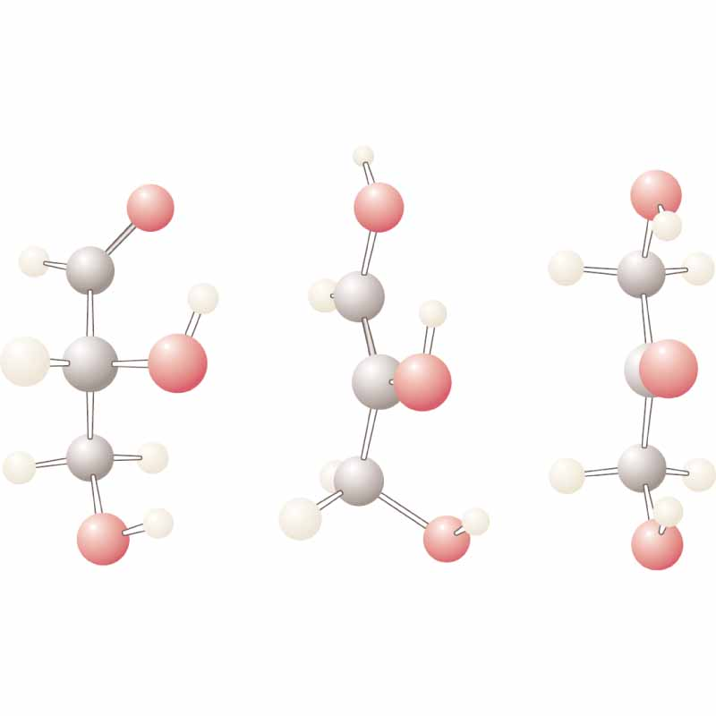
Glyceraldehyde

Slide 21
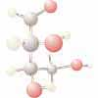
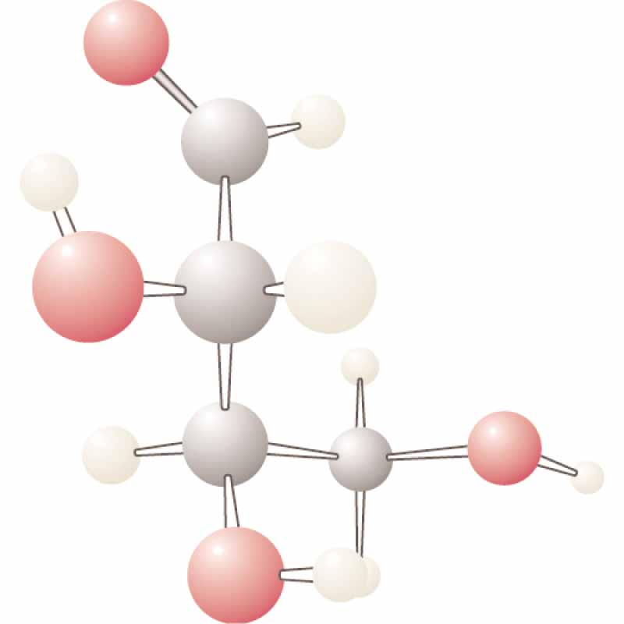
Tetroser

Slide 22
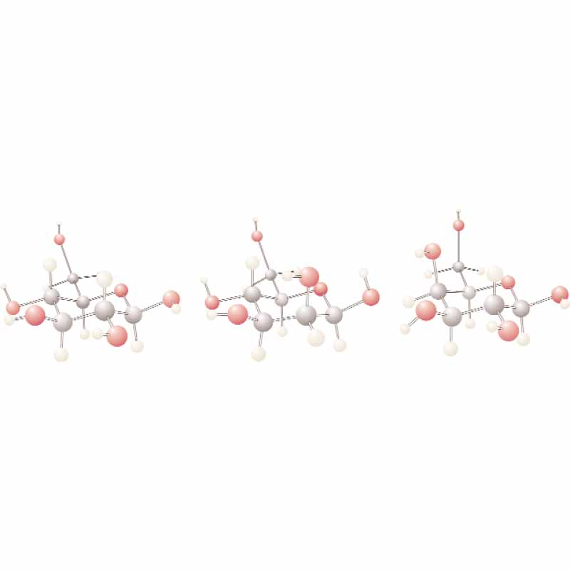
Hexoses
glucose
mannose
galactose

Slide 23
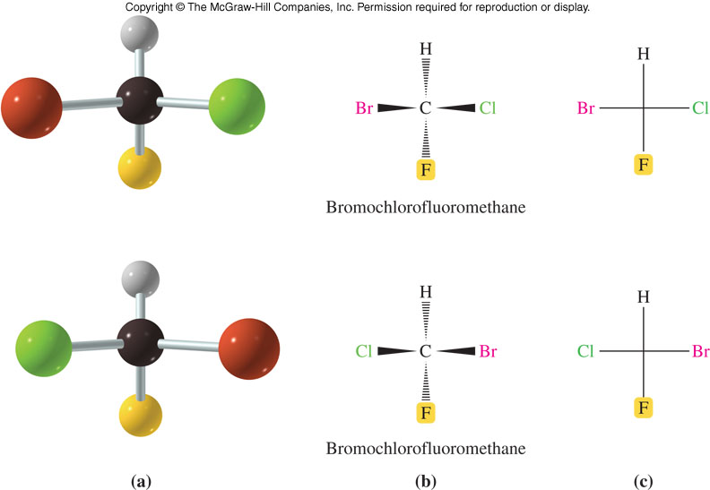
Fischer Projection Formulas
A Fischer projection uses lines crossing through a chiral carbon to represent bonds
  Projecting out of the page (horizontal lines)
  Projecting into the page (vertical lines)
Compare the wedge to the Fischer diagrams
16.3 Stereoisomers and Stereochemistry

Slide 24
Fischer Projections of Monosaccharides
1
1
2
2
16.3 Stereoisomers and Stereochemistry
3
3
4
4
5
6

Slide 25
Fischer projection

Slide 26
The D- and L-System
Monosaccharides are drawn in Fischer projections
  With the most oxidized carbon closest to the top
  The carbons are numbered from the top
  If the chiral carbon with the highest number has the OH to the right, the sugar is D
  If the OH is to the left, the sugar is L
Most common sugars are in the D form
16.3 Stereoisomers and Stereochemistry

Slide 27
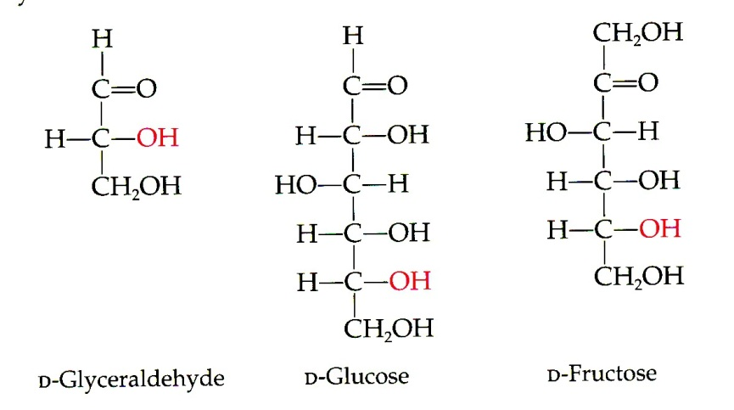
D,L nomenclature

Slide 28
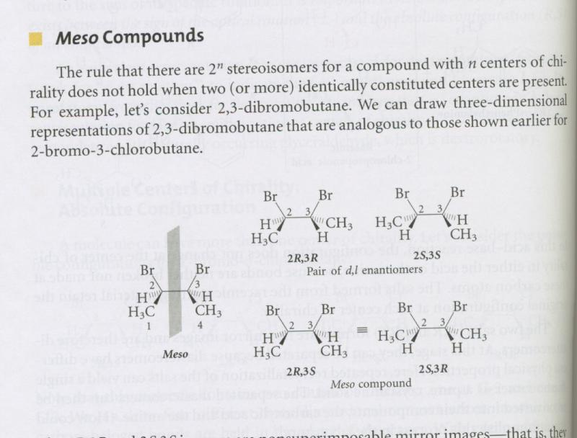
Meso

Slide 29
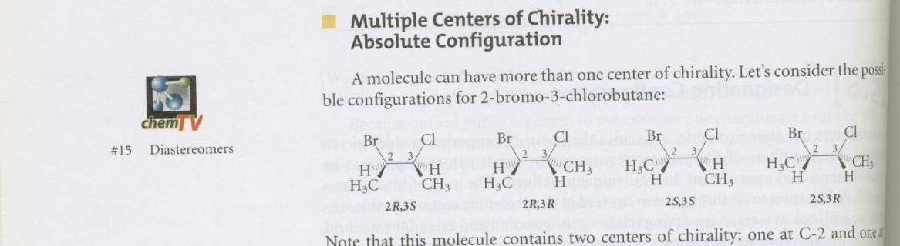
Diastereomers
Mirror images 2R,3S and 2S,3R
2R3R and 2S3S

Slide 30
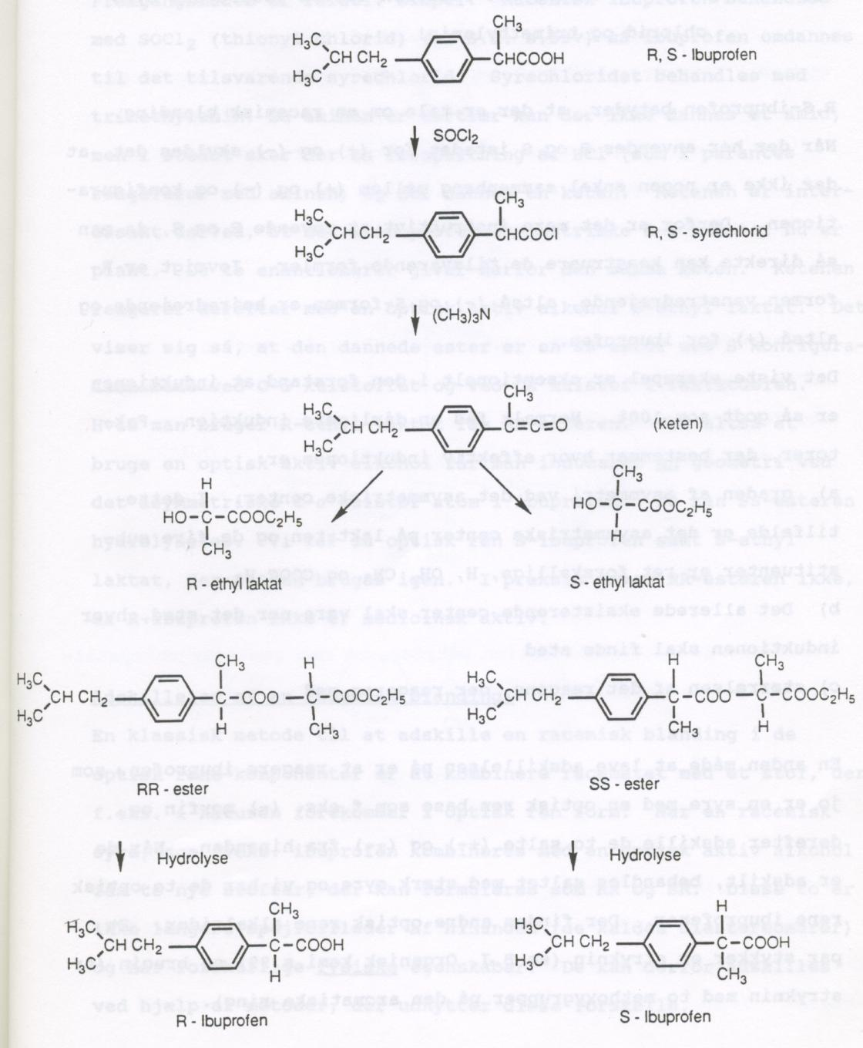
Ibuprofen synthesis and resolution

Slide 31
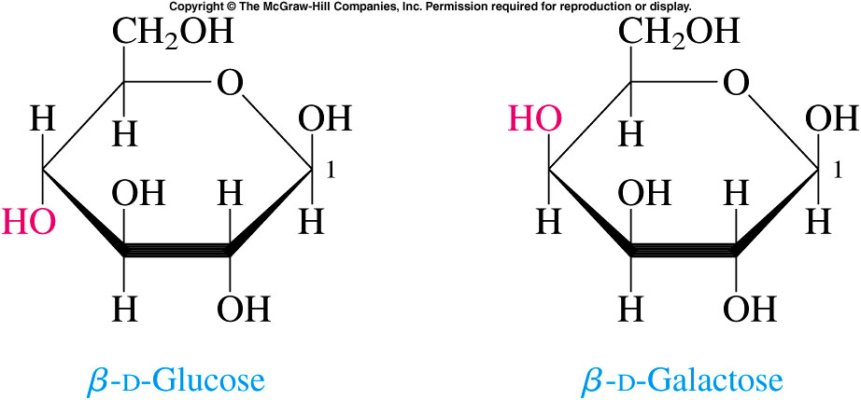
Galactose Orientation
Glucose and galactose differ only in
the orientation of one hydroxyl group
16.4 Biological Monosaccharides

Slide 32
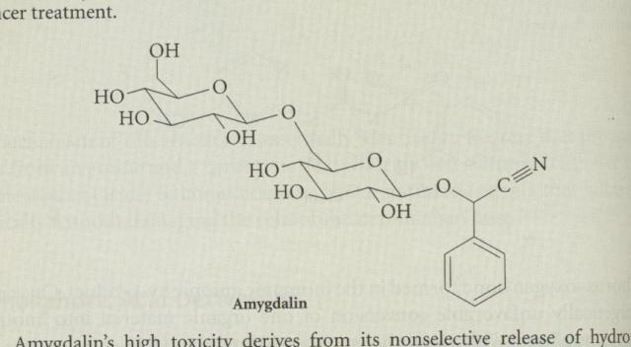
Amygdalin

Slide 33
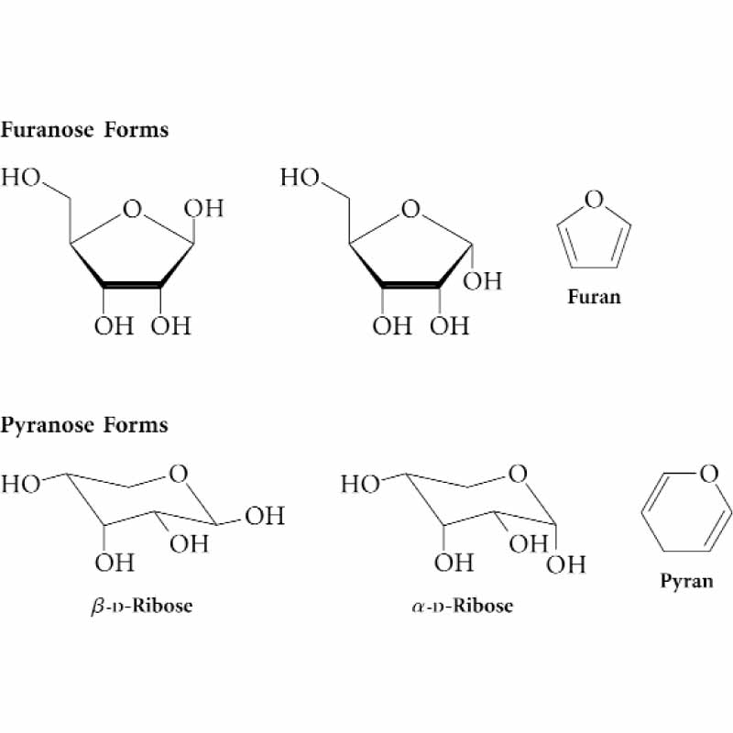
Furanose and pyranoses

Slide 34
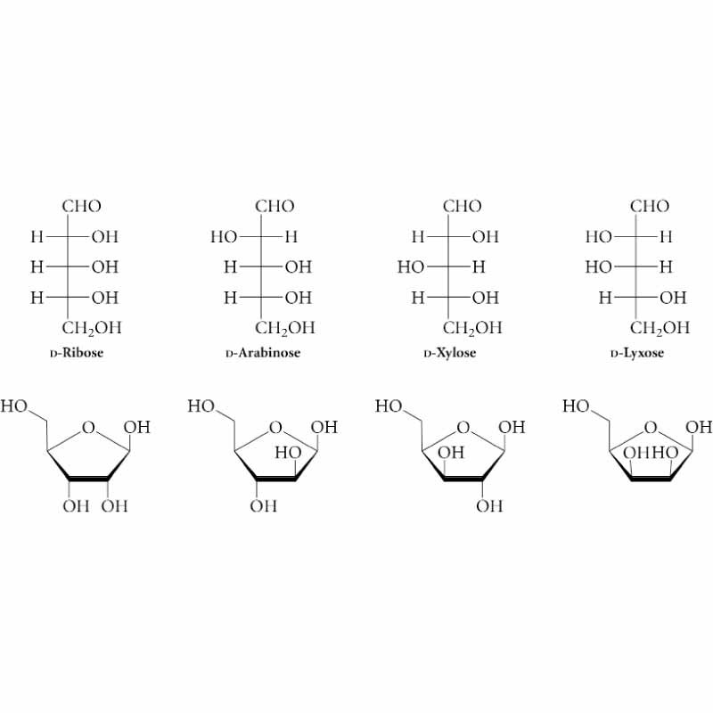
Aldopentoser

Slide 35
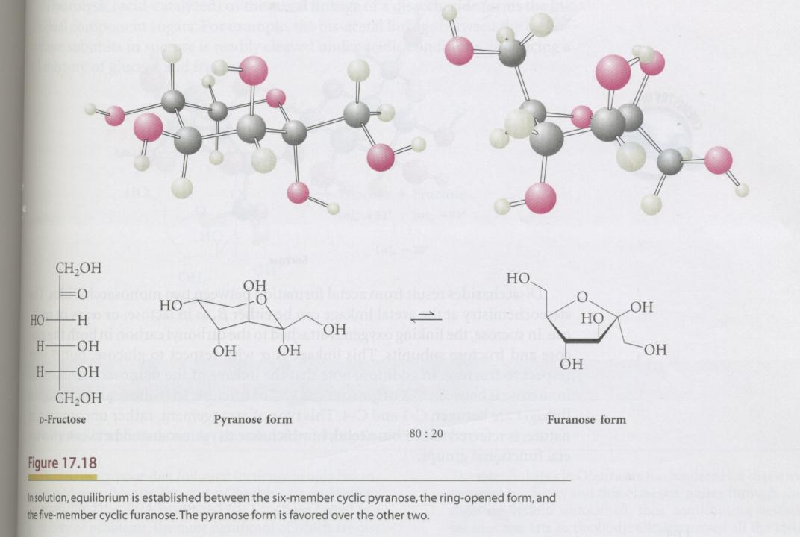

Slide 36
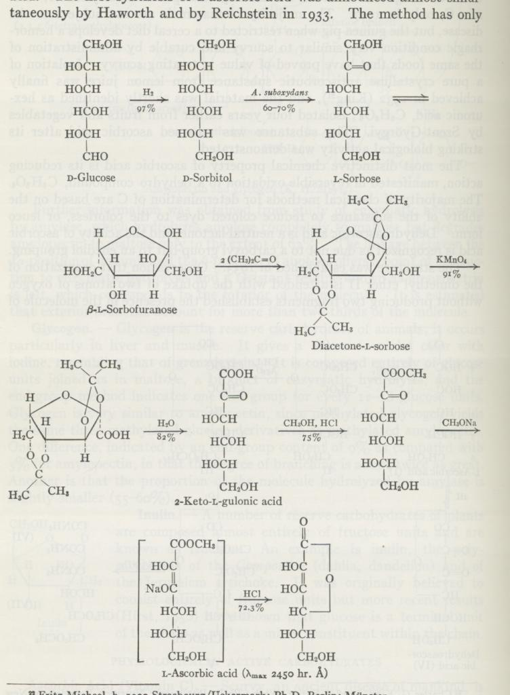

Slide 37
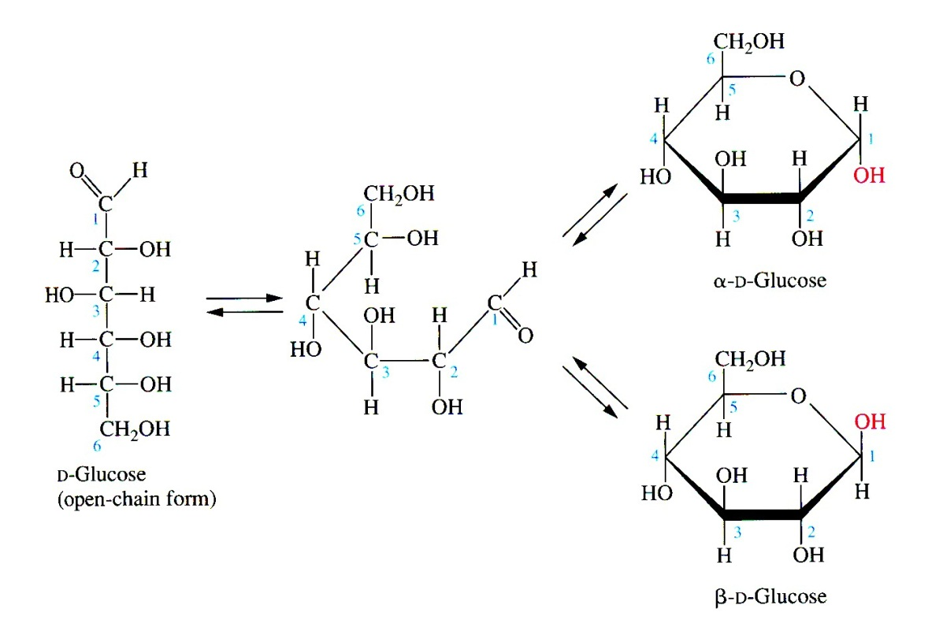
Haworth

Slide 38
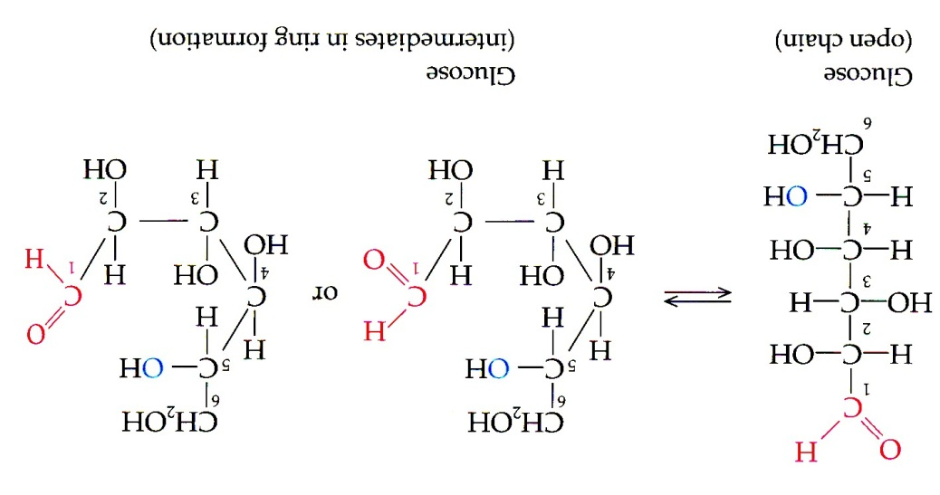
Haworth

Slide 39
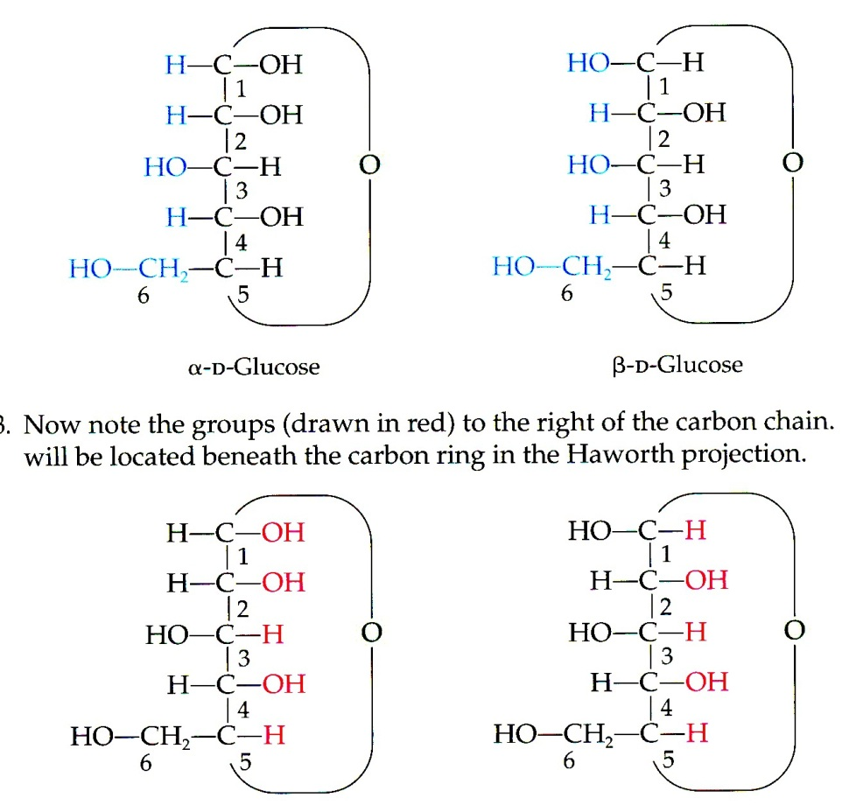
Haworth

Slide 40
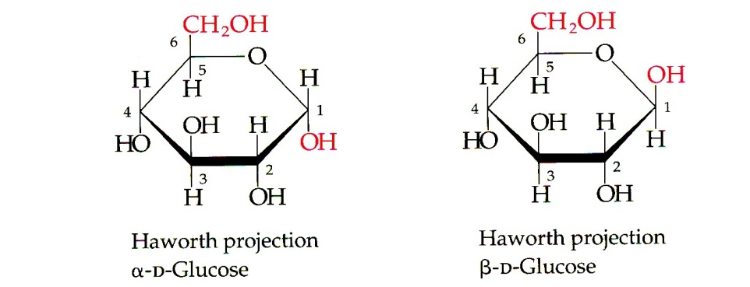
Haworth

Slide 41
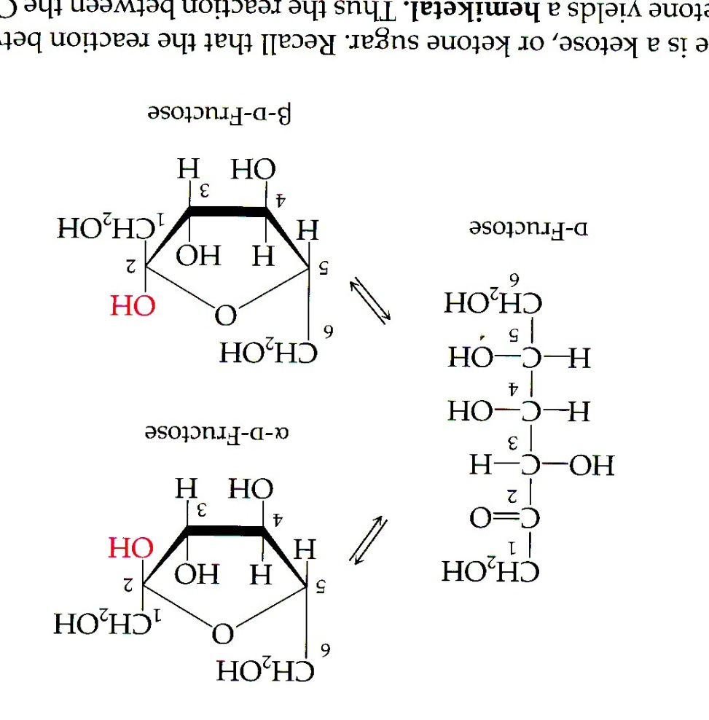
Fructose

Slide 42
Aldopentoser

Slide 43
Reducing Sugars
8
The aldehyde groups of aldoses are oxidized by Benedict’s reagent, an alkaline copper(II) solution
The blue color of the reagent fades as reaction occurs reducing Cu²⁺ to Cu⁺ with a red-orange precipitate forming as Cu₂O results
Test can measure glucose in urine
16.4 Biological Monosaccharides
9
+ Cu₂O (red-orange)

Slide 44
Reducing Sugars
All monosaccharides and the disaccharides except sucrose are reducing sugars
Ketoses can isomerize to aldoses and react also
16.4 Biological Monosaccharides

Slide 45
A Reduced Sugar
The most important reduced sugar is deoxyribose
16.4 Biological Monosaccharides

Slide 46
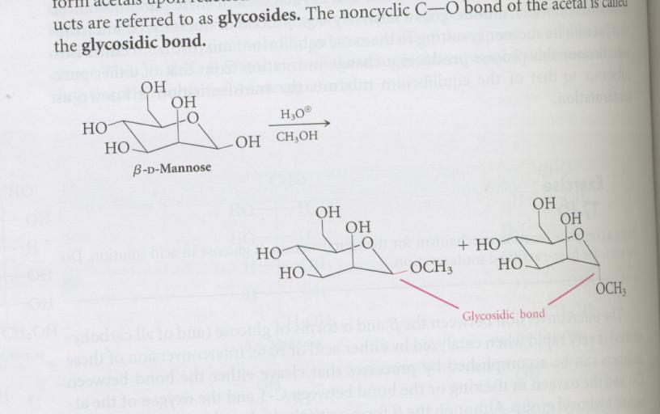
Glucosides

Slide 47
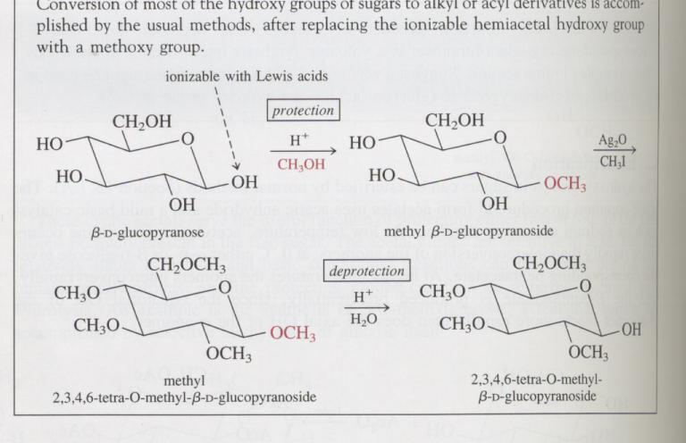
Alkylation

Slide 48
16.5 Biologically Important Disaccharides
10
The anomeric -OH can react with another -OH on an alcohol or sugar
Process is forming a glycosidic bond
Water is lost to form an acetal

Slide 49
Maltose
Maltose is formed by linking two α-D-glucose molecules to give a 1,4 glycosidic linkage
Maltose is malt sugar
Formed as an intermediate in starch hydrolysis
Reducing sugar due to the hemiacetal hydroxyl
16.5 Biologically Important Disaccharides

Slide 50
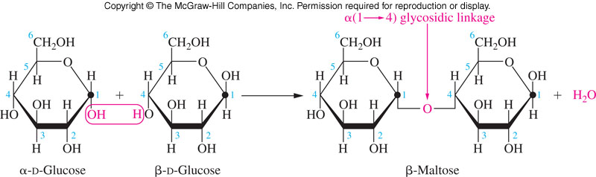
Formation of Maltose
16.5 Biologically Important Disaccharides

Slide 51
Lactose
Lactose is formed by joining β−D-galactose to α-D-glucose to give a β−1,4-glycoside
Lactose is milk sugar
  For use as an energy source, must be hydrolyzed to glucose and galactose
  Lactose intolerance results from lack of lactase to hydrolyze the glycosidic link of lactose
11
16.5 Biologically Important Disaccharides

Slide 52
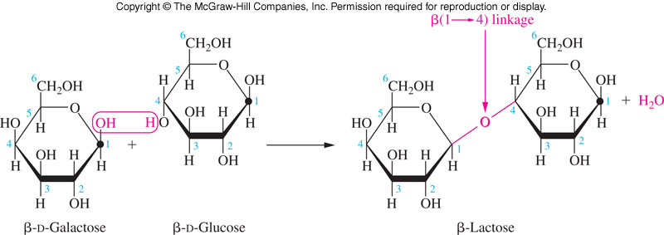
Lactose Glycosidic Bond
16.5 Biologically Important Disaccharides

Slide 53
Sucrose
Sucrose is formed by linking α−D-glucose with β−D-fructose to give a 1,2 glycosidic linkage
  Nonreducing – negative reaction in Benedict test
  The glycosidic O is part of an acetal and a ketal
Important plant carbohydrate
  Water soluble
  Easily transported in plant circulatory system
Cannot by synthesized by animals
Sucrose called:
  Table sugar
  Cane sugar
  Beet sugar
  Linked to dental caries
16.5 Biologically Important Disaccharides

Slide 54
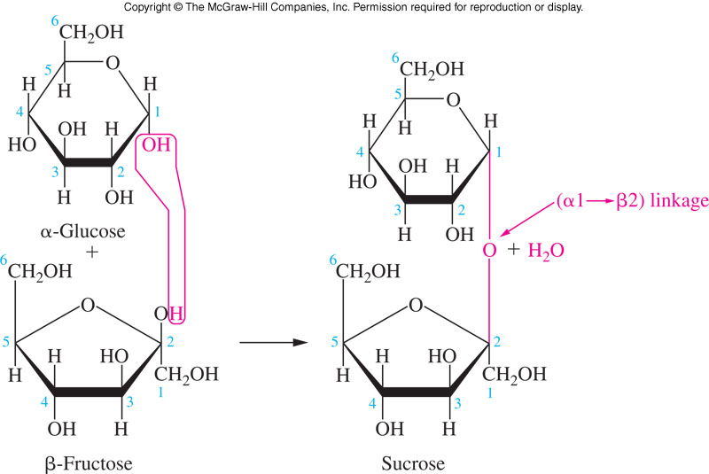
Glycosidic Bond Formed in Sucrose
16.5 Biologically Important Disaccharides

Slide 55
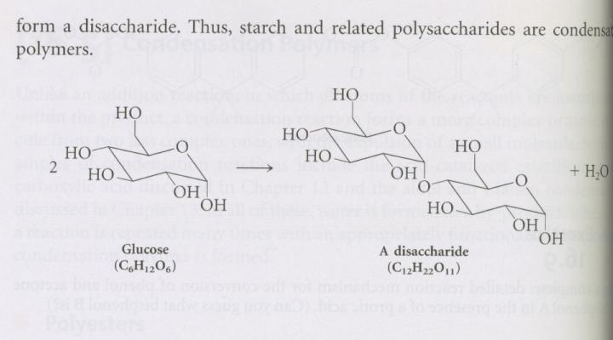

Slide 56
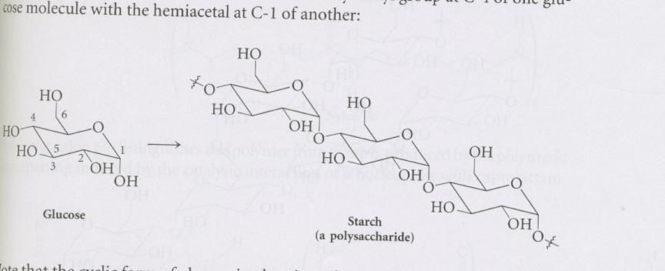
Starch

Slide 57
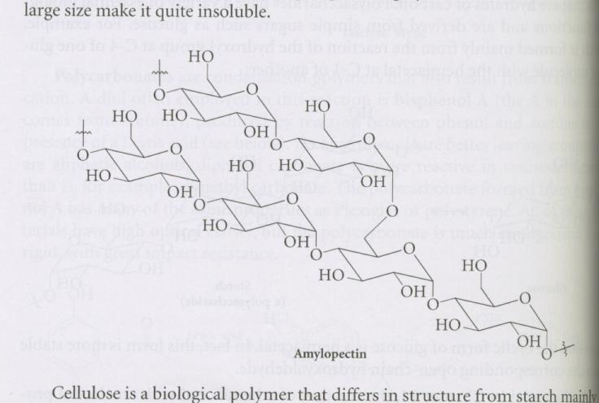
Amylopectin

Slide 58
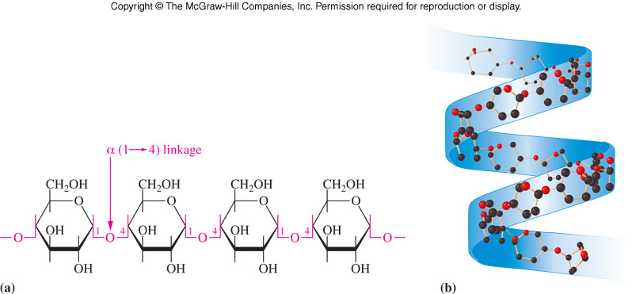
Structure of Amylose
16.6 Polysaccharides

Slide 59
Comparison of Amylose to Amylopectin
16.6 Polysaccharides

Slide 60
Glycogen
12
The major glucose storage carbohydrate in animals is glycogen
A highly branched chain polymer like amylopectin
  More frequent branching – 10 monomers
Glycogen is stored in:
  Liver
  Muscle cells
16.6 Polysaccharides

Slide 61
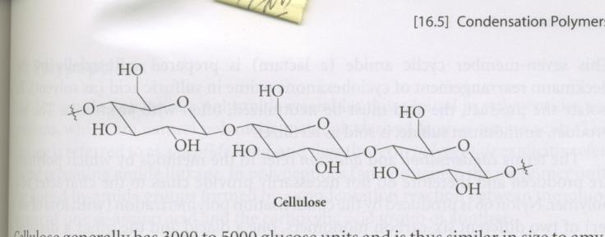
Cellulose

Slide 62
Cellulose
12
Cellulose is the major structural polymer in plants
It is a liner homopolymer composed of β-D-glucose units linked β-1,4
The repeating disaccharide of cellulose is β-cellobiose
Animals lack the enzymes necessary to hydrolyze cellulose
The bacteria in ruminants (e.g., cows) can digest cellulose so that they can eat grass, etc.
16.6 Polysaccharides

Slide 63
Structure of Cellulose
β-(1->4) glycosidic bond
16.6 Polysaccharides

Slide 64
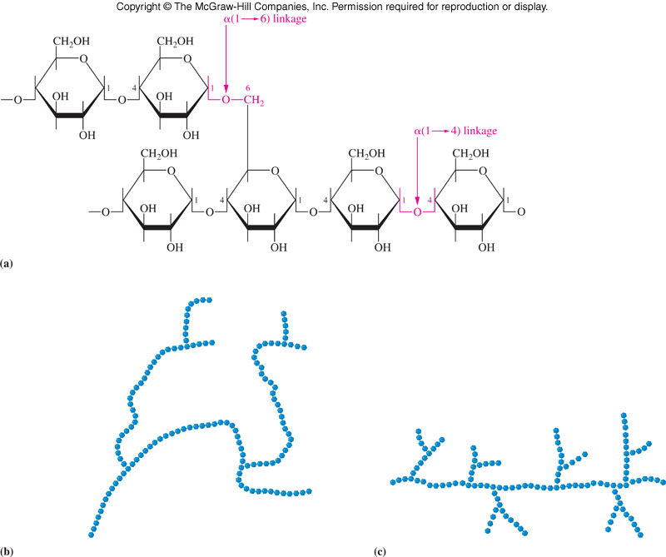
Glycogen and Amylopectin Structures
Glycogen and
Amylopectin are
α(1-4) chains
with α(1-6)
branches
16.6 Polysaccharides
Amylopectin
Glycogen

Slide 65
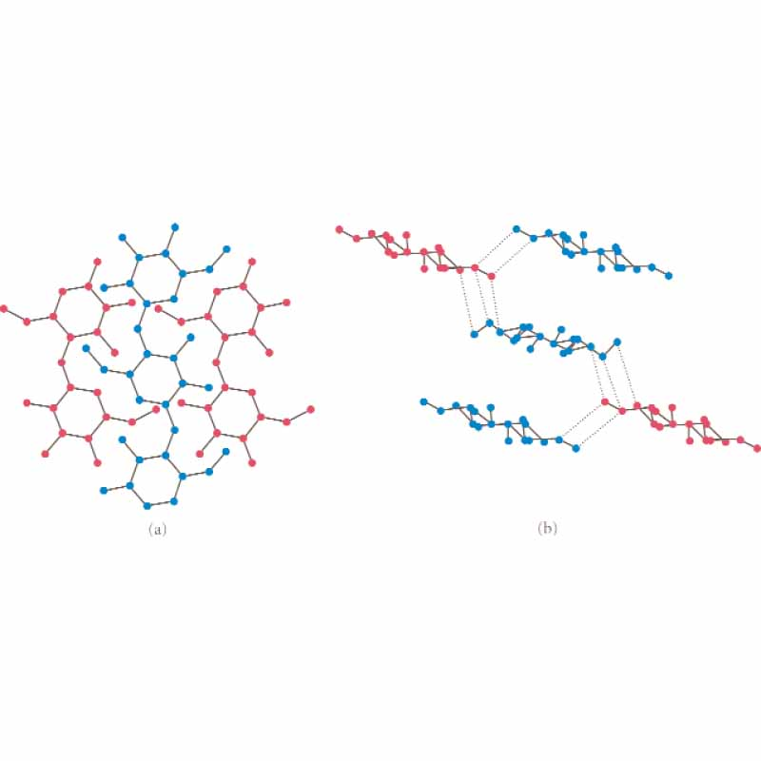
Cellulose as found in wood

Slide 66
CELLULOSE
Cellulose can exist both in a crystalline and in an amorphous state.
Each ring have 6 carbons.
.
Notes:
66

Slide 67
HEMICELLULOSE
Hemicelluloses contain xylan as the principle component , but also contain mannan, galactan, and arabinan heteropolymers as well.
Notes:
67

Slide 68
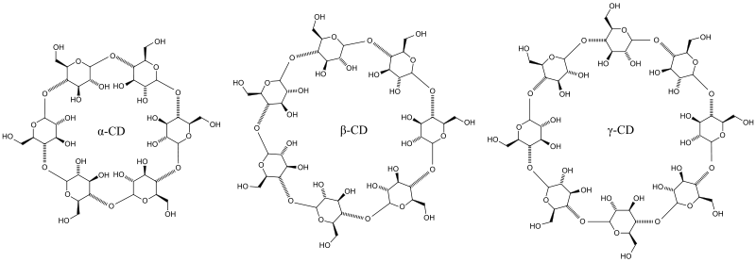
Cyclodextrins

Slide 69
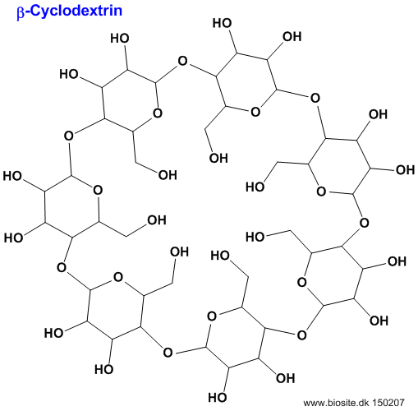
β-Cyclodextrin

Slide 70
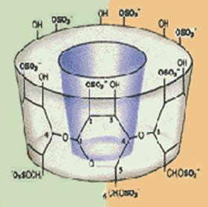
Barrel character

Slide 71
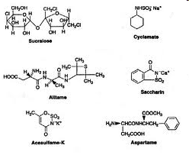
Artificial sweeteners

Slide 72

Nutrasweet

Slide 73

(E,RS)-Perillartine.

Slide 74

Neotame

Slide 75

Acesulfame sodium

Slide 76

Sucralose

Slide 77

Steviol

Slide 78

Brazzein
QDKCKKVYEN YPVSKCQLAN QCNYDCKLDK HARSGECFYD EKRNLQCICD YCEY

Slide 79

Artificial sweeteners

Slide 80

Ketales

Slide 81

Reduction

Slide 82

Oxidation

