Slide 1
Amines, amides and heterocycles

Slide 3
Histamine

Slide 4
Amines
Amides
Amino acid
Peptides

Slide 5
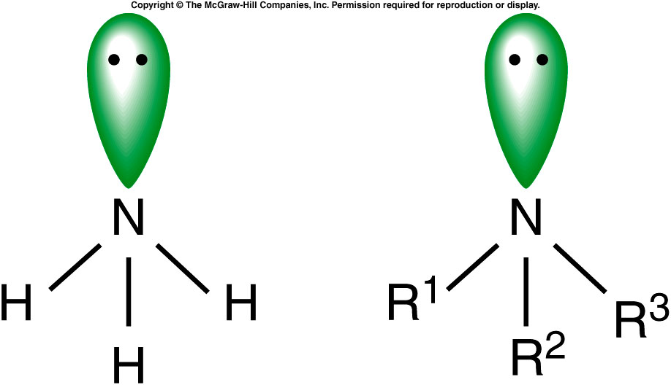
Comparison of NH₃ to Amines
15.1 Amines
pyramidal

Slide 6
VSEPR?

Slide 7
Classification of Amines
Amines are classified by the number of carbons directly bonded to the nitrogen atom:
A primary amine has one
RNH₂ = 1º
A secondary amine has two
R₂NH = 2º
A tertiary three
R₃N = 3º

Slide 8
Boiling Points
Amines have boiling points between alkanes and alcohols
15.1 Amines
Tertiary amines boil lower then 1º or 2º of similar molecular weight

Slide 9
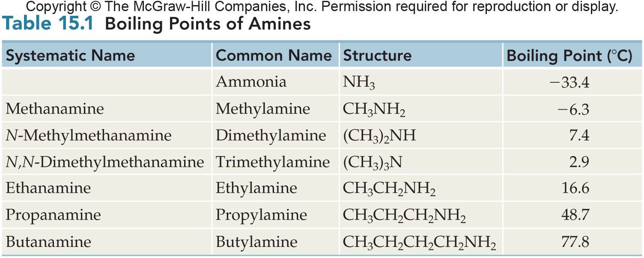
Boiling Points of Amines
15.1 Amines

Slide 10
Hydrogen bonding

Slide 11
Solubility
All amines can form hydrogen bonds with water
Amines up to 6 carbons long are water soluble due to this hydrogen bonding
Water solubility decreases as the length of the hydrocarbon portion of the molecule increases
15.1 Amines

Slide 12
Systematic Nomenclature of Primary Amines
3
Primary aliphatic amines are named by:
Find the parent compound - Longest continuous carbon chain containing the amine group
Dropping the final –e of the parent name and adding the suffix –amine
Number the parent chain to give the amine carbon the lowest possible number
Name and number all substituents as usual
15.1 Amines

Slide 13
Systematic Nomenclature of 2º and 3º Amines
The prefix N-alkyl is added to the name of the parent for 2º and 3º amines
15.1 Amines
N-ethylethanamine

Slide 14
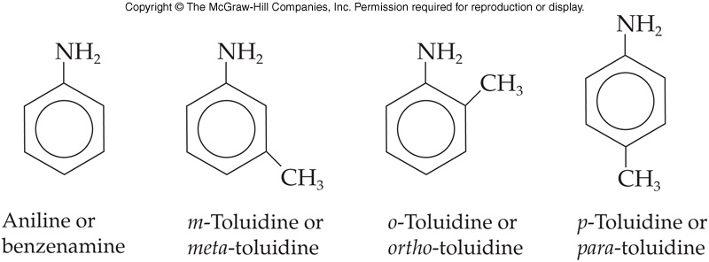
Naming Aromatic Amines
Several aromatic amines have special IUPAC-approved names
Amine of benzene is named aniline
Systematic name = benzenamine
As additional groups are attached they are named as N-substituted derivatives of aniline
15.1 Amines

Slide 15
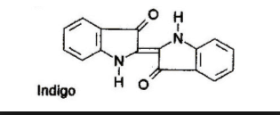
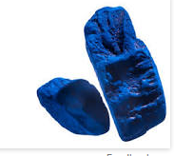

Slide 16
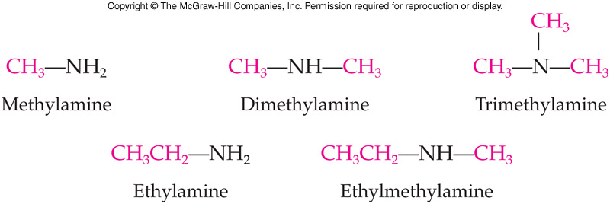
Common Names of Amines
Name the alkyl groups attached to the N in alphabetical order
Add –amine
The name is continuous, no spaces between groups
15.1 Amines

Slide 17
IUPAC Nomenclature of Amine
For primary amines:
The prefix amino and a number designates the position of the amino group on an alkane parent chain
A substituent on the N uses the –N prefix as with the systematic naming
15.1 Amines
2-aminopropane
N-methyl-2-aminopropane

Slide 18
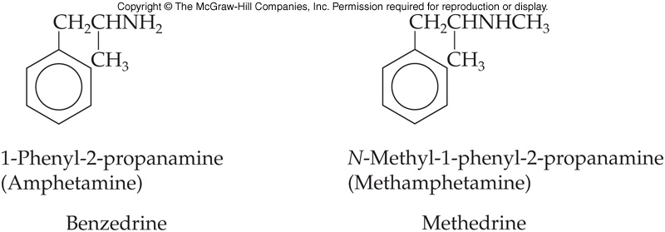
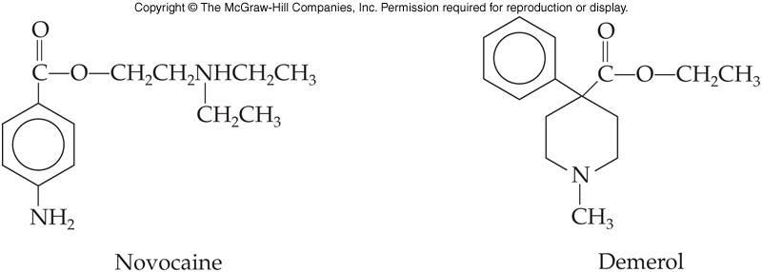
Medically Important Amines
Amphetamines stimulate the central nervous system
Analgesics (pain relievers) and anesthetics (pain blockers)
15.1 Amines

Slide 19
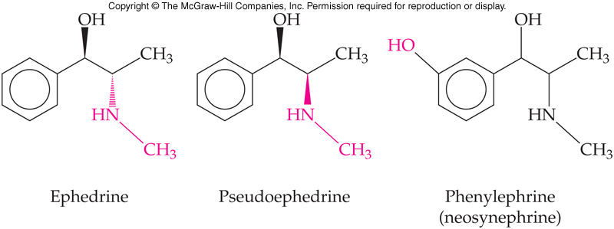
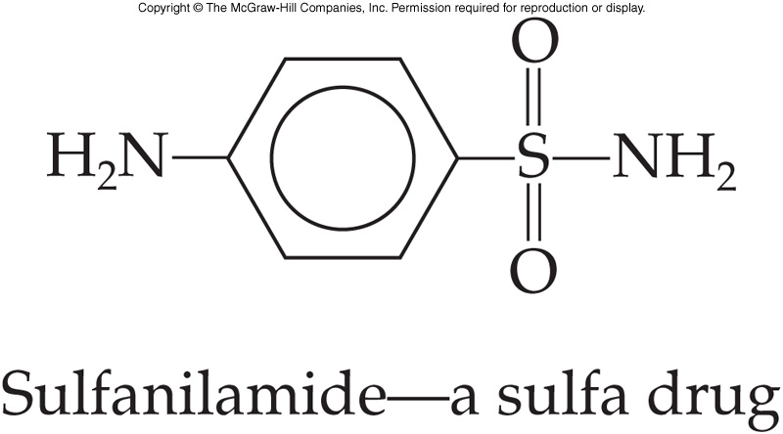
Medically Important Amines
Decongestants shrink the membranes lining the nasal passages
Sulfa drugs (first chemicals used to fight infections) are also made from amines
15.1 Amines

Slide 20
Preparation of amines
Nitro compounds
amides

Slide 21
Basicity
5
Amines are weak bases
They accept H⁺ when dissolved in water
Lone pair electrons of nitrogen can be shared with a proton from water
An alkylammonium ion is produced
Hydroxide ions are also formed, making solutions basic
15.1 Amines

Slide 22
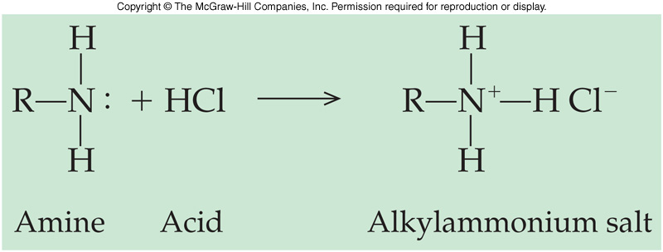
Neutralization
Amines form salts by accepting a proton from strong mineral acids
15.1 Amines

Slide 23
Alkylammonium Salts
Name amine salts by replacing the suffix –amine with ammonium
Add the name of the anion
Converting amines to salts often makes insoluble amines soluble as the salts are ionic
15.1 Amines
e.g., propylammonium chloride

Slide 24
Neutralization
Alkylammonium salts can neutralize hydroxide ions
Water is formed
The protonated amine cation converts into an amine
This reversal of the alkylammonium salt to the amine is extremely important in many drugs
15.1 Amines

Slide 25
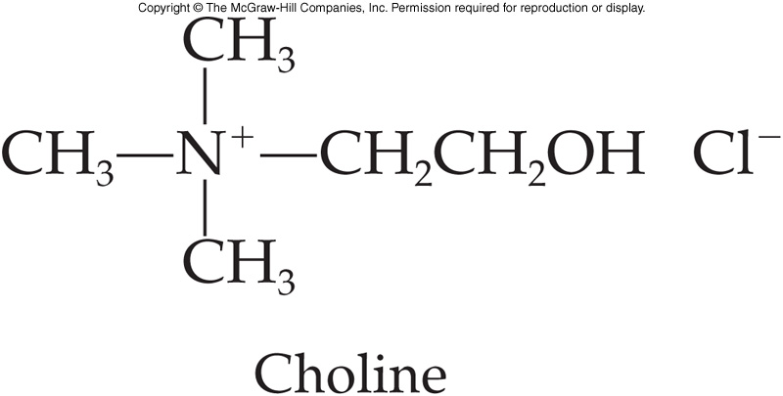
Quaternary Ammonium Salts
6
Quaternary ammonium salts are ammonium salts that have 4 organic groups bonded to the nitrogen
Quaternary ammonium salts that have a very long carbon chain are sometimes called “quats”
Choline is a very important example of a quaternary ammonium salt
15.1 Amines

Slide 26
Comparison of NH₄⁺ to Amine Salt
H
H
15.1 Amines
Amine Salt⁺
NH₄⁺

Slide 27
Quaternary Ammonium salts
15.1 Amines
Benzalkonium chloride (Zephiran™) and cetylpyridinium are important examples of quats that serve as disinfectants and antiseptics

Slide 28
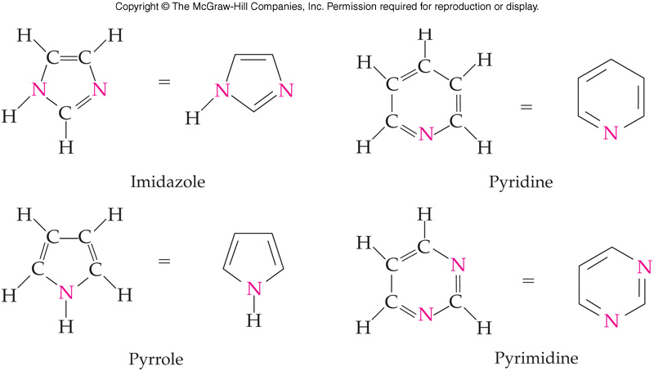
15.2 Heterocyclic Amines
7
Heterocyclic amines are:
Cyclic compounds
Have at least one N in the ring
MANY are physiologically active and many are critical in biochemistry

Slide 29
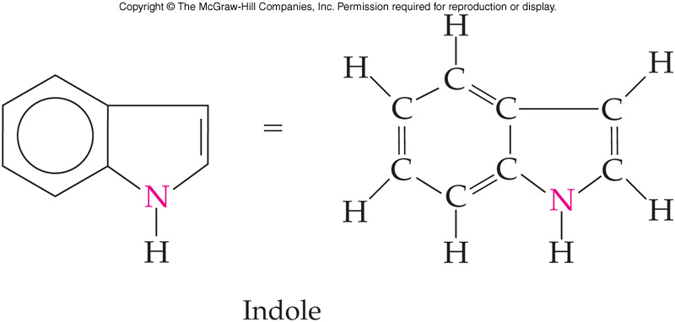
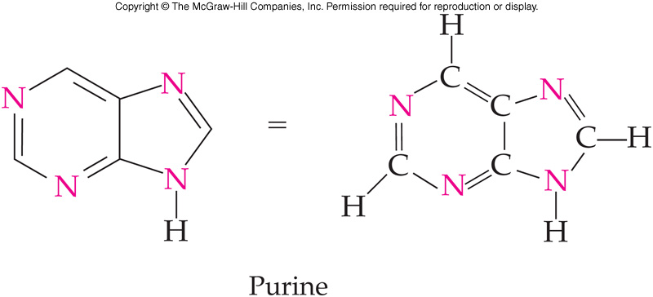
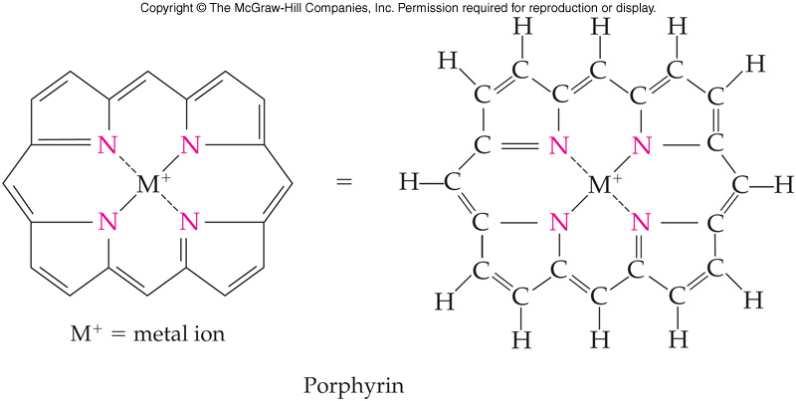
Fused Ring Heterocyclic Amines
15.2 Heterocyclic Amines
Fused ring structures share 2 carbon atoms in common
Share one or more common bonds as part of their ring backbones

Slide 30
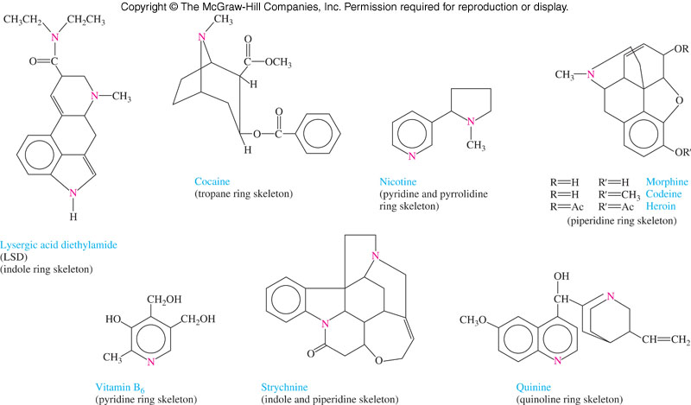
Fused Ring Heterocyclic Amines
Examples of heterocyclic amines include:
Pyrimidine and purine of DNA and RNA
Porphyrin ring structure of hemoglobin and myoglobin
Alkaloids:
Cocaine
Nicotine
Quinine
Morphine
Heroin
LSD
15.2 Heterocyclic Amines

Slide 31
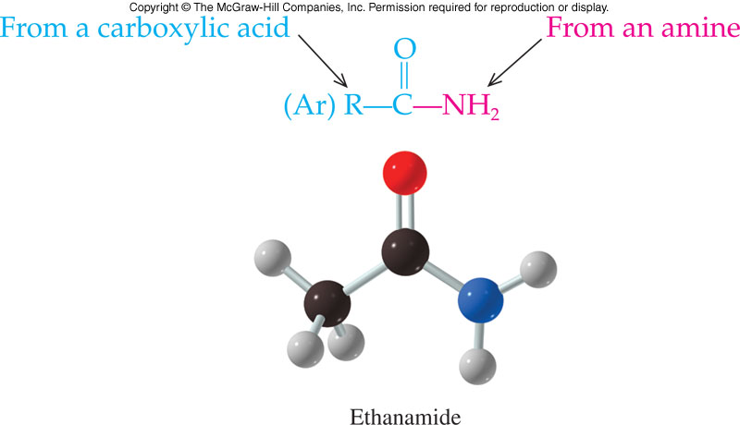
15.3 Amides
Amides are formed in a reaction between a carboxylic acid derivative and an amine or ammonia
The amide bond is the bond formed between:
Carbonyl group from the carboxylic acid
Amino group from the amine or ammonia
8

Slide 32
Fused Ring Heterocyclic Amines
Examples of heterocyclic amines include:
Pyrimidine and purine of DNA and RNA
Porphyrin ring structure of hemoglobin and myoglobin
Alkaloids:
Cocaine
Nicotine
Quinine
Morphine
Heroin
LSD
15.2 Heterocyclic Amines

Slide 33
Physical Properties
Most amides are solids at room temperature due to internal hydrogen bonding
They are not bases
A resonance structure shows why the N lone pair is unavailable to accept a proton
15.1 Amines

Slide 34
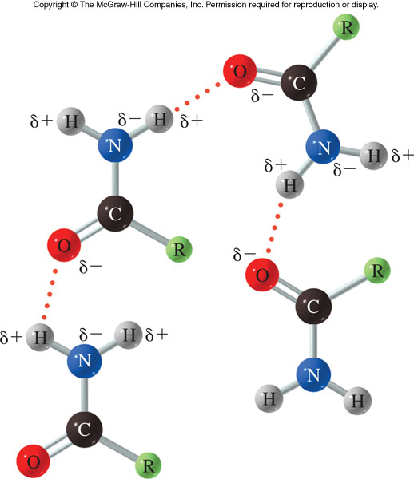
Amide Hydrogen Bonding
Strong intermolecular hydrogen bonding between the N-H bond of one amide and the C=O bond of another
Very high boiling points
Simple amides are quite soluble in water
15.1 Amines

Slide 35
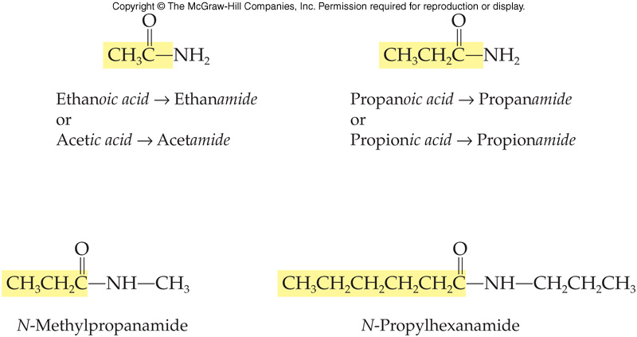
Amide Nomenclature
Names are derived from the carboxylic acid
Remove –oic acid and replace with –amide
Nitrogen substituents are prefixed to the name and indicated by N-
15.3 Amides
9

Slide 36
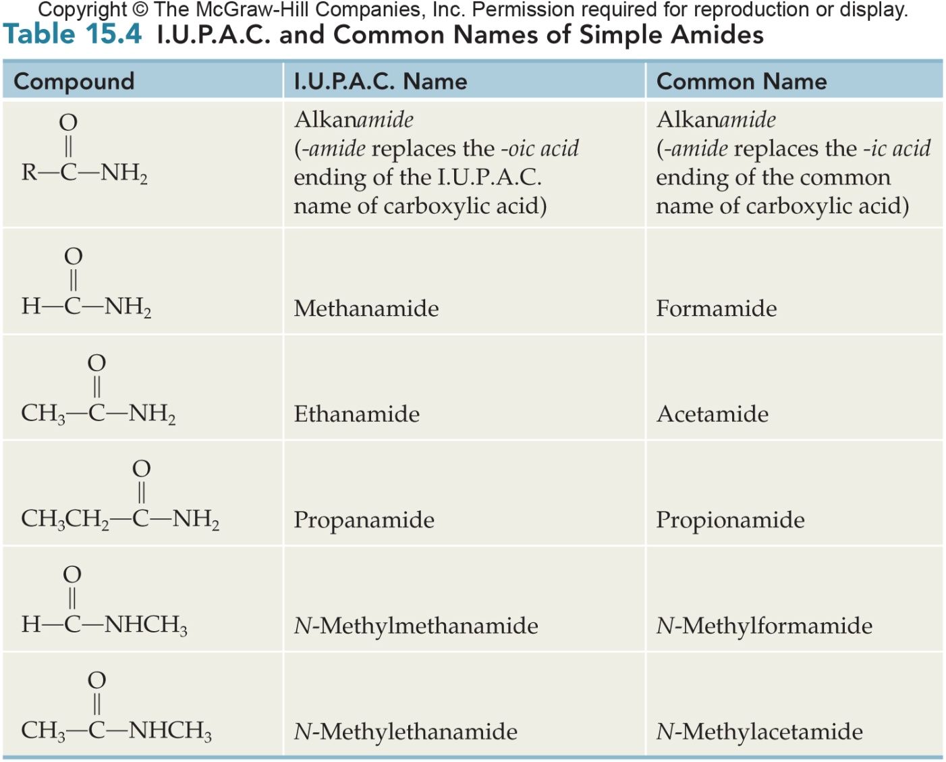
Comparison of Names for Simple Amides
15.1 Amines

Slide 37
Reactions Involving Amides
10
Preparation of Amides
1º and 2º amines react with acid chlorides and acid anhydrides to produce amides
Two molar equivalents of the nitrogen source are required in these reactions
These reactions are acyl group transfers

Slide 38
Hydrolysis of Amides
11
Amides hydrolyze with:
Acid to produce
Carboxylic acid
Amine salt
Base to produce
Carboxylic acid salt
Amine
15.3 Amides

Slide 39
Reactions Involving Amines
Preparation of Amines
Aliphatic amines are prepared via reduction of amides and nitro compounds
Aromatic amines are prepared via reduction of nitro compounds
4
15.1 Amines

Slide 40
Sulphonamide

Slide 41
Amino Acids and Proteins
An alpha amino acid is a carboxylic acid with an amino group on the carbon α to the carboxylic acid .
The α carbon also has an R group side chain except for glycine, which has two H
15.4 A Preview of Amino Acids, Proteins and Protein Synthesis
Generic amino
acid at physiological
pH
α C

Slide 42
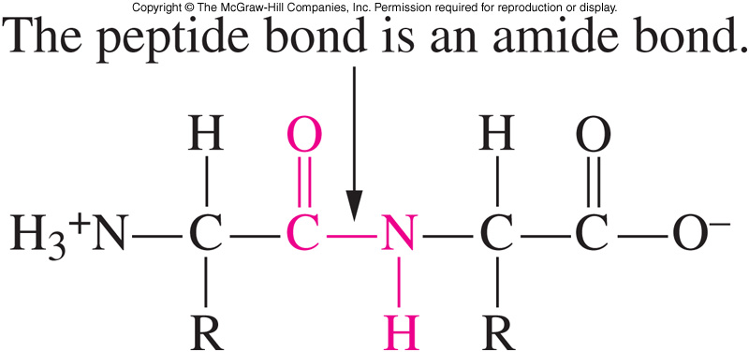
15.4 A Preview of Amino Acids, Proteins, and Protein Synthesis
12
A protein is a polymer of amino acids linked by the amide bonds
As the amino group and the carboxyl group link, water is lost
13

Slide 43
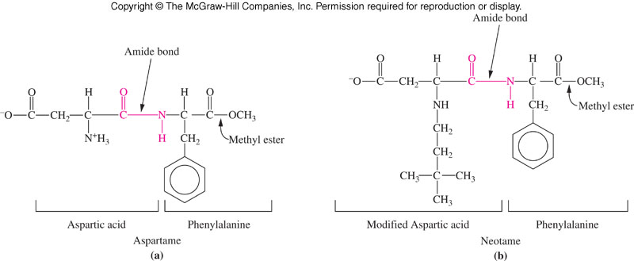
Amide Bond in Artificial Sweeteners

Slide 44
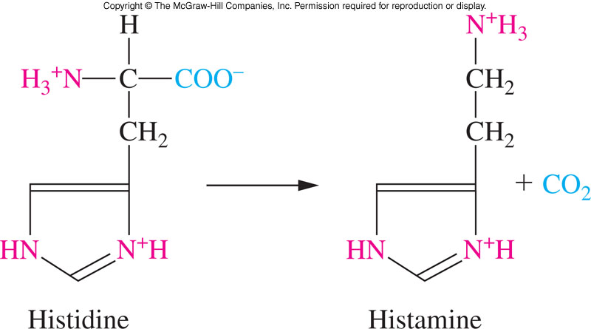
Synthesis of Histamine
15.5 Neurotransmitters

Slide 45
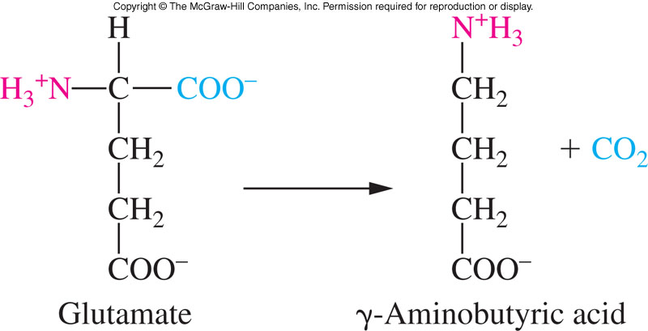
Glycine and Aminobutyric Acid
Removal of a carboxyl group from glutamate, an amino acid, produces γ-aminobutyric acid, GABA
GABA and glycine, another amino acid, are inhibitory neurotransmitters acting on the central nervous system
15.5 Neurotransmitters

Slide 46
N-methylpyridine oxime

Slide 47
Reaction Schematic
Nitro Compound
Amine
Amide
Basicity with Water
Neutralization
with Acid
AlkylNH₄ Ion
Hydroxide Ion
Alkylammonium
Salt

Slide 48
Reaction Schematic
Amide
Acid Chloride
Amine / NH₃
Acid Anhydride
Amine / NH₃
Hydrolysis
If Acid
If Base
Carboxylic Acid
AlkylNH₄ Ion
Carboxylate ion
Amine / NH₃

Slide 49
Summary of Reactions
1. Amines
a. Preparation from nitro compounds and amides
b. Basicity
c. Neutralization
i. Hemiacetal and acetal
ii. Hemiketal and ketal
2. Amides
a. Preparation
i. Acid chloride or acid anhydride
ii. Amine or ammonia
b. Hydrolysis
i. Amide + acid produces carboxylic acid + alkylammonium ion
ii. Amide + base produces carboxylic acid salt + amine

Slide 50
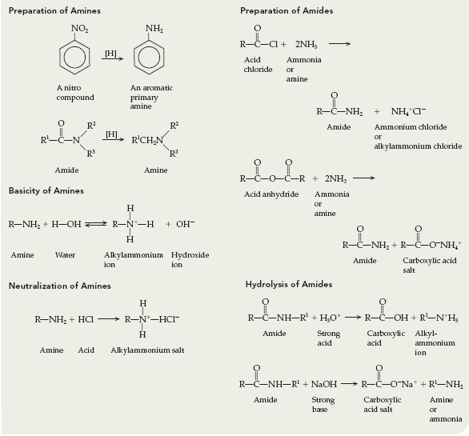
Summary of Reactions

