Slide 1
Capsaicin

Slide 2
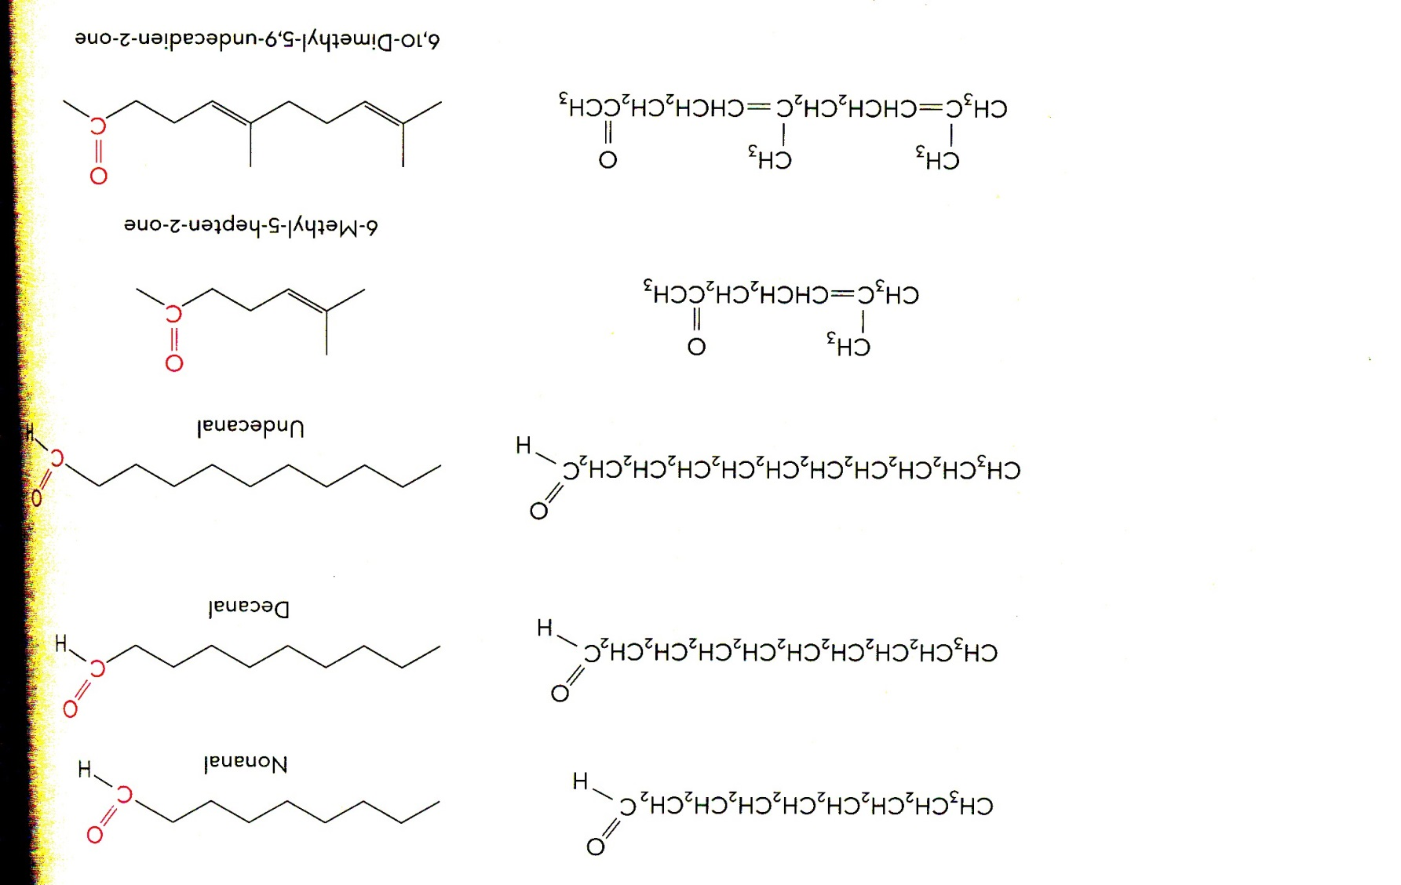
Aldehydes and ketones

Slide 3
Carbonyl Compounds
Contain the carbonyl group C=O
Aldehydes:
R may be hydrogen, usually a carbon containing group
Ketones:
R contains carbon
Short
forms

Slide 4
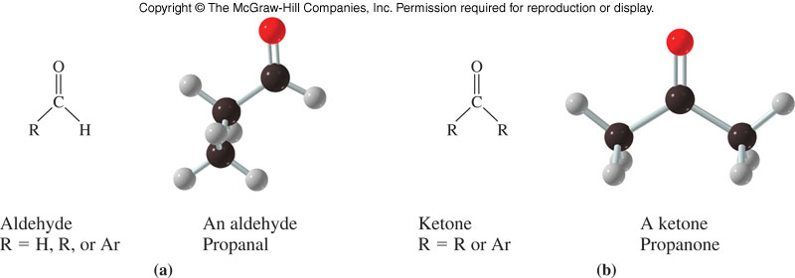
Structures of Aldehydes and Ketones

Slide 5
13.1 Structure and Physical Properties
1
Aldehydes and ketones are polar compounds
The carbonyl group is polar
The oxygen end is electronegative
Can hydrogen bond to water
Cannot form intermolecular hydrogen bond
Hydrogen
bond

Slide 6
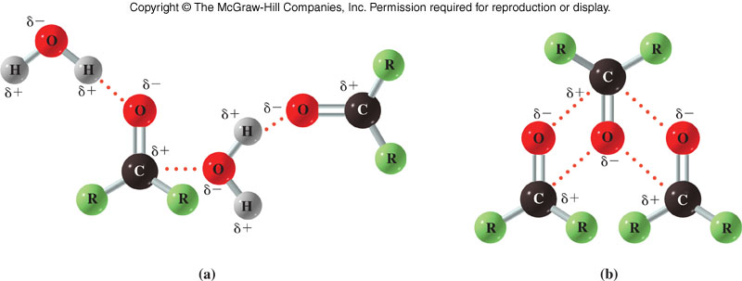
Hydrogen Bonding and dipole association in Carbonyls
13.1 Structure and Physical Properties
Bonding with H₂O dipole-dipole

Slide 7
Physical Properties
Carbonyls boil at
Higher temperatures than:
Hydrocarbons
Ethers
Lower temperatures than:
Alcohols

Slide 8
13.2 Nomenclature and Common Names
1
Naming Aldehydes
Locate the parent compound
Longest continuous carbon chain
Must contain the carbonyl group
Replace the final –e of the parent with –al
Number the chain with the carbonyl carbon as 1
Number and name all substituents

Slide 9
Naming Aldehydes
What is the name of this molecule?
Parent chain – 5 carbons = pentane
Change suffix – pentanal
Number from carbonyl end – L to R
Number / name substituents – 4-methyl
13.2 Nomenclature and Common Names
5
4
3
2
1
4-methylpentanal

Slide 10
Common Names of Aldehydes
These names are taken from Latin roots as are the first 5 carboxylic acids
Greek letters are used to indicate the position of substituents with the carbon atom adjacent or bonded to the carbonyl carbon being the α carbon
13.2 Nomenclature and Common Names
γ-chlorovaleraldehyde

Slide 11
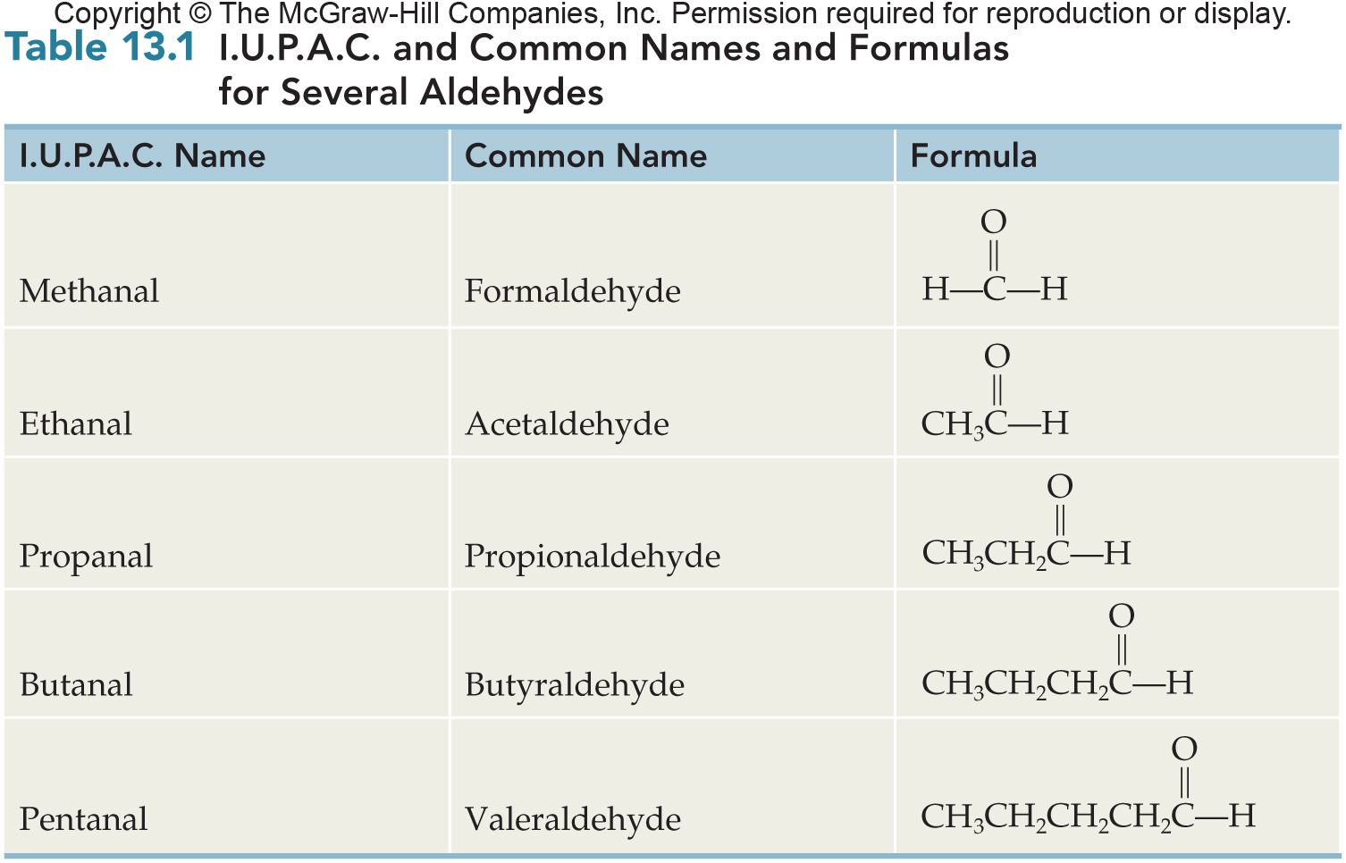
IUPAC and Common Names With Formulas for Several Aldehydes
13.2 Nomenclature and Common Names

Slide 12
Examples of Ketones
Simplest ketone MUST have 3 carbon atoms so that the carbonyl group is interior
Base name: longest chain with the C=O
Replace the –e of alkane name with –one
Indicate position of C=O by number on chain so that C=O has lowest possible number
2

Slide 13
IUPAC Naming of Ketones
2
Rules directly analogous to those for aldehydes
Base name: longest chain with the C=O pent
Replace the –e of alkane name with –one
Indicate position of C=O by number on chain so that C=O has lowest possible number 2
13.2 Nomenclature and Common Names
5
4
3
2
1
4-chloro-2-pentanone

Slide 14
Common Names of Ketones
Based on the alkyl groups that are bonded to the carbonyl carbon
Alkyl groups are prefixes (2 words) followed by the word ketone
Order of alkyl groups in the name
Alphabetical
Size – smaller to larger
13.2 Nomenclature and Common Names
Methyl ethyl ketone or
Ethyl methyl ketone
Dimethyl ketone

Slide 15
13.3 Important Aldehydes and Ketones
3
Methanal (b.p. –21ºC) is a gas used in aqueous solutions as formalin to preserve tissue
Ethanal is produced from ethanol in the liver causing hangover symptoms
Propanone (Acetone) is the simplest possible ketone
Miscible with water
Flammable
Both acetone methyl ethyl ketone (MEK or butanone) are very versatile solvents

Slide 16
Fragrant aldehydes

Slide 17
Oxidation
Tollens test
Benedict

Slide 18
Reduction of Carbonyls
7
Both aldehydes and ketones are readily reduced to alcohols
Reduction occurs with hydrogen as the reducing agent
Classical reaction is hydrogenation
React with hydrogen gas
Requires a catalyst – Ni, Pt, Pd
Occurs with heat and pressure
13.4 Reactions Involving Aldehydes and Ketones

Slide 19
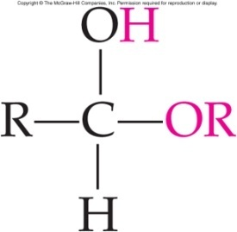
Addition Reactions
7
Principal reaction is the addition reaction across the polar C=O double bond
Very similar to the addition hydrogenation of alkenes
Requires catalytic acid in the solution
Product of the reaction is a hemiacetal
Hemiacetals are quite reactive
Undergo a substitution reaction with the –OH group of the hemiacetal is exchanged for another –OR group from the alcohol
Reaction product is an acetal
This reaction is reversible
13.4 Reactions Involving Aldehydes and Ketones

Slide 20
Formation of Hemiacetal or Hemiketal
Product of the addition reaction is a hemiacetal (above) or a hemiketal (below)
13.4 Reactions Involving Aldehydes and Ketones
Hemiacetal (ketal) carbons are part of both alcohol and ether functions and are a new functional group

Slide 21
Carbohydrates

Slide 22
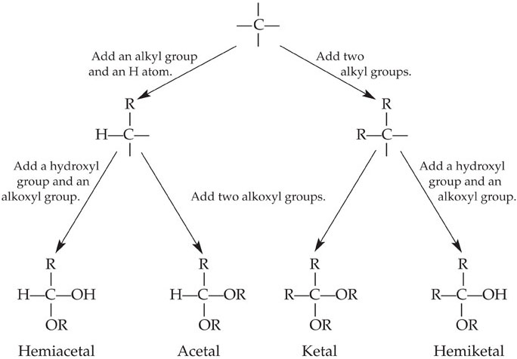
Recognizing Hemiacetals, Acetals, Hemiketals, and Ketals
13.4 Reactions Involving Aldehydes and Ketones

Slide 23
Keto-Enol Tautomers
8
Tautomers are isomers which differ in the placement of:
A hydrogen atom
A double bond
The keto form has a C=O while the enol form has a C=C.
The keto form is usually the most stable
13.4 Reactions Involving Aldehydes and Ketones

Slide 24
Aldol Condensation
9
Self-addition or condensation
Uses two molecules of the same aldehyde or ketone
The α carbon of the second molecule adds to the carbonyl carbon of the first molecule
Strong base such as hydroxide catalyzes the reaction
Very complex reaction occurring in multiple steps
13.4 Reactions Involving Aldehydes and Ketones

Slide 25
Condensation of an Aldehyde
An aldol has an –OH β to the carbonyl group
13.4 Reactions Involving Aldehydes and Ketones
α C, 2nd molecule
original
α C
carbonyl carbon of first molecule becomes
alcohol carbon in aldol

Slide 26
Aldol Condensation: Aldolase
Dihydroxyacetone phosphate +
D-glyeraldehyde-3-phosphate
13.4 Reactions Involving Aldehydes and Ketones
Bond formed
D-fructose-1,6-bisphosphate
α carbon (3) adds to carbonyl carbon (4)

Slide 27
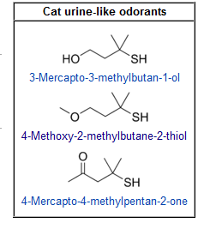
Cats pea

Slide 28
Tautomerization

Slide 29
Reaction Schematic
Carbonyl
Oxidation
Addition
Carboxylic
Acid
Reduction
If aldehyde
If ketone
If aldehyde
Hemiacetal - Acetal
2º Alcohol
1º Alcohol
If ketone
Hemiketal - Ketal

Slide 30
Summary of Reactions
1. Aldehydes and ketones
a. Oxidation of an aldehyde
b. Reduction of aldehydes and ketones
c. Addition reactions
i. Hemiacetal and acetal
ii. Hemiketal and ketal
2. Keto-enol tautomerization
3. Aldol condensation

Slide 31
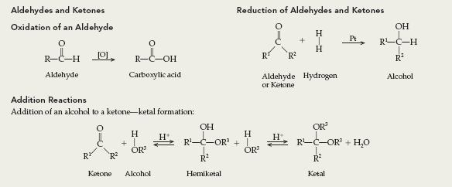
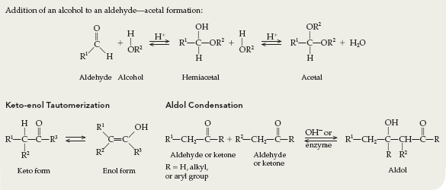
Summary of Reactions

