Slide 1
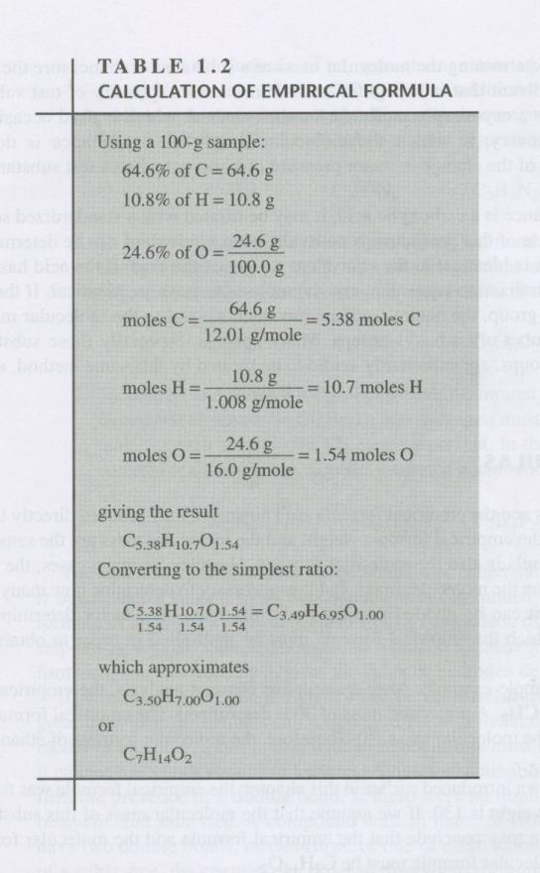
Elementary analysis

Slide 2
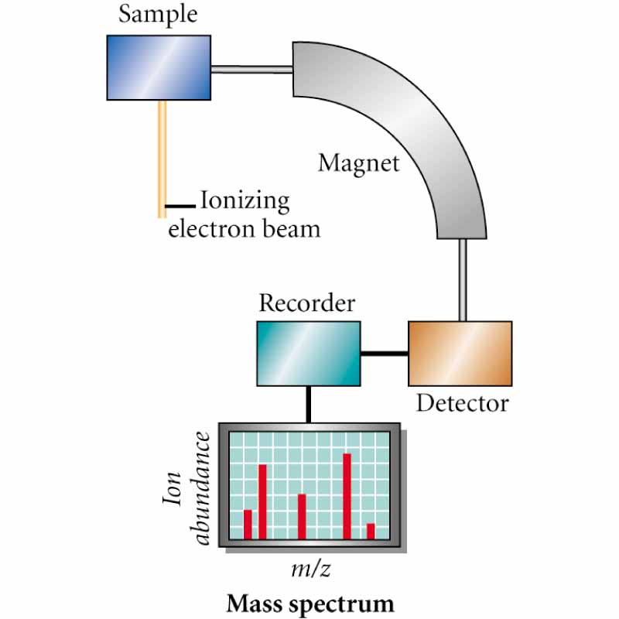
Mass spectrometer

Slide 3
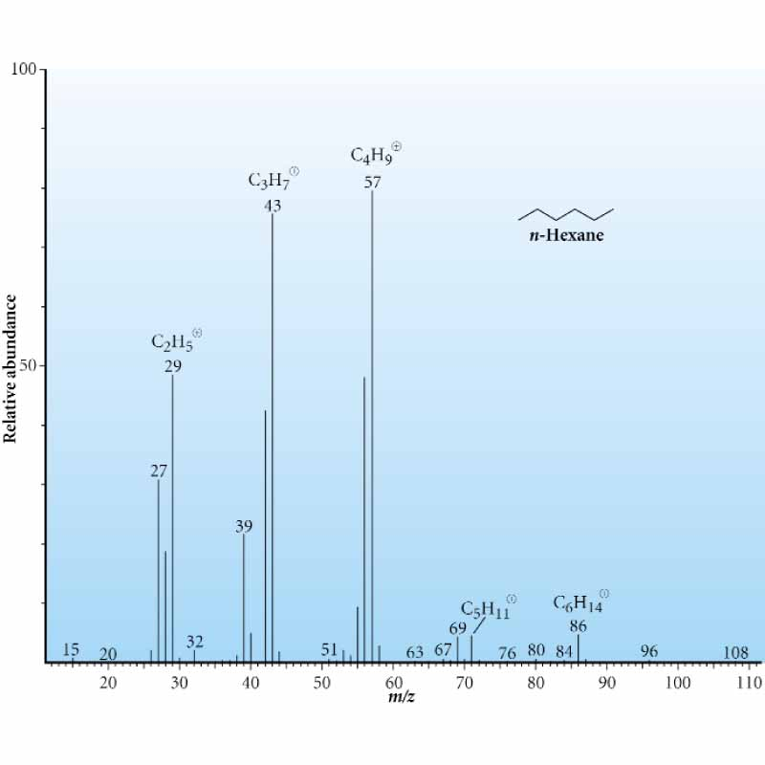
n-hexane

Slide 4
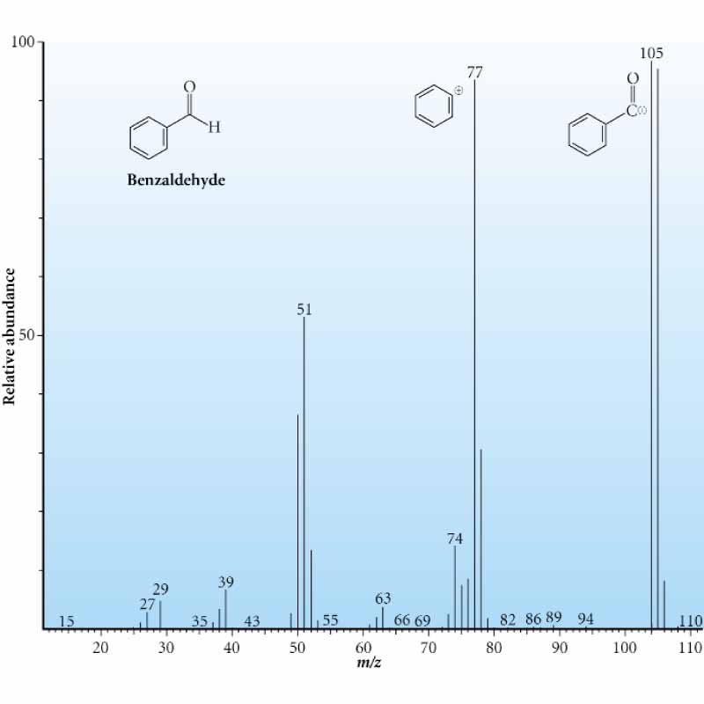

Slide 5
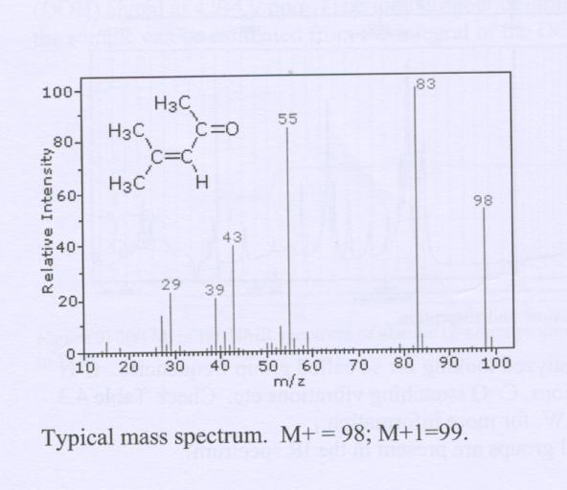
MS

Slide 6
Alcohols, ethers, thiols
Sweet
Hydrogen bonding
Hydrophilic
Hydrophobic
Oxidation

Slide 7
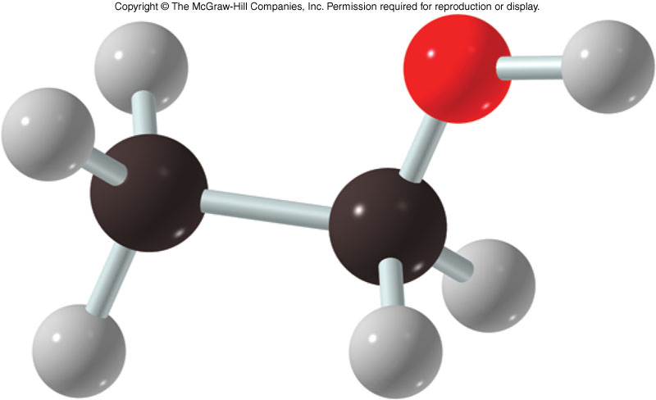
12.1 Alcohols: Structure and Physical Properties
1
An organic compound containing a hydroxyl group attached to an alkyl group
Alcohols have the general formula R-OH

Slide 8
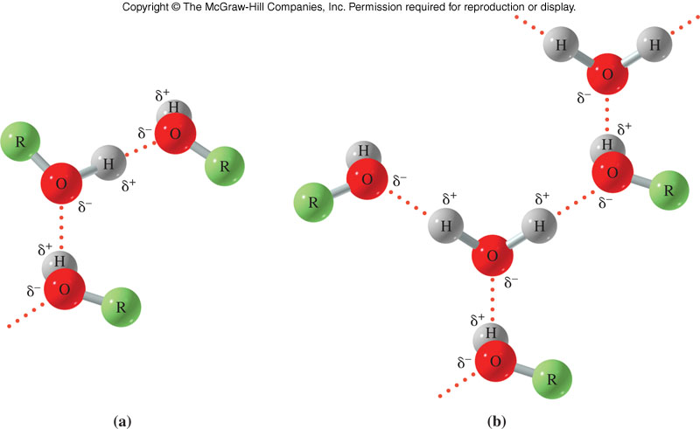
Physical Properties
R-O-H has a structure similar to that of water
Hydroxyl group is very polar
Hydrogen bonds can form readily
12.1 Structure and Physical Properties

Slide 9
Trends in Alcohol Boiling Points
12.1 Structure and Physical Properties

Slide 10
Solubility
Low molecular weight alcohols (up to 5-6 carbons) are soluble in water
Very polar
Hydrogen bond with the water molecule
CH₃CH₂OH very soluble
CH₃OCH₃ barely soluble
CH₃CH₂CH₂CH₂OH, 7 g per 100 mL
HOCH₂CH₂CH₂CH₂OH is very soluble (two OH groups)
12.1 Structure and Physical Properties

Slide 11
Use of alcohols
Which alcohols do we know?

Slide 12
1,2,3-Propanetriol
Very viscous, thick
Has a sweet taste
Non-toxic
Highly water soluble
Used in:
Cosmetics
Pharmaceuticals
Lubricants
Obtained as a by-product of fat hydrolysis
12.3 Medically Important Alcohols

Slide 13
Sorbitol

Slide 14
1,2-ethanediol

Slide 15
Naming of alcohols
Find longest chain in which the OH group is included
-ol
Lowest possible number
Diols, triols etc.

Slide 16
12.4 Classification of Alcohols
4
Alcohols, depending on the number of alkyl groups attached to the carbinol carbon, are classified as:
Primary
Secondary
Tertiary
Carbinol carbon is the carbon bearing the hydroxyl group

Slide 17
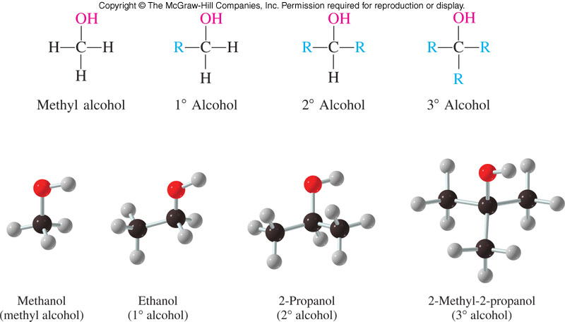
Structures of Different Alcohol Categories
12.4 Classification of Alcohols

Slide 18
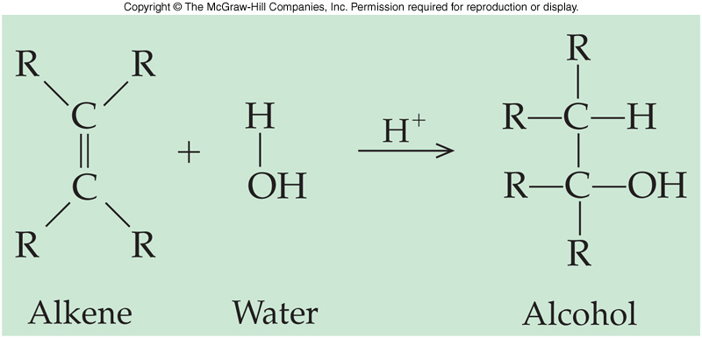
12.5 Reactions Involving Alcohols
5
Preparation of Alcohols
Hydration
Addition of water to the carbon-carbon double bond of an alkene produces an alcohol
A type of addition reaction called hydration
Requires a trace of acid as a catalyst

Slide 19
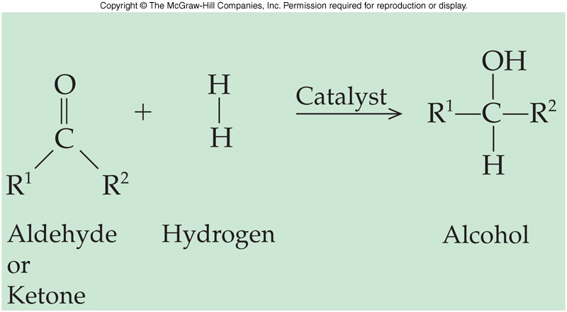
Preparation of Alcohols
6
Hydrogenation
Addition of hydrogen to the carbon-oxygen double bond of an aldehyde or ketone produces an alcohol
A type of addition reaction
Also considered a reduction reaction
Requires Pt, Pd, or Ni as a catalyst
12.5 Reactions Involving Alcohols

Slide 20
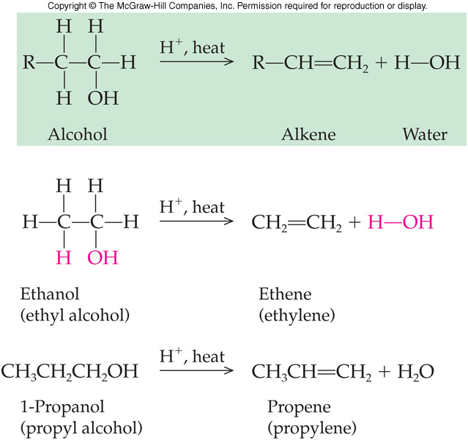
Dehydration of Alcohols
Alcohols dehydrate with heat in the presence of strong acid to produce alkenes
Dehydration is a type of elimination reaction
A molecule loses atoms or ions from its structure
Here –OH and –H are removed / eliminate from adjacent carbon atoms to produce an alkene and water
A reversal of the hydration reaction that forms alcohols
7
12.5 Reactions Involving Alcohols

Slide 21
Zaitsev’s Rule
Some alcohol dehydration reactions produce a mixture of products
Zaitsev’s rule states that in an elimination reaction the alkene with the greatest number of alkyl groups on the double bonded carbon is the major product of the reaction
12.5 Reactions Involving Alcohols

Slide 22
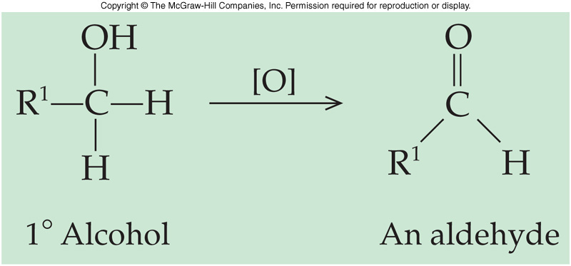
Oxidation Reaction of Primary Alcohols
Primary alcohols usually oxidize to carboxylic acids
With some care (using CrO₃ as the reagent) an aldehyde may be obtained
12.5 Reactions Involving Alcohols
8

Slide 23
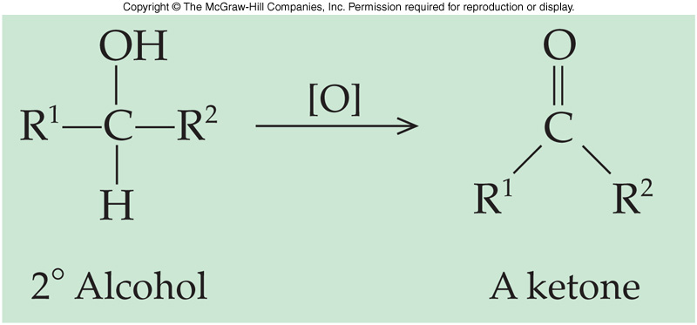
Oxidation Reaction of Secondary Alcohols
Secondary alcohols oxidize to ketones
This reaction is also an elimination of 2H
The usual oxidizing agent is a Cr(VI) species
Tertiary alcohols do not oxidize as there is no H on the carbonyl carbon to remove
12.5 Reactions Involving Alcohols

Slide 24
12.6 Oxidation and Reduction in Living Systems
9
Oxidation
loss of electrons
Reduction
gain of electrons
These changes are easily detected in inorganic systems with formation of charged ions
In organic systems it is often difficult to determine whether oxidation or reduction has taken place as there might be no change in charge

Slide 25
Organic Oxidation and Reduction
In organic systems changes may be tracked:
Oxidation
gain of oxygen
loss of hydrogen
Reduction
loss of oxygen
gain of hydrogen
12.6 Oxidation and Reduction in Living Systems
More oxidized form
Alkane Alcohol Aldehyde Acid
More reduced form

Slide 26
Biological Oxidation-Reduction
Oxidoreductases catalyze biological redox reactions
Coenzymes (organic molecules) are required to donate or accept hydrogen
NAD⁺ is a common coenzyme
12.6 Oxidation and Reduction in Living Systems

Slide 27
Oxidation of ethanol

Slide 28
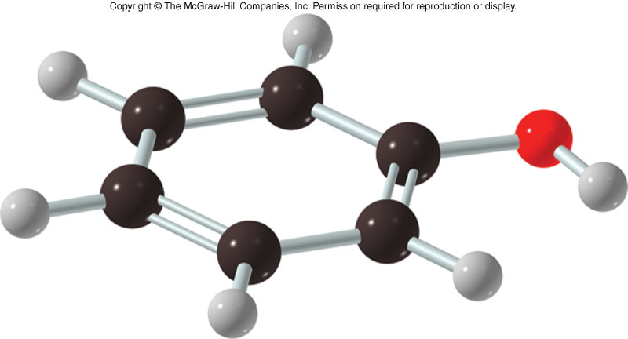
12.7 Phenol
Phenols are compounds in which the hydroxyl group is attached to a benzene ring
Polar compounds due to the hydroxyl group
Simpler phenols are somewhat water soluble
Components of flavorings and fragrances
Phenols have the formula Ar-OH
Ar must be an aromatic ring (e.g., Benzene)
10

Slide 29
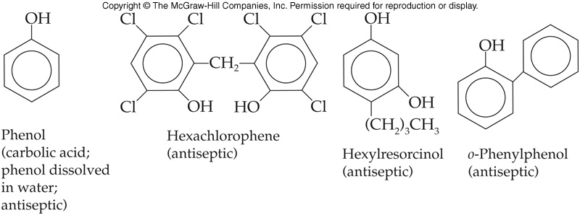
Phenol Derivatives
Widely used in healthcare as:
Germicides
Antiseptics
Disinfectants
12.7 Phenols

Slide 30
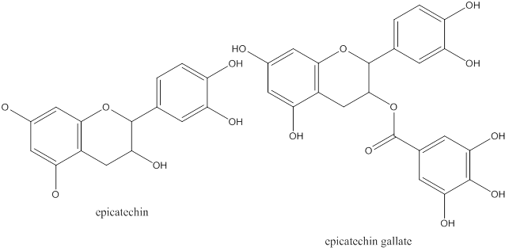
Green tea

Slide 31
Phenol Reactivity
12.7 Phenols
Phenols are acidic, but not as acidic as carboxylic acids
They react with NaOH to give salt and water

Slide 32
12.8 Ethers
Ethers have the formula R-O-R
R can be aliphatic or aromatic
Ethers are slightly polar due to the polar C=O bond
Do not hydrogen bond to one another as there are no –OH groups
11

Slide 33
Ether Physical Properties
Ethers have much lower boiling points than alcohols due to the lack of hydrogen bonding
12.8 Ethers

Slide 34
Common Names of Ethers
Common names for ethers consist of the names of the two groups attached to the O listed in alphabetical order (or size) and followed by ‘ether’
Each of the three parts is a separate word
Name:
12.8 Ethers
Isopropyl methyl ether
Ethyl phenyl ether

Slide 35
IUPAC Nomenclature of Ethers
The IUPAC names for ethers are based on the alkane name of the longest chain attached to the oxygen
The shorter chain is named as an alkoxy substituent
Alkane with the -ane replaced by -oxy
e.g., CH₃CH₂O = ethoxy
CH₃CH₂CH₂CH₂CH₂-O-CH₃ 1-methoxypentane
12.8 Ethers

Slide 36
Reactivity of Ethers
Chemically, ethers are moderately inert
Do not normally react with reducing agents or bases
Extremely volatile
Highly flammable = easily oxidized in air
Symmetrical ethers may be prepared by dehydrating two alcohol molecules
Requires heat and acid catalyst
12.8 Ethers

Slide 37
Medical Uses of Ethers
Ethers are often used as anesthetics
Accumulate in the lipid material of nerve cells interfering with nerve impulse transmission
Today halogenated ethers are used routinely as general anesthetics
Less flammable
Safer to store and to work with
12.8 Ethers
Diethyl ether -
First successful
general anesthetic
Penthrane

Slide 38
12.9 Thiols
Thiols have the formula R-SH
Similar in structure to alcohols with S replacing O
Disulfides have the formula R-S-S-R
R may be aliphatic or aromatic
Name is based on longest alkane chain with the suffix –thiol position indicated by number
3-methyl-1-butanethiol

Slide 39
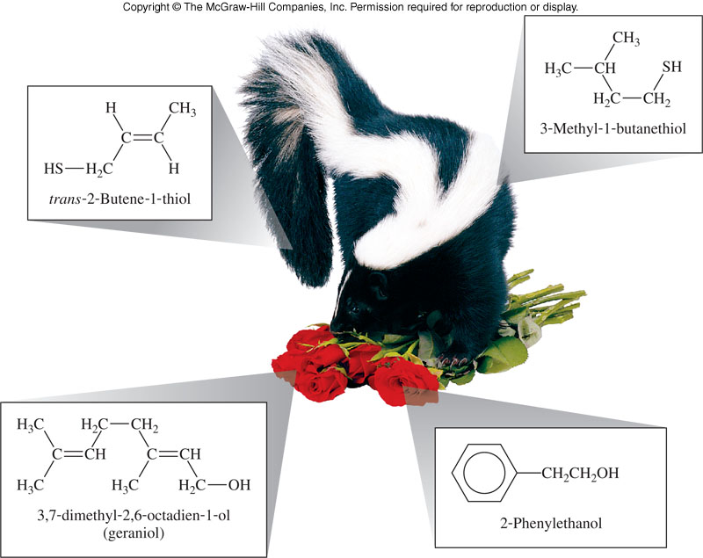
Thiols and Scent
Thiols, as many other sulfur-containing compounds can have nauseating aromas
Defensive spray of North American striped skunk
Onions and garlic
Compare with pleasant scents below
12.9 Thiols

Slide 40
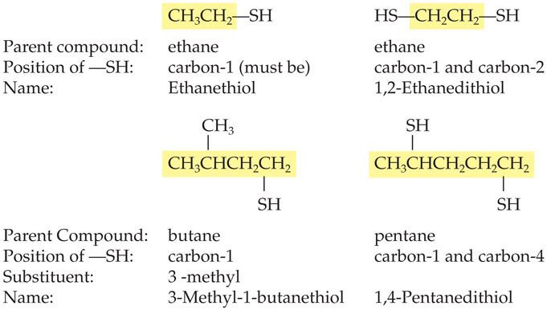
Naming Thiols
Write the IUPAC name for the thiols shown
12.9 Thiols

Slide 41
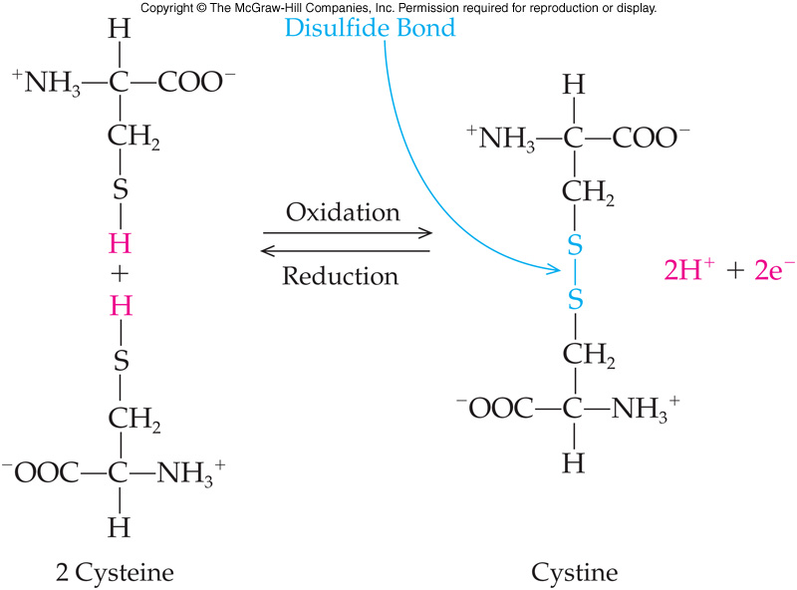
Disulfide Formation
The thiol-disulfide redox pair controls a critical factor in protein structure called a disulfide bridge
Two cysteine molecules (amino acids) can undergo oxidation to form cystine
Forms a new bond called a disulfide bond
12.9 Thiols

Slide 42
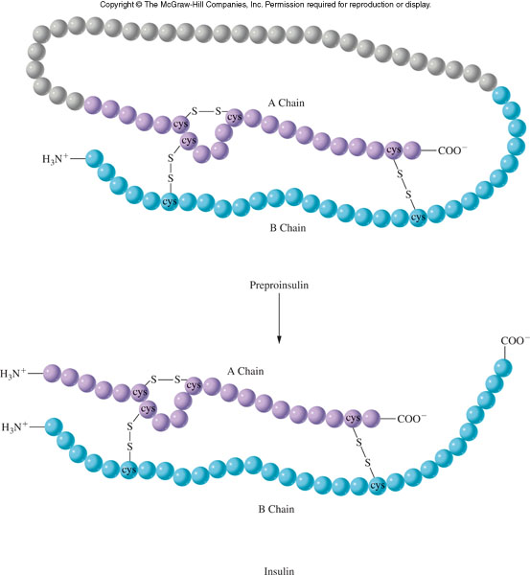
Disulfide Formation and Insulin Structure
12.9 Thiols

Slide 43
Reaction Schematic
Hydration
Reduction
Alkene
Alcohol
Carbonyl
Oxidation
If tertiary
+ H⁺ and heat
NO REACTION
Dehydration
If primary
If secondary
Aldehyde
Ketone

Slide 44
Summary of Reactions
1. Preparation of Alcohols
a. Hydration of Alkenes
b. Reduction of Aldehyde or Ketone
2. Reactions of Alcohols
a. Dehydration
b. Oxidation
i. Primary alcohol to aldehyde
ii. Secondary alcohol to ketone
iii. Tertiary alcohol does not react
3. Dehydration Synthesis of an Ether

Slide 45
Ninhydrin

