Slide 1
Unsaturated hydrocarbons
Orbitals
Natural gas?

Slide 2
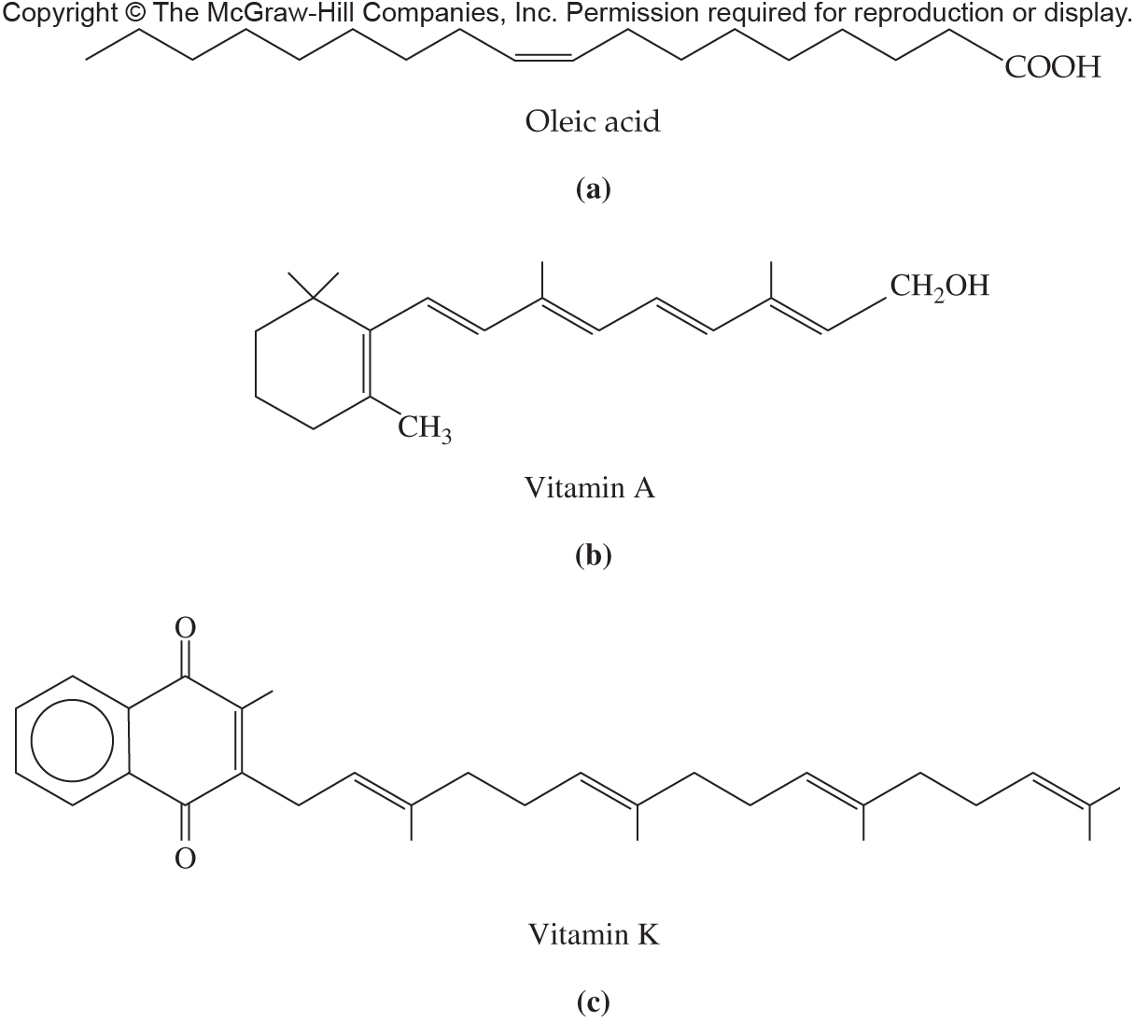
Fig. 11.1

Slide 3
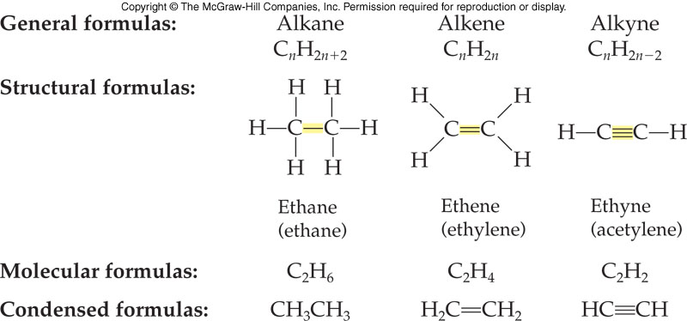
Aliphatic Hydrocarbon Structure Comparison

Slide 4
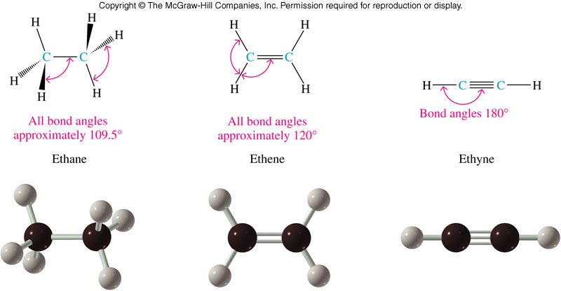
Bonding and Geometry of Two-Carbon Molecules
11.1 Structure and Physical
Properties

Slide 5
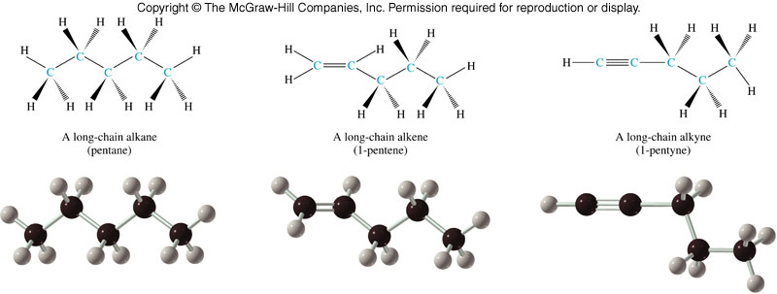
Structural Comparison of Five Carbon Molecules
11.1 Structure and Physical
Properties
Basic tetrahedral Planar around the Linear at the
zig-zag shape double bond triple bond

Slide 6
11.2 Alkenes and Alkynes: Nomenclature
2
Base name from longest chain containing the multiple bond
Change from -ane to -ene or -yne
Number from the end, that will give the first carbon of the multiple bond the lower number
Prefix the name with the number of the first multiple bond carbon
Prefix branch/substituent names as for alkanes

Slide 7
Naming Geometric Isomers
2-butene is the first example of an alkene which can have two different structures based on restricted rotation about the double bond
11.3 Geometric Isomers
trans-2-butene cis-2-butene

Slide 8
E,Z
E means entgegen = on opposite sites
Z means zusammen = on the same side
Priority rules, the higher the number in the periodic table the higher the priority
The two substituents with highest priority determines whether it is E or Z

Slide 9
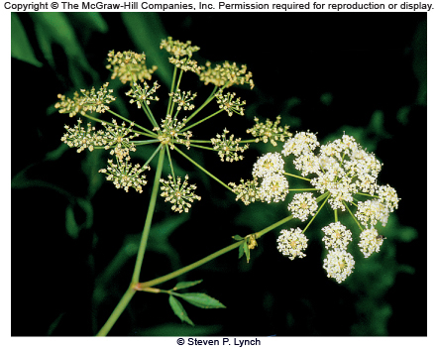
Page 355

Slide 10
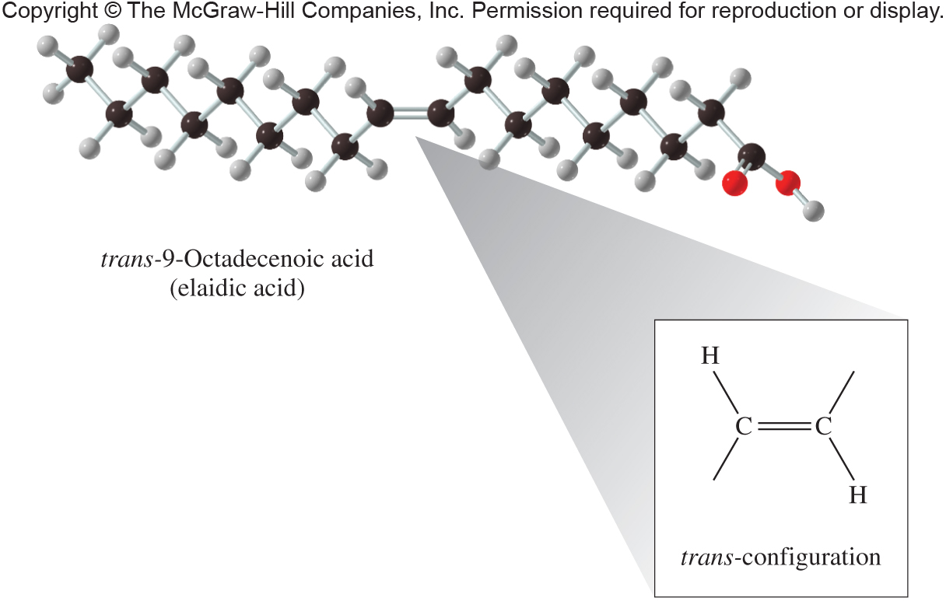
Page 359

Slide 11
Alkenes in nature
Isoprene

Slide 12
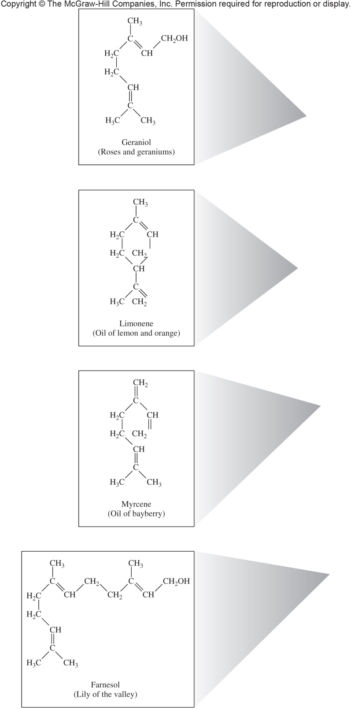
Fig. 11.3a

Slide 13
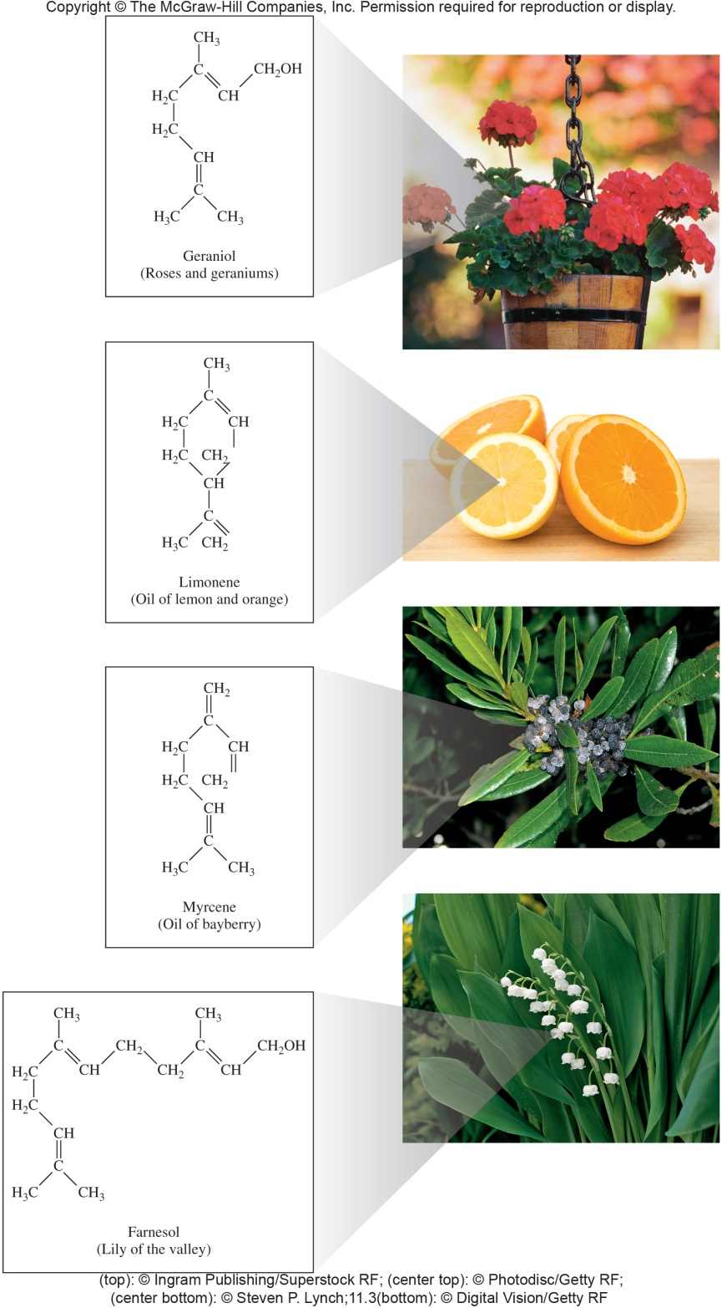
Fig. 11.3

Slide 14
Fig. 11.4

Slide 15
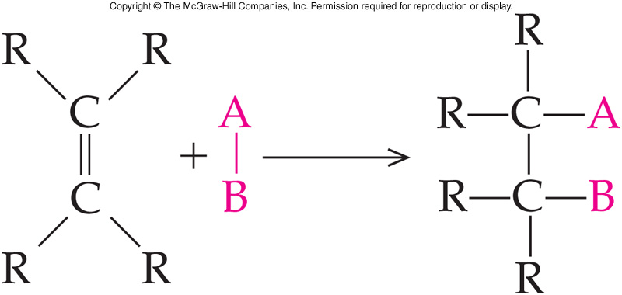
Addition: General Reaction
11.5 Reactions Involving Alkenes and Alkynes
A small molecule, AB, reacts with the pi electrons of the double bond
The pi bond breaks and its electrons are used to bond to the A and B pieces
Some additions require a catalyst

Slide 16
Unsymmetrical Addition
11.5 Reactions Involving Alkenes and Alkynes
Two products are possible depending how the 2 groups (as H and OH) add to the ends of the pi bond
The hydrogen will add to one carbon atom
The other carbon atom will attach the other piece of the addition reagent
OH (Hydration)
Halogen (Hydrohalogenation)

Slide 17
Markovnikov’s Rule
5
When an acid adds to a double bond -the H of the acid most often goes to the end of the double bond, which had more hydrogens attached initially
H-OH
H-Cl
H-Br
11.5 Reactions Involving Alkenes and Alkynes

Slide 18
Hydration of Alkynes
11.5 Reactions Involving Alkenes and Alkynes
Hydration of an alkyne is a more complex process
The initial product is not stable
Enol produced – both an alkene and an alcohol
Product is rapidly isomerized
Final product is either
Aldehyde
Ketone

Slide 19
Polymers
PVC
PETE
PP
PS

Slide 20
Table 11.2

Slide 21
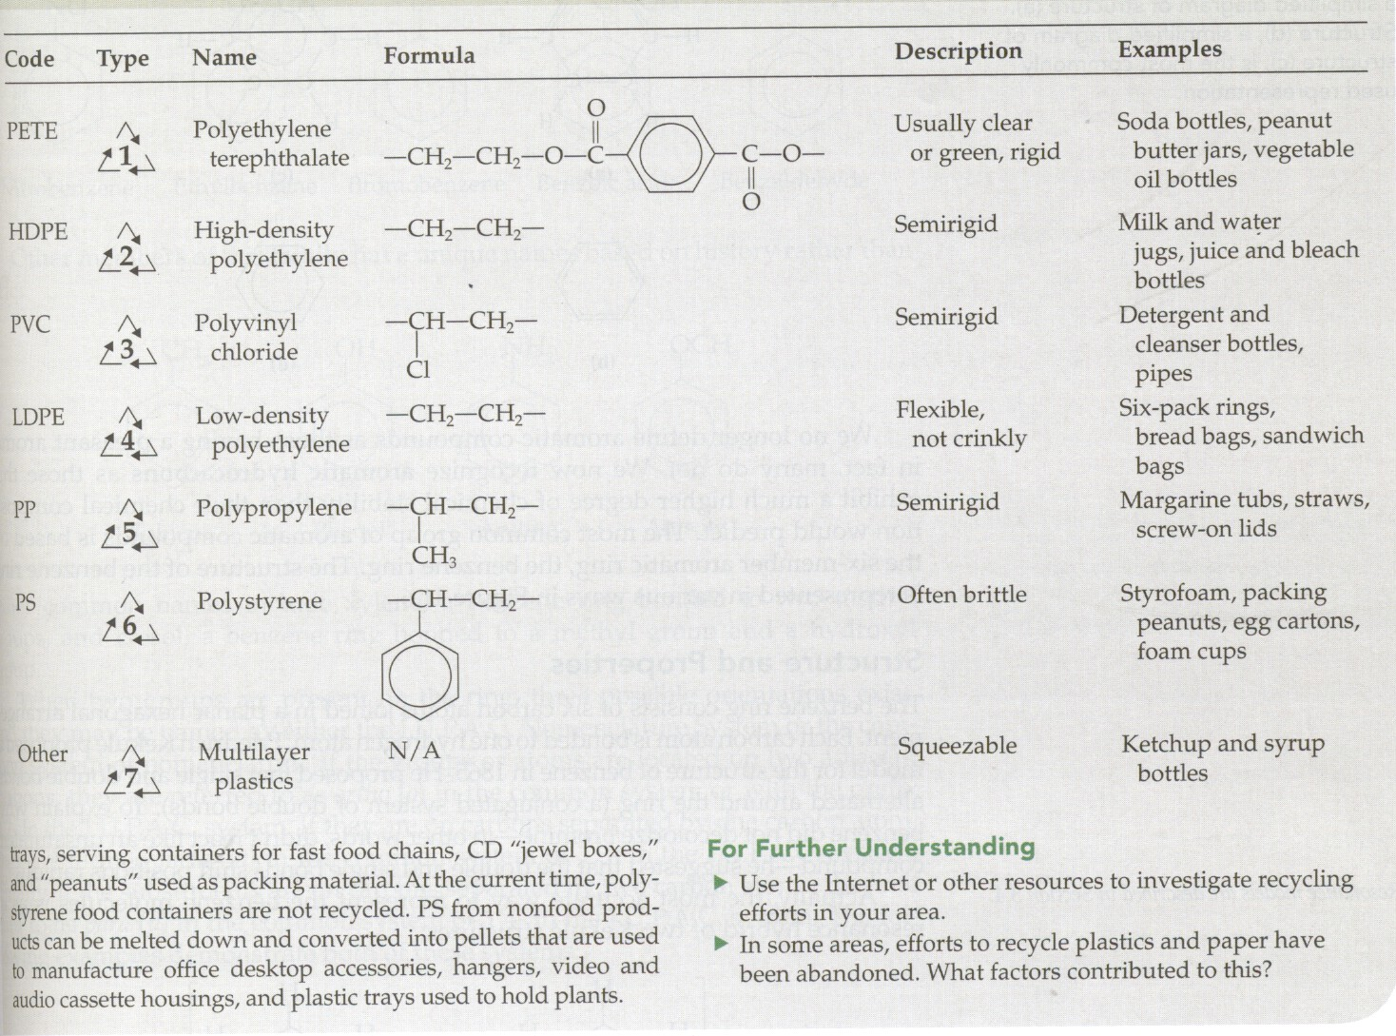

Slide 22
Aromatic compounds

Slide 23
Benzene Structure
The benzene ring consists of:
Six carbon atoms
Joined in a planar hexagonal arrangement
Each carbon is bonded to one hydrogen atom
Two equivalent structures proposed by Kekulé are recognized today as resonance structures
The real benzene molecule is a hybrid with each resonance structure contributing to the true structure
11.6 Aromatic Hydrocarbons

Slide 24
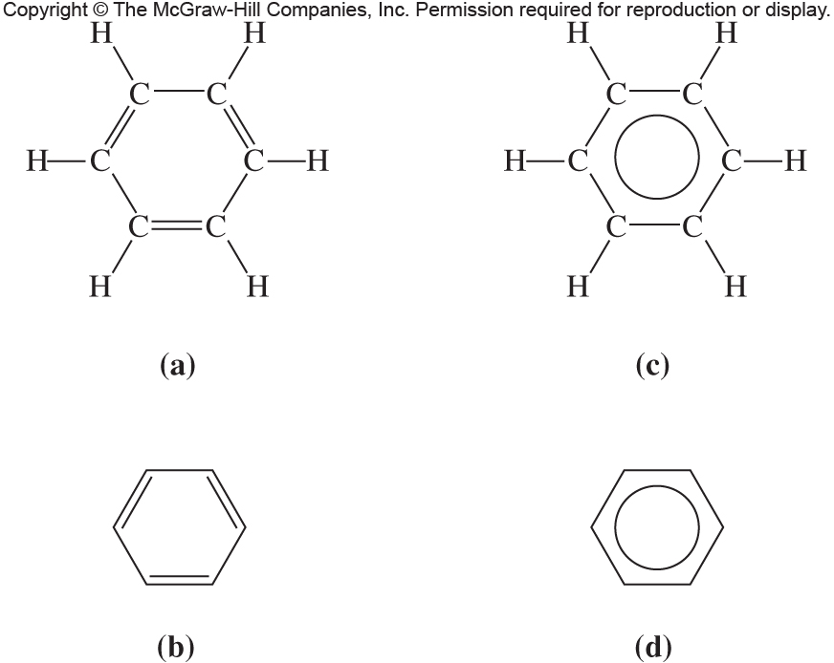
Fig. 11.6

Slide 25
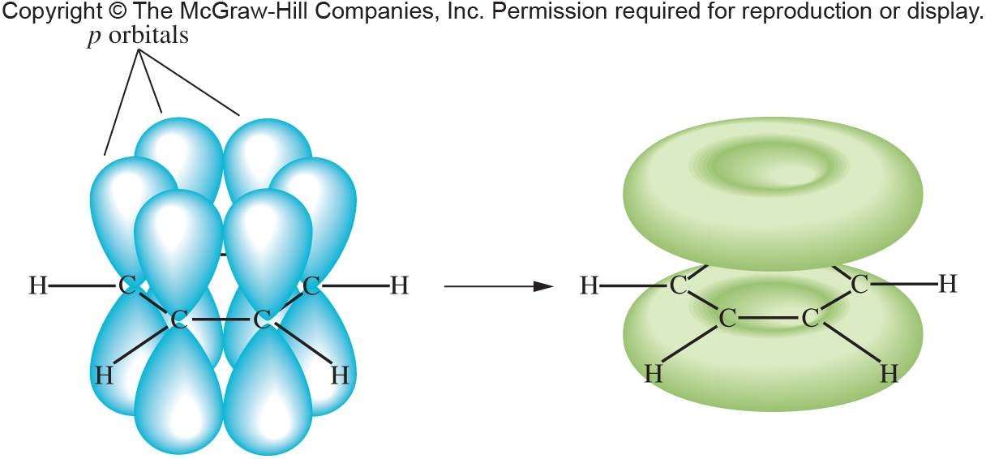
Fig. 11.7

Slide 26
IUPAC Names: Benzenes
Most simple aromatic compounds are named as derivatives of benzene
For monosubstituted benzenes, name the group and add “benzene”
7
11.6 Aromatic Hydrocarbons
nitrobenzene
ethylbenzene
chlorobenzene

Slide 27
IUPAC Names of Substituted Benzenes
11.6 Aromatic Hydrocarbons
1-bromo-2-ethylbenzene
o-bromoethylbenzene
3-nitrotoluene
m-nitrotoluene
1,4-dichlorobenzene
p-dichlorobenzene

Slide 28
Historical Nomenclature
Some members of the benzene family have unique names acquired before the IUPAC system was adopted that are still frequently used today
11.6 Aromatic Hydrocarbons

Slide 29
Benzene As a Substituent
When the benzene ring is a substituent on a chain (C₆H₅), it is called a phenyl group
Note the difference between
Phenyl
Phenol (a functional group)
11.6 Aromatic Hydrocarbons
4-phenyl-1-pentene

Slide 30
Polynuclear Aromatic Hydrocarbons
11.6 Aromatic Hydrocarbons
Polynuclear aromatic hydrocarbons (PAH) are composed of two or more aromatic rings joined together
Many have been shown to cause cancer

Slide 31
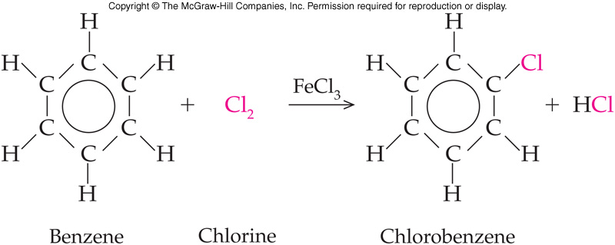
Benzene Halogenation
Halogenation places a Br or Cl on the ring
The reagent used is typically Br₂ or Cl₂
Fe or FeCl₃ are used as catalysts
11.6 Aromatic Hydrocarbons

Slide 32
Benzene Nitration
Nitration places the nitro group on the ring
Sulfuric acid is needed as a catalyst
11.6 Aromatic Hydrocarbons

Slide 33
Benzene Sulfonation
Sulfonation places an SO₃H group on the ring
Concentrated sulfuric acid is required as a catalyst
This is also a substitution reaction
11.6 Aromatic Hydrocarbons

Slide 34
11.7 Heterocyclic Aromatic Compounds
9
Rings with at least one atom other than carbon as part of the structure of the aromatic ring
This hetero atom is typically O, N, S
The ring also has delocalized electrons
The total number of atoms in the ring is typically either:
A six membered ring
Some have a five membered ring

Slide 35
Heterocyclic Aromatics
Heterocyclic aromatics are similar to benzene in stability and chemical behavior
Many are significant biologically
11.7 Heterocyclic Aromatic Compounds
Found in
DNA and RNA
Found in hemoglobin
and chlorophyll

Slide 36
Reaction Schematic
Alkene
+ HX
+ H₂O
acidic
+ H₂
Pt, Pd, or Ni
Hydrohalogenation
Hydration
+ X₂
adds easily
Hydrogenation
Halogenation

Slide 37
Summary of Reactions
1. Addition Reactions of Alkenes
a. Hydrogenation
b. Hydration
c. Halogenation
d. Hydrohalogenation
2. Addition Polymers of Alkenes
3. Reactions of Benzene
a. Halogenation
b. Nitration
c. Sulfonation

Slide 38
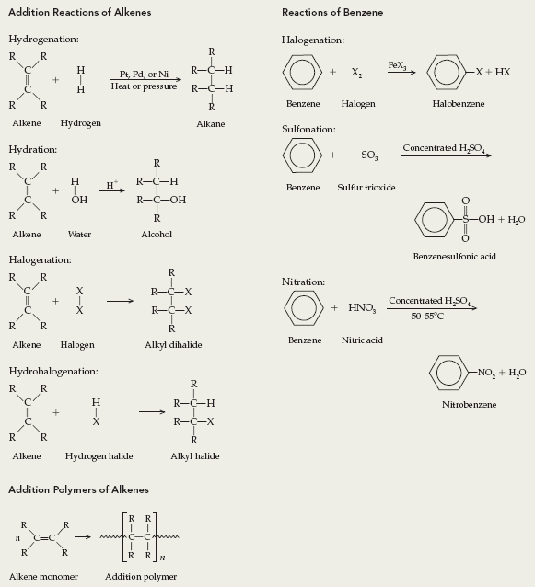
Diagrammatic Summary of Reactions

