Slide 1
Organic chemistry Welcome

Slide 2
Questions
1. octet rule
Lewis dot structures
Covalent bond
In which main group do you find carbon?
Electronegativity

Slide 3
Electronegativity
See p. 85-86

Slide 4
Where to go for informations:
Milne.ruc.dk/kemikurser/ChemistryB
Bookmark this page

Slide 5
Aim
Learn simple organic chemistry
Learn how to interpret names
Be familiar with chemical reactions
Build a fundament for understanding more complex structures such as biomolecules
Be able to relate organic chemistry to daily day life

Slide 6
Organic chemisty
Wöhler
Organic chemisty is carbon chemistry

Slide 7
Allosteric forms of carbon

Slide 8
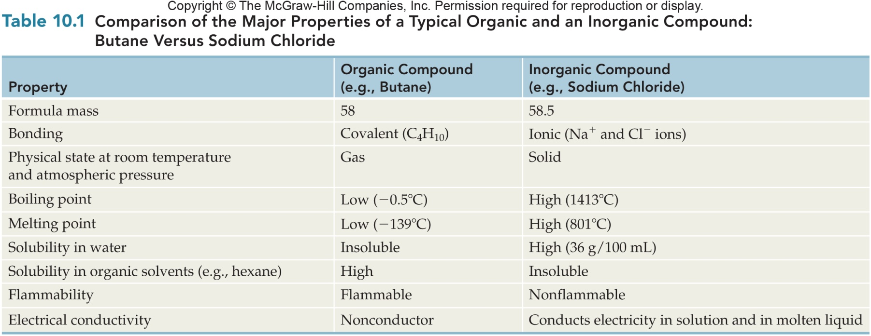
Comparison of Major Properties of Organic and Inorganic Compounds
10.1 The Chemistry of Carbon

Slide 9
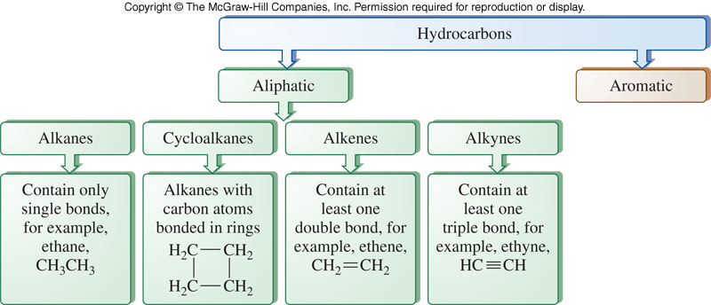
Division of the Family of Hydrocarbons
10.1 The Chemistry of Carbon

Slide 10
Hydrocarbon Saturation
Alkanes are compounds that contain only carbon-carbon and carbon-hydrogen single bonds
A saturated hydrocarbon has no double or triple bonds
Alkenes and alkynes are unsaturated because they contain at least one carbon to carbon double or triple bond
10.1 The Chemistry of Carbon

Slide 11
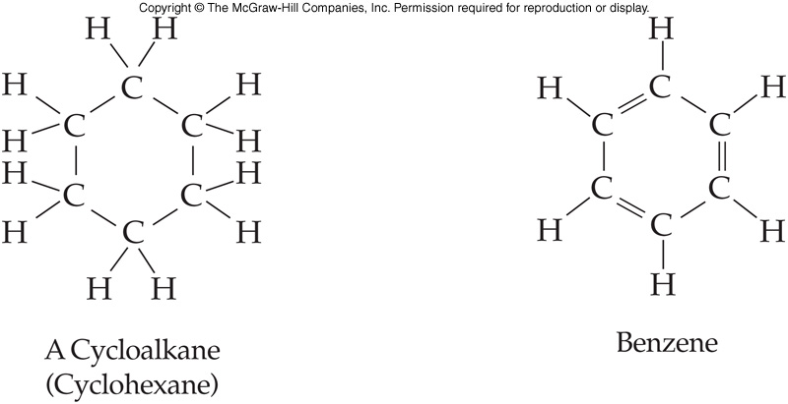
Cyclic Structure of Hydrocarbons
Some hydrocarbons are cyclic
Form a closed ring
Aromatic hydrocarbons contain a benzene ring or related structure
10.1 The Chemistry of Carbon

Slide 12
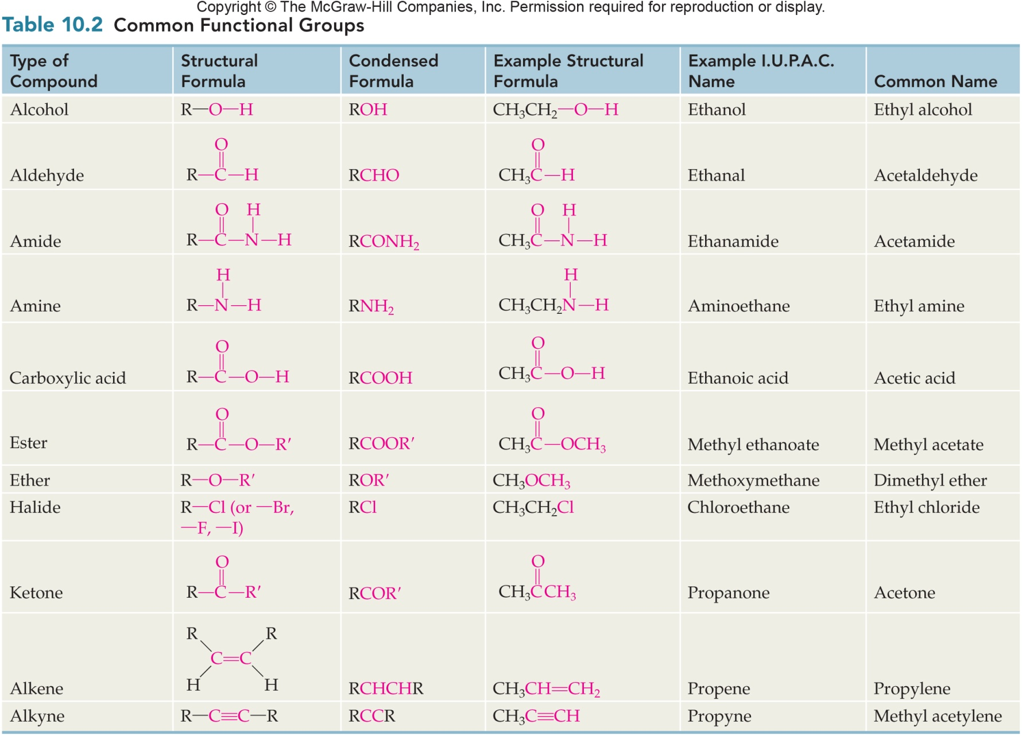
Common Functional Groups
10.1 The Chemistry of Carbon

Slide 13
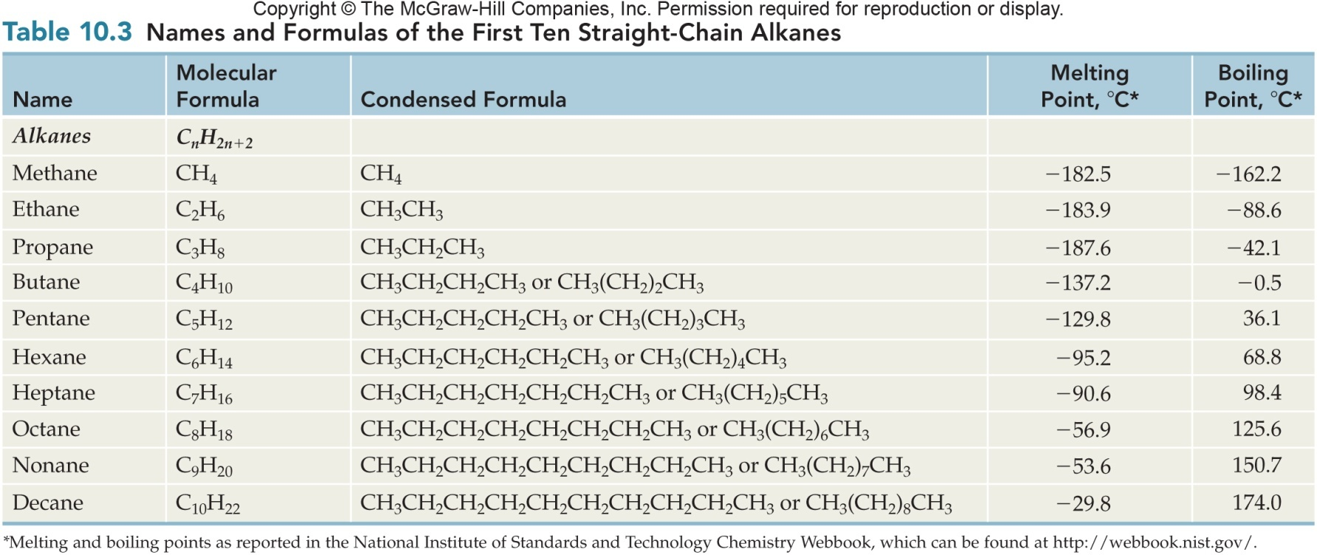
Names and Formulas of the First Ten Straight-Chain Alkanes
10.2 Alkanes

Slide 14
The Tetrahedral Carbon Atom
10.2 Alkanes
Lewis dot structure
The tetrahedral shape around the carbon atom
The tetrahedral carbon drawn with dashes and wedges
The stick drawing of the tetrahedral carbon atom
Ball and stick model of methane

Slide 15
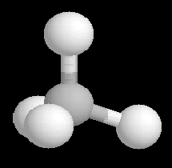
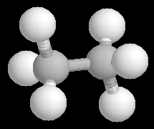
Drawing Methane and Ethane
10.2 Alkanes
Staggered form of ethane

Slide 16
VSEPR
Valence shell electron pair repulsion
Principle: arrange atoms so negatively charged parts are as far from each other as possible

Slide 17
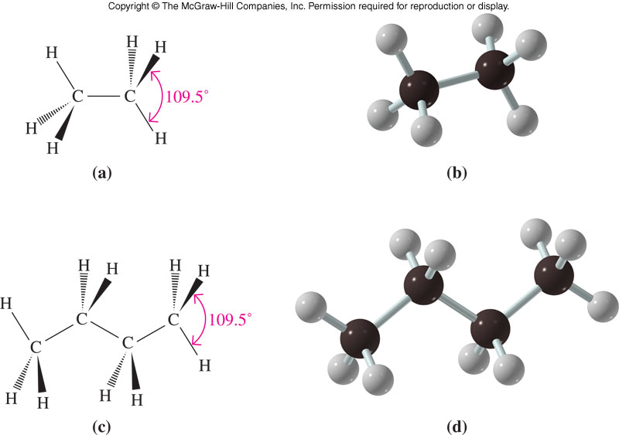
Comparison of Ethane and Butane Structures
10.2 Alkanes

Slide 18
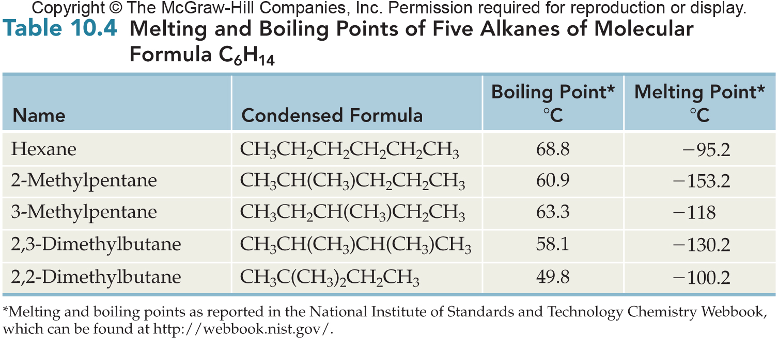
Comparison of Physical Properties of Five Isomers of Hexane

Slide 19
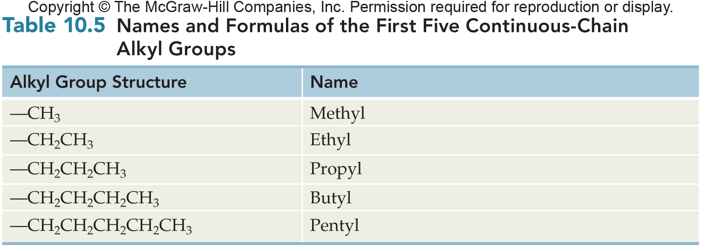
Names and Formulas of the First Five Alkyl Groups
10.2 Alkanes

Slide 20
Alkyl Group Classification
Alkyl groups are classified according to the number of carbons attached to the carbon atom that joins the alkyl group to a molecule
All continuous chain alkyl groups are 1º
Isopropyl and sec-butyl are 2º groups
10.2 Alkanes

Slide 21
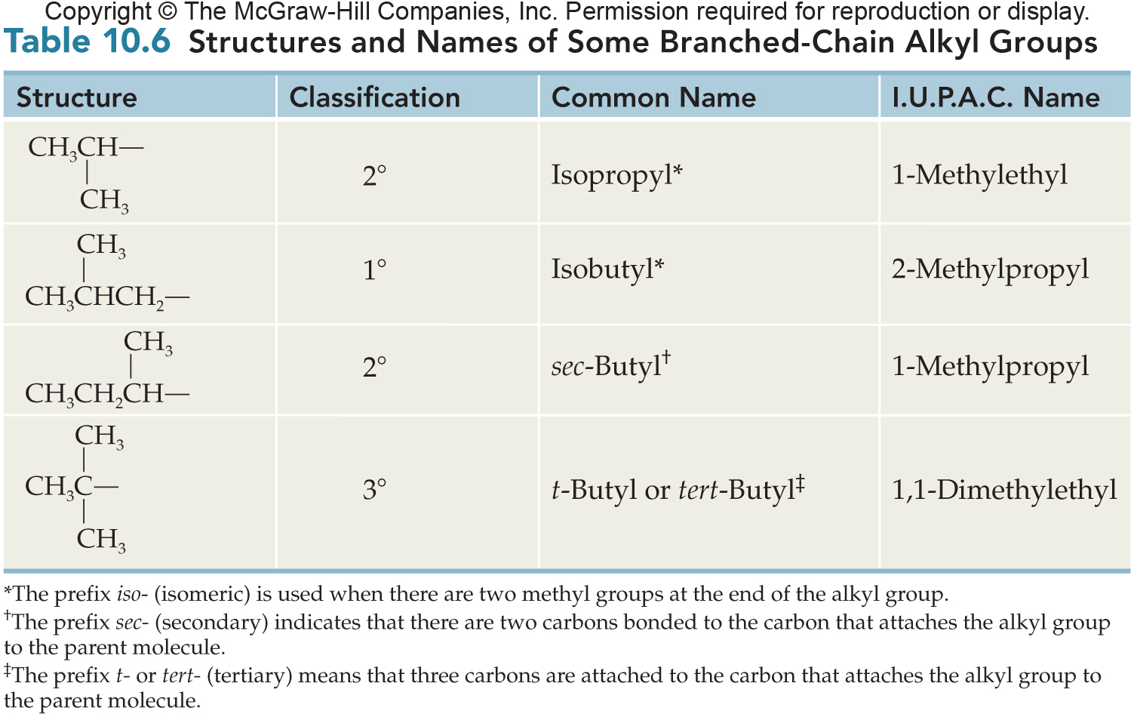
Structures and Names of Some Branched-Chain Alkyl Groups
10.2 Alkanes

Slide 22
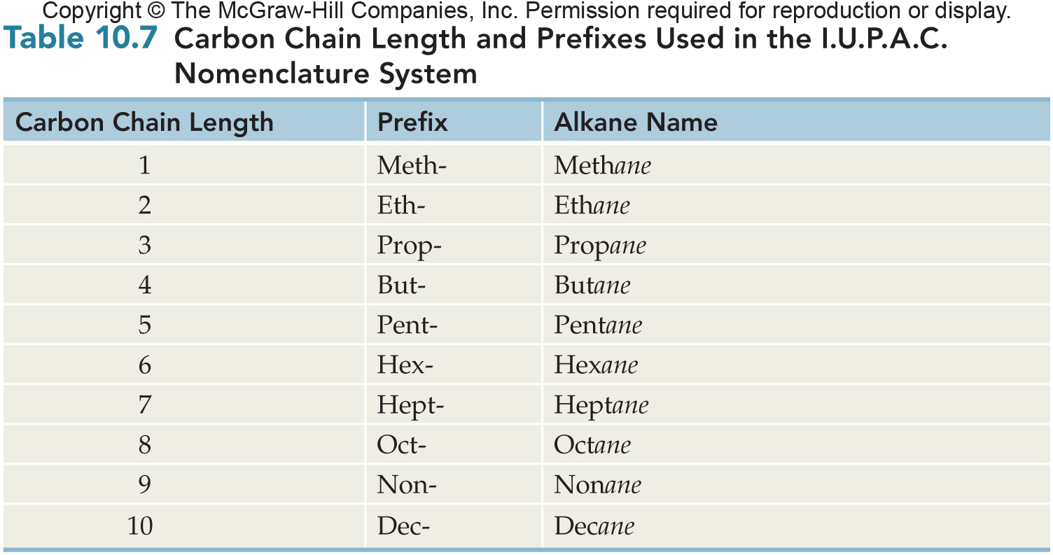
Carbon Chain Length and Prefixes
10.2 Alkanes

Slide 23
IUPAC Names for Alkanes
6
The base or parent name for an alkane is determined by the longest chain of carbon atoms in the formula
The longest chain may bend and twist, it is seldom horizontal
Any carbon groups not part of the base chain are called branches or substituents
These carbon groups are also called alkyl groups
10.2 Alkanes

Slide 24
IUPAC Names for Alkanes
Number the carbon atoms in the chain starting from the end with the first branch
If both branches are equally from the ends, continue until a point of difference occurs
10.2 Alkanes

Slide 25
IUPAC Names for Alkanes
Write each of the branches/substituents in alphabetical order before the base/stem name (longest chain)
Halogens usually come first
Indicate the position of the branch on the main chain by prefixing its name with the carbon number to which it is attached
Separate numbers and letters with a hyphen
Separate two or more numbers with commas
10.2 Alkanes

Slide 26
IUPAC Names for Alkanes
Hyphenated and number prefixes are not considered when alphabetizing groups
Name the compound below
5-sec-butyl-4-isopropylnonane
10.2 Alkanes

Slide 27
IUPAC Names for Alkanes
When a branch/substituent occurs more than once
Prefix the name with
di
tri
tetra
Then list the number of the carbon branch for that substituent to the name with a separate number for each occurrence
Separate numbers with commas
e.g., 3,4-dimethyl or 4,4,6-triethyl
10.2 Alkanes

Slide 28
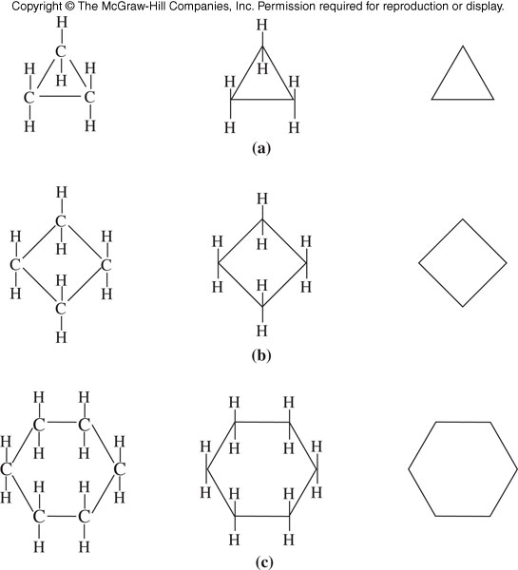
Cycloalkane Structures
Cyclopropane
Cyclobutane
Cyclohexane
10.3 Cycloalkanes
Type of Formula: Structural Condensed Line

Slide 29
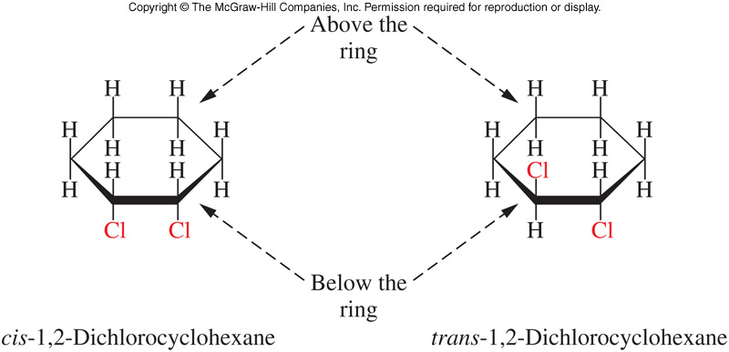
cis-trans Isomers in Cycloalkanes
Two groups may be on the same side (cis) of the imagined plane of the cycloring or they may be on the opposite side (trans)
Geometric isomers do not readily interconvert, only by breaking carbon-carbon bonds can they interconvert
10.3 Cycloalkanes

Slide 30
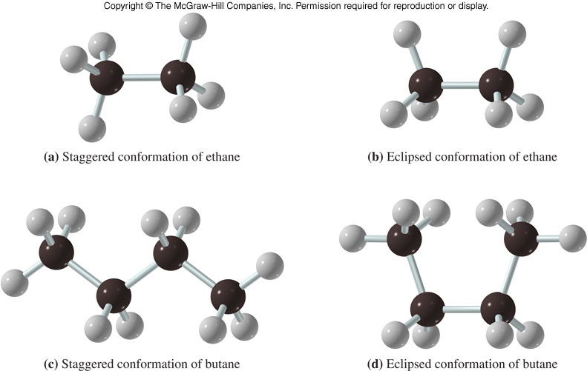
10.4 Conformations of Alkanes
11
Conformations differ only in rotation about carbon-carbon single bonds
Two conformations of ethane and butane are shown
The first (staggered form) is more stable because it allows hydrogens to be farther apart and thus, the atoms are less crowded

Slide 31
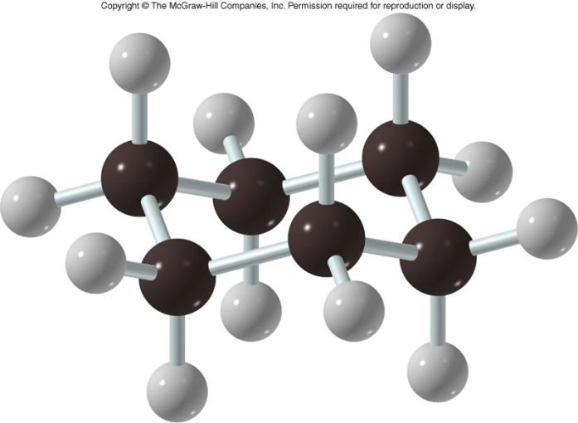
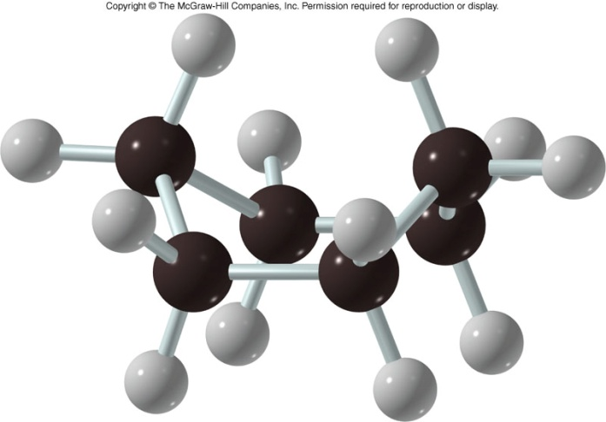
Two Conformations of Cyclohexane
11
10.4 Conformations of Alkanes and Cycloalkanes
Chair form (more stable) Boat form
E = equatorial A = axial

Slide 32
Alkane Reactions
The majority of the reaction of alkanes are combustion reactions
Complete CH₄ + 2O₂ CO₂ + 2H₂O Complete combustion produces
Carbon dioxide and water
Incomplete 2CH₄ + 3O₂ 2CO + 4H₂O
Incomplete combustion produces
Carbon monoxide and water
Carbon monoxide is a poison that binds irreversibly to red blood cells
10.5 Reactions of Alkanes

Slide 33
Halogenation
Halogenation is a type of substitution reaction, a reaction that results in a replacement of one group for another
Products of this reaction are:
Alkyl halide or haloalkane
Hydrogen halide
This reaction is important in converting unreactive alkanes into many starting materials for other products
Halogenation of alkanes ONLY occurs in the presence of heat and/or light (UV)
10.5 Reactions of Alkanes

Slide 34
Petroleum Processing
Fraction | Boiling Pt Range ºC | Carbon size | Typical uses
Gas | -164-30 | C1-C4 | Heating, cooking
Gasoline | 30-200 | C5-C12 | Motor fuel
Kerosene | 175-275 | C12-C16 | Fuel for stoves, diesel and jet engines
Heating oil | Up to 375 | C15-C18 | Furnace oil
Lubricating oil | 350 and up | C16-C20 | Lubrication, mineral oil
Greases | Semisolid | C18-up | Lubrication, petroleum jelly
Paraffin (wax) | Melts at 52-57 | C20-up | Candles, toiletries
Pitch / tar | Residue in boiler | High | Roofing, asphalt paving
10.5 Reactions of Alkanes

Slide 35
Chloroform
Halothane CF₃CHBrCl
Freons
Artificial blood, perfluorodecalin 50% oxygen

