Slide 1
Karboxylsyrer og derivater

Slide 2
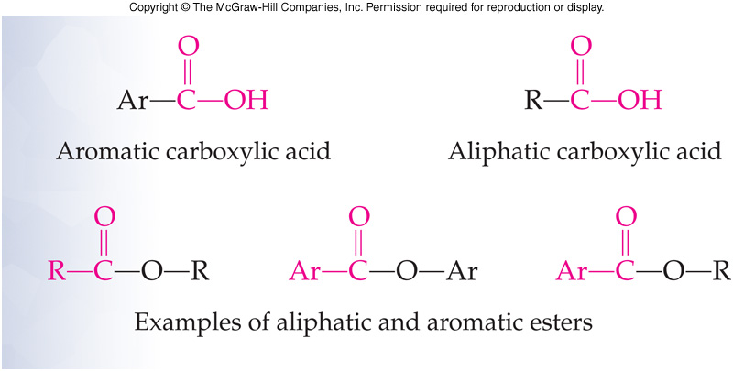
Functional groups

Slide 3
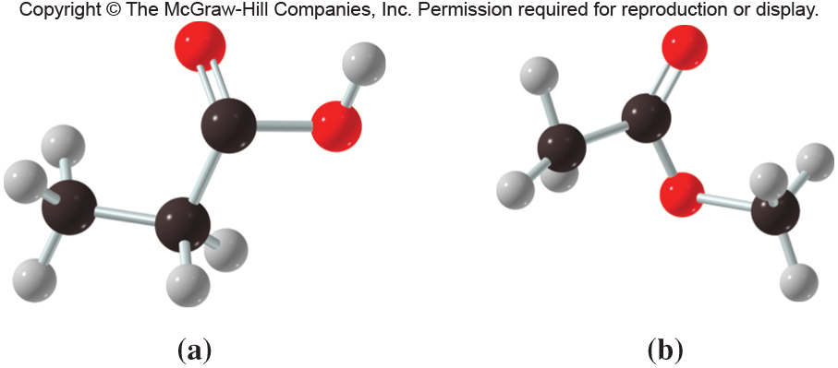
Acid and esters

Slide 4
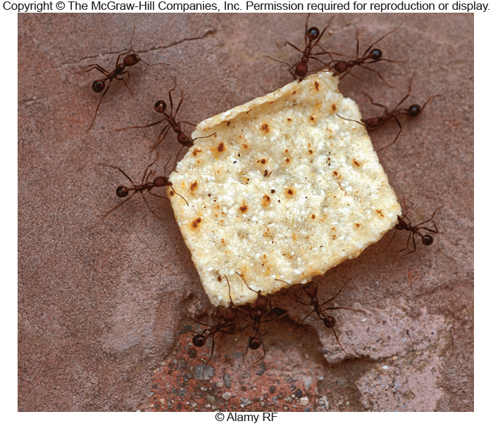
Formic acid

Slide 5
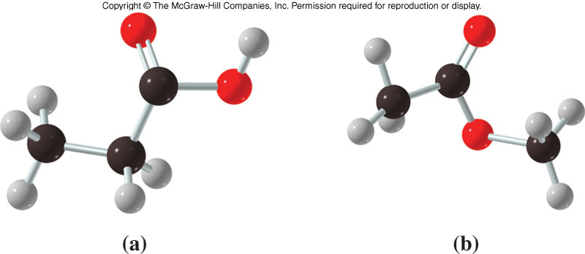
14.1 Karboxylsyrer
Structure
Carboxylic acid groups consist of two very polar functional groups
Carbonyl group
Hydroxyl group
Carboxylic acid groups are very polar
1
Carboxylic acid – Ester –
propanoic acid methyl ethanoate

Slide 6
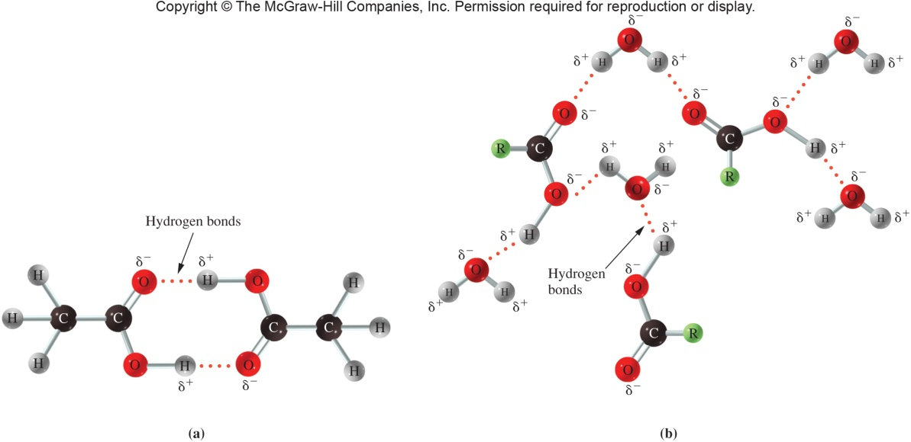
Physical properties
Low molecular weight carboxylic acids
Sharp, sour taste
Unpleasant aromas
High molecular weight carboxylic acids
Fatty acids important in biochemistry
Low molecular weight carboxylic acids are water soluble due to hydrogen bonding with:
Water
Each other
14.1 Carboxylic Acids

Slide 7
Hydrogen bonding

Slide 8
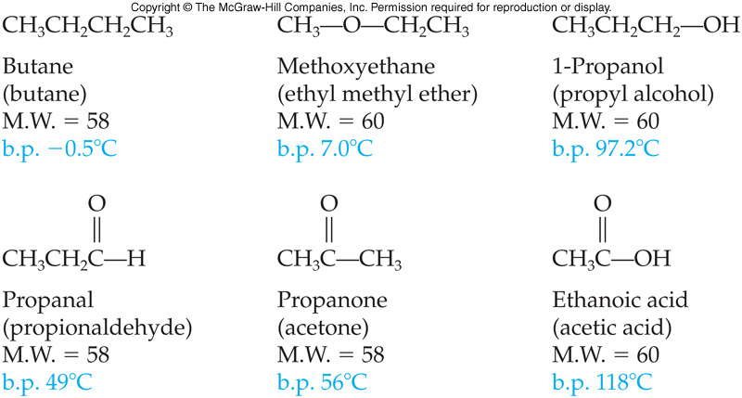
Fysiske egenskaber
Due to carboxylic acids forming intermolecular hydrogen bonds boiling points are at higher temperatures than those of any other functional group studied
14.1 Carboxylic Acids

Slide 9
Nomenklatur
-oic acid
-carboxylic acid
trivial name

Slide 10
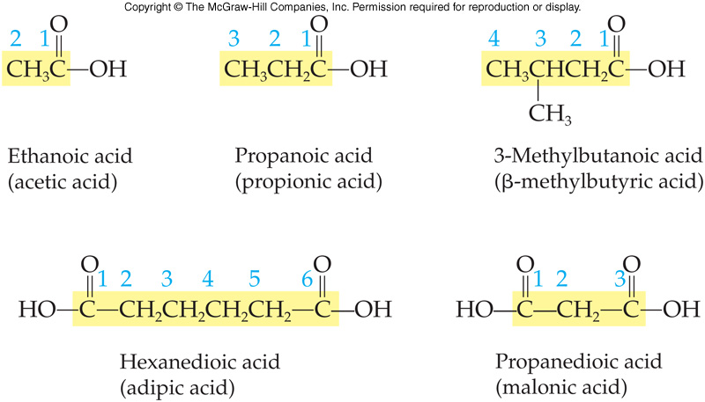
Karboxylic acids
14.1 Carboxylic Acids

Slide 11
Navne for aromatiske syrer

Slide 12
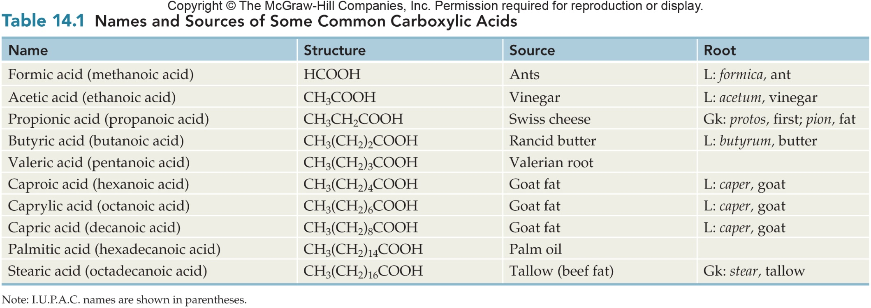
Typiske karboxylsyrer

Slide 13
Acids from natural sources

Slide 14
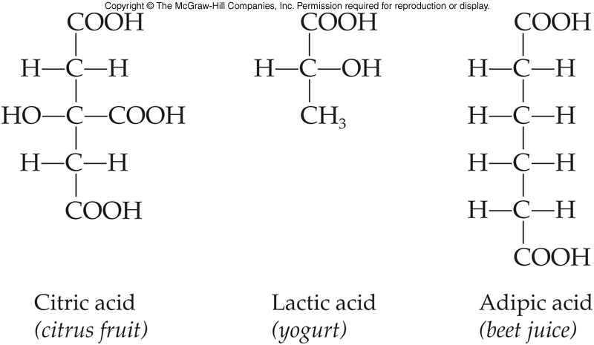
Some Important Carboxylic Acids
3
Stearic acid
found in beef fat
14.1 Carboxylic Acids

Slide 15
Acids from fruits

Slide 16
Aspirin

Slide 17
Oxidation
Which compounds can be oxidized to an acid?

Slide 18
Acid-base reactions!

Slide 19
Salts of Carboxylic Acids
Nomenclature
First add the cation’s name
Sodium
Then drop the –oic acid and add –ate
Sodium benzoate
Uses of carboxylic acids
Soaps like sodium stearate
Preservatives
Anti-fungal medicines
Used to control food pH
14.1 Carboxylic Acids

Slide 20
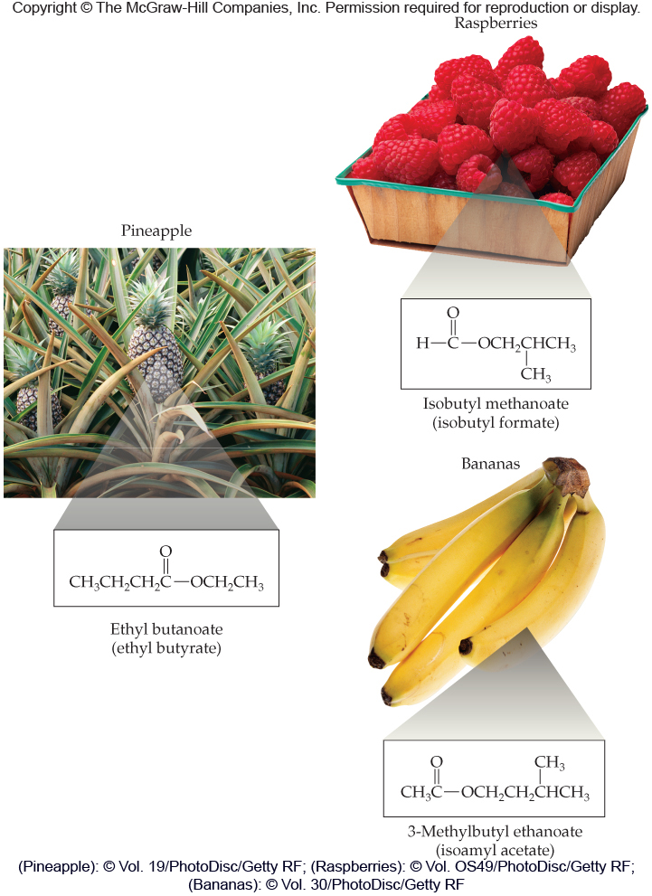
Esters with nice smells

Slide 21
Naming
-oate

Slide 22
Naming Esters
Name the following esters:
Alkyl portion = first name ethyl
Parent carboxylic acid = butanoic acid
Change suffix to reflect ester = Ethyl butanoate
Alkyl portion = first name propyl
Parent carboxylic acid = ethanoic acid
Change suffix to reflect ester = Propyl ethanoate
14.2 Esters

Slide 23
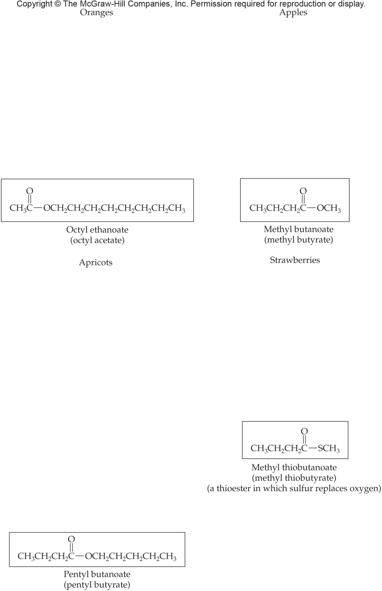
Page 471

Slide 24
How to make esters
Acid plus alchol
Plus catalyst?

Slide 25
Esterification
6
Carboxylic acids react with alcohols to form:
Esters
Water
14.1 Carboxylic Acids

Slide 26
Nomenclature
8
Form from the reaction of a carboxylic acid with an alcohol, which is reflected in the naming
Use the alkyl group as the first name
(Alcohol part of the ester)
Base the name for the acid part of the structure from the longest chain ending in the C=O
(Carboxylic acid part of the ester)
Change the –oic acid of the acid name to –oate
14.2 Esters

Slide 27
Acid hydrolysis of Esters
Acid hydrolysis products are:
Acid
Alcohol
14.2 Esters

Slide 28
Base Hydrolysis of Esters
10
The base catalyzed hydrolysis of an ester:
Saponification or soap-making
Products are:
Acid salt
Alcohol
Acid can’t exist in basic conditions, so the product is the salt of the carboxylic acid using the cation of the base catalyst
14.2 Esters

Slide 29
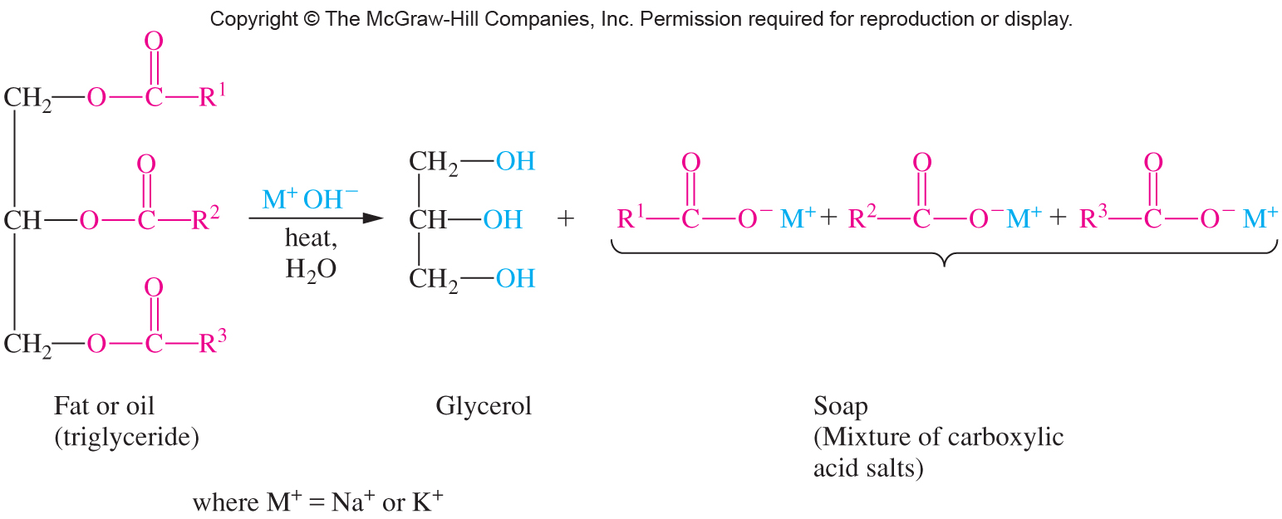
Hydrolysis of fat (saponification)

Slide 30
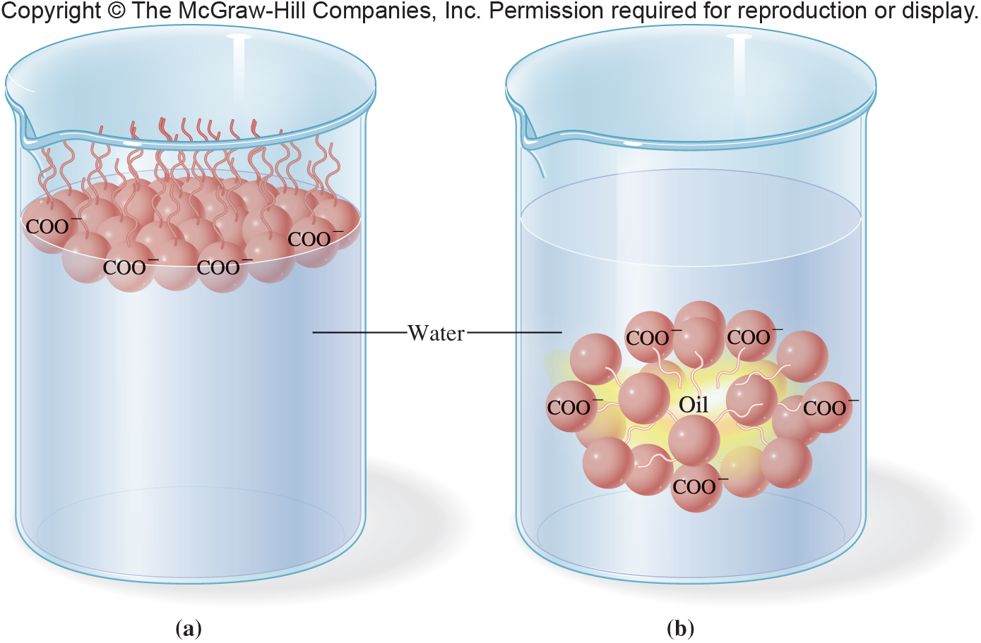
Micelle formation (soap action)

Slide 31
Condensation polymers
PETE
PEN

Slide 32
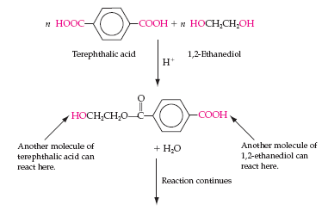
Condensation Polymers
Polyesters are condensation polymers
They are formed by eliminating a small molecule (e.g., H₂O) when combining:
Diacid
Diol
Each of the combining molecules has two reactive functional groups, highlighted in red
14.2 Esters

Slide 33
Polethylene terphthalate, PETE
Terphthalic acid
1,2-ethanediol
PETE is used in:
Mylar
Plastic bottles
Polyester fabric
Continued condensation
at each end
Repeating unit of the polymer

Slide 34
PEN

Slide 35
Acid derivatives
Acid chlorides
Acid anhydrides

Slide 36
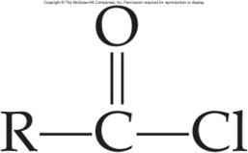
14.3 Acid Chlorides and Acid Anhydrides
11
Acid chlorides are derivatives of carboxylic acids having the general formula:
Are named:
by replacing the –oic acid ending of the IUPAC name with –oyl chloride
ethanoyl chloride
(acetyl chloride)
4-chlorobenzoyl chloride
(p-chlorobenzoyl chloride)

Slide 37
Acids Chlorides
12
Acid chlorides
Noxious, irritating chemicals requiring great care in handling
Slightly polar, boiling near the corresponding carbonyl’s temperature
React violently with water
Are good acyl group transfer reagents
14.3 Acid Chlorides and Acid Anhydrides

Slide 38
Inorganic acid chloride
SOCl₂ thionyl chloride

Slide 39
Acid anhydrides

Slide 40
Acid Anhydride Reactions With Alcohols
Acid anhydride reacts with alcohol to produce:
Ester
Carboxylic acid
An acyl group transfer reaction
14.3 Acid Chlorides and Acid Anhydrides

Slide 41
Aspirin

Slide 42
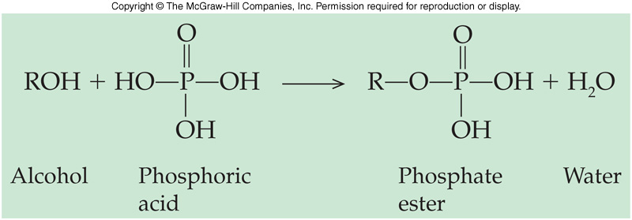
14.4 Nature’s High Energy Compounds: Phosphoesters and Thioesters
15
Phosphoric acid reacts with alcohols to produce a phosphate ester or phosphoester
The ester can then react with a second or third acid to give phosphoric acid anhydrides
ADP and ATP of biochemistry fame are important examples of phosphate esters

Slide 43
Phosphoric Acid Esters
Ester bond
14.4 Nature’s High Energy Compounds: Phosphoesters and Thioesters
Anhydride bonds

Slide 44
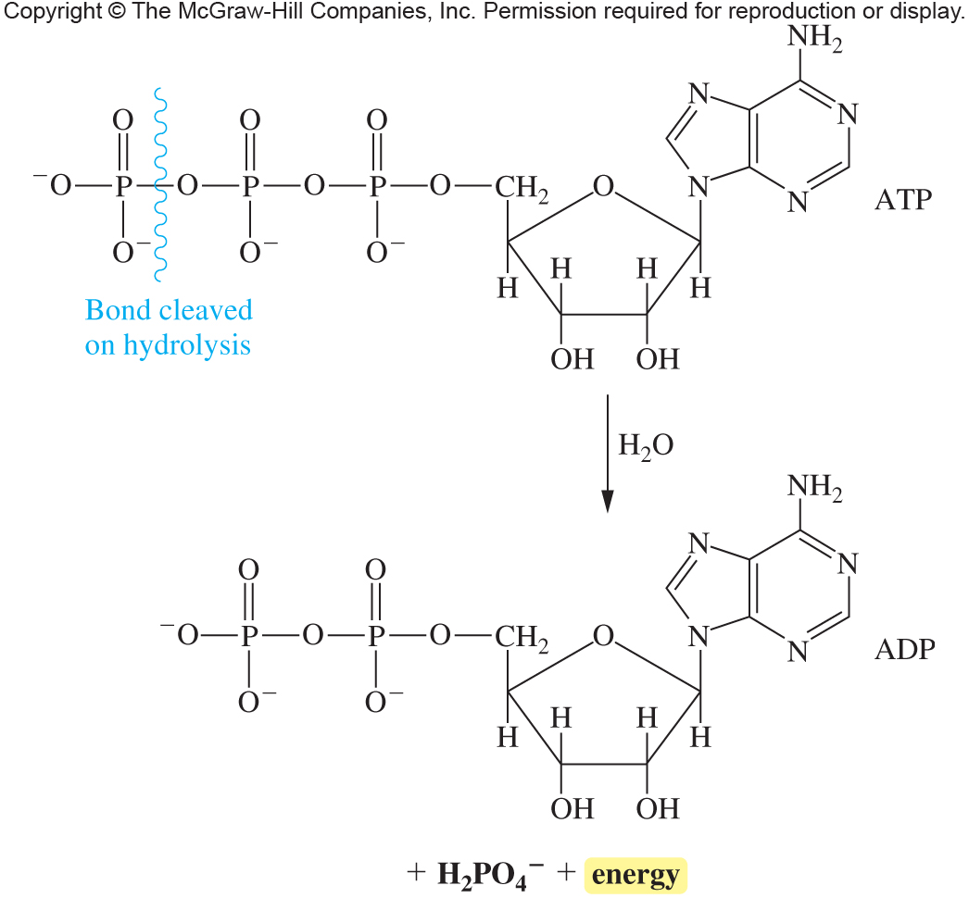
Phosphate esters

Slide 45
Thioesters
In biochemistry, acetyl coenzyme A (acetyl CoA-SH) reacts with acyl groups to “activate” them for further biological reaction by forming a thioester
14.4 Nature’s High Energy Compounds: Phosphoesters and Thioesters

Slide 46
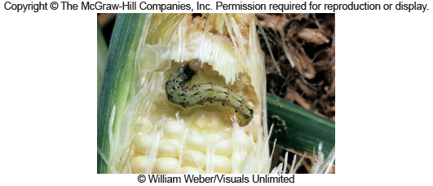
Pheromones

Slide 47
Pain killers

Slide 48
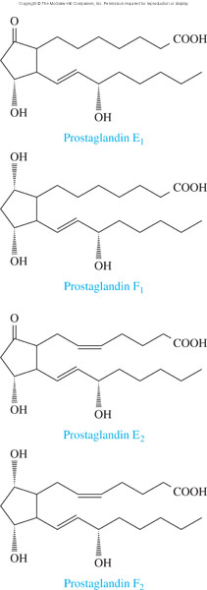
Structures of Four Prostaglandins
17.2 Fatty Acids

Slide 49
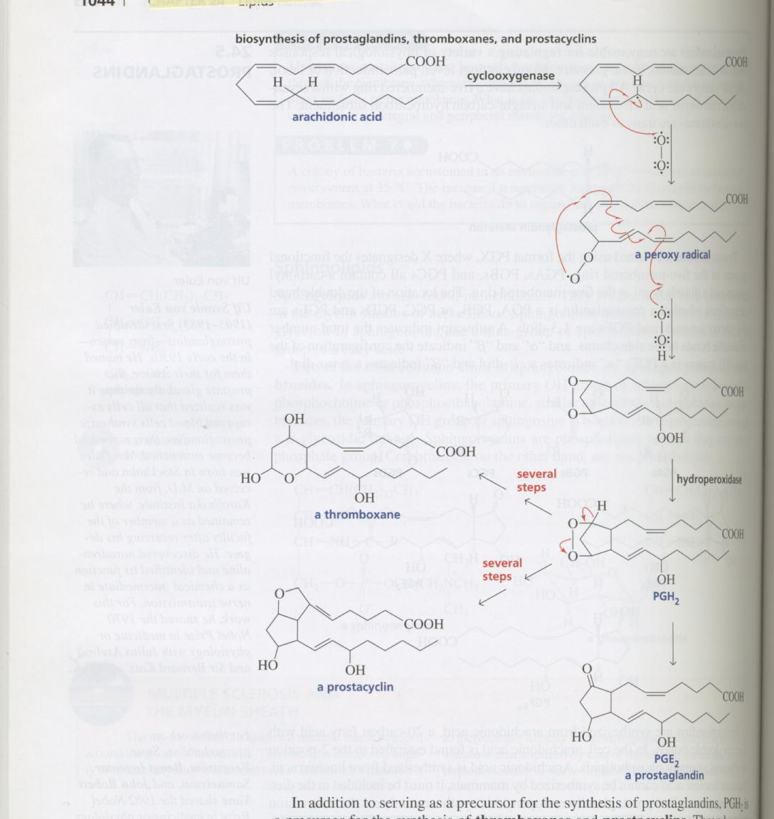
Prostaglandin synthesis

Slide 50
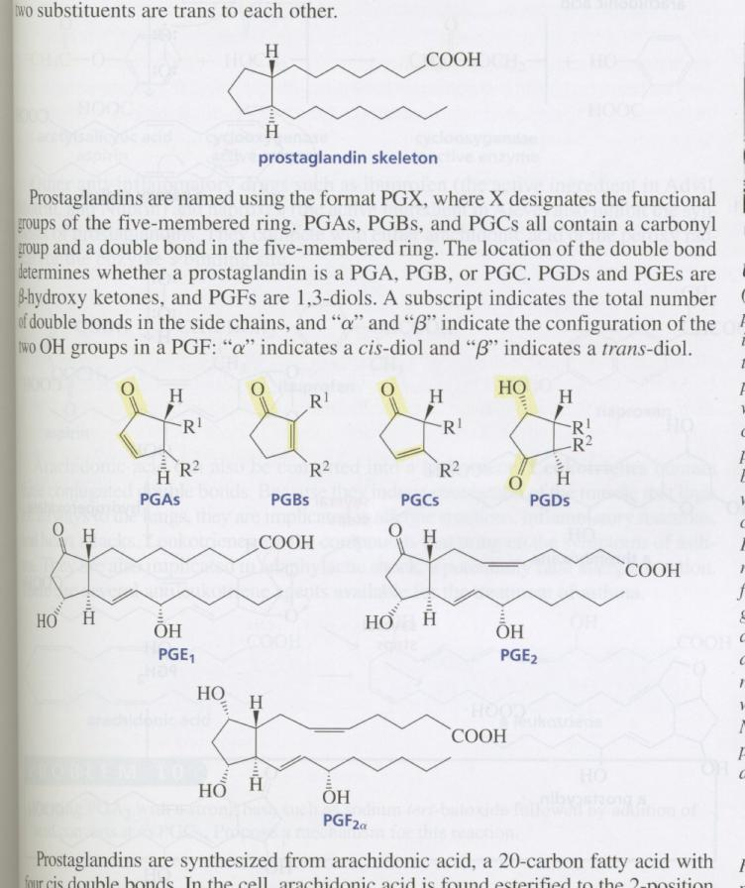
Prostaglandins

Slide 51
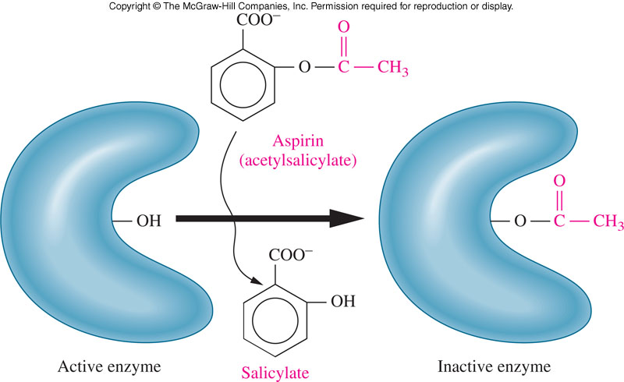
Aspirin and Prostaglandins
Aspirin inhibits prostaglandin synthesis by acetylating cyclooxygenase, an enzyme necessary for prostaglandin synthesis
17.2 Fatty Acids

Slide 52
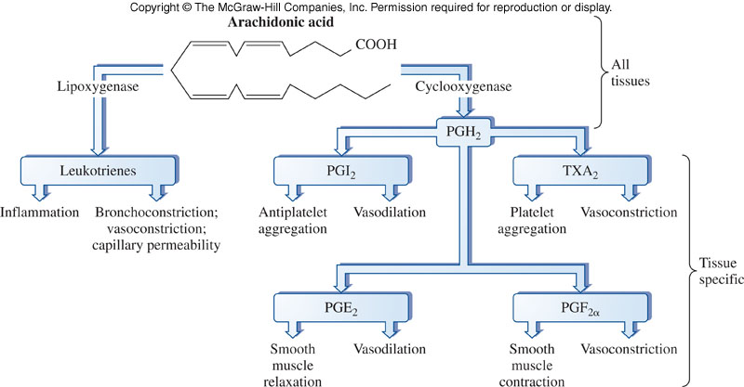
Overview of Prostaglandin Synthesis From Arachidonic Acid
17.2 Fatty Acids

Slide 53
Reaction Schematic
Carboxylic Acid
Aldehyde
1º Alcohol
Oxidation
Oxidation
Dissociation
Esterification
Neutralization
Carboxylate anion
Esterification
Carboxylic Acid salt

Slide 54
Summary of Reactions
1. Carboxylic acids
a. Preparation
b. Dissociation
c. Neutralization
d. Esterification
2. Esters
a. Acid hydrolysis
b. Saponification
3. Acid chloride synthesis
4. Acid anhydride synthesis
5. Phosphoester formation

Slide 55
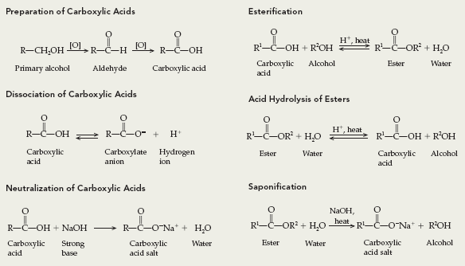
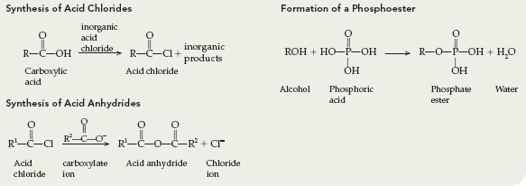
Summary of Reactions

Slide 56
Thioesters
In biochemistry, acetyl coenzyme A (acetyl CoA-SH) reacts with acyl groups to “activate” them for further biological reaction by forming a thioester
14.4 Nature’s High Energy Compounds: Phosphoesters and Thioesters

Slide 57
Carboxylic Acid Naming Examples
14.1 Carboxylic Acids

Slide 58
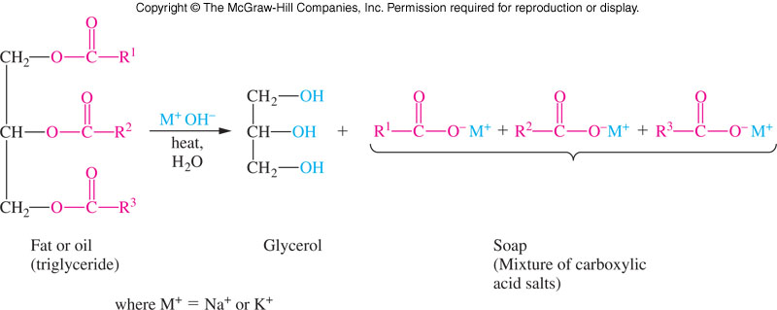
Saponification
Saponification (soap-making) is:
Base-catalyzed hydrolysis of fats (glycerol triesters)

Slide 59
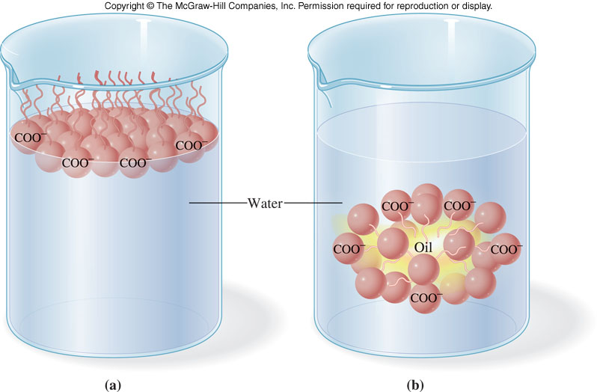
Simplified Action of Soap
14.2 Esters

Slide 60
Reactions Involving Esters
Another example:
6
14.2 Esters

Slide 61
Hydrolysis of Esters
9
The main reaction of esters is hydrolysis, reaction with water
This reaction is also called hydration = cleavage of any bond by the addition of a water molecule
However, the uncatalyzed reaction is slow and requires heat
Mineral acid is used as a catalyst
14.2 Esters

Slide 62
Acid hydrolysis of Esters
Acid hydrolysis products are:
Acid
Alcohol
14.2 Esters

Slide 63
Base Hydrolysis of Esters
10
The base catalyzed hydrolysis of an ester:
Saponification or soap-making
Products are:
Acid salt
Alcohol
Acid can’t exist in basic conditions, so the product is the salt of the carboxylic acid using the cation of the base catalyst
14.2 Esters

